Slide 1
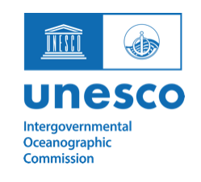

Survey on tsunami warning services, evacuation, and sheltering during COVID-19
Professor Richard Haigh & Professor Dilanthi Amaratunga
University of Huddersfield, UK

Slide 2
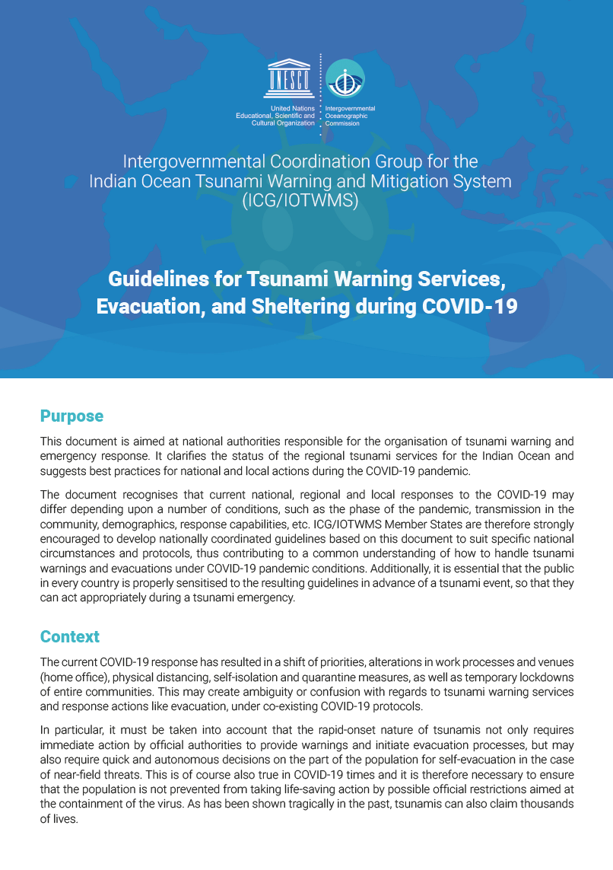
Background
The COVID-19 response resulted in a shift of priorities, alterations in work patterns, processes and venues, the introduction of physical distancing, self-isolation and quarantine measures, as well as temporary lockdowns of entire communities.
This may create ambiguity or confusion with regards to tsunami warning services and response actions like evacuation, under coexisting COVID-19 protocols.
In response, Guidelines for Tsunami Warning Services, Evacuation, and Sheltering during COVID-19 were issued by the Intergovernmental Coordination Group for the Indian Ocean Tsunami Warning and Mitigation System (ICG/IOTWMS) in 2020.

Slide 3
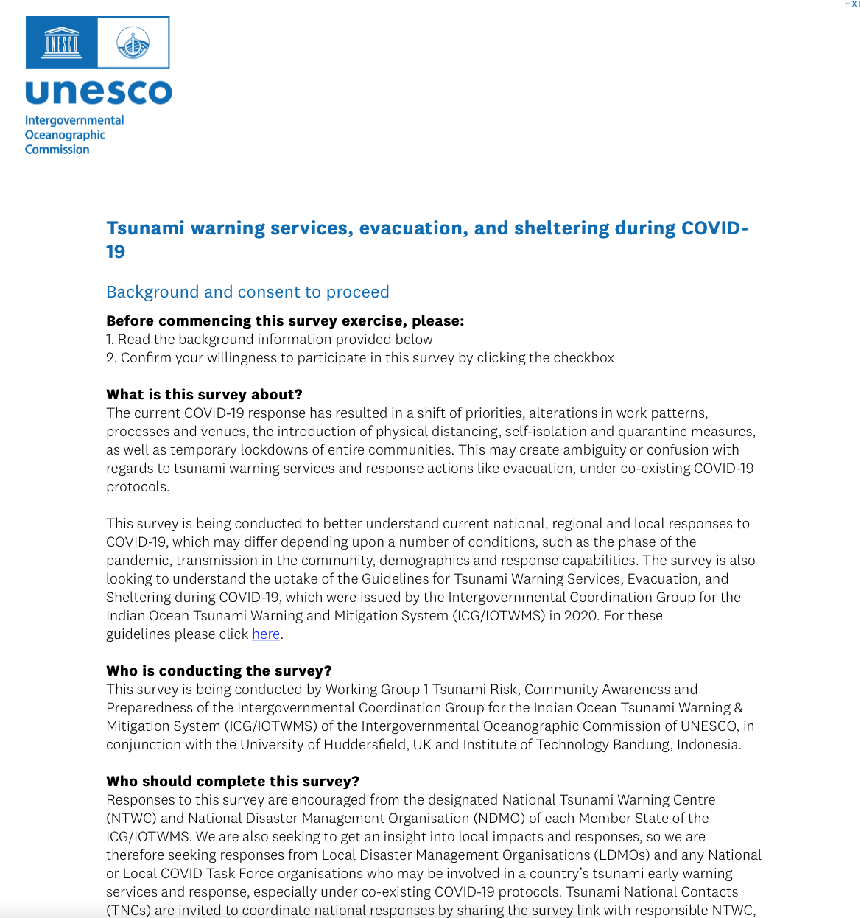
Survey of national and local responses to COVID-19 in relation to tsunami early warning
Developed by HUD and ITB through Working Group 1 Tsunami Risk, Community Awareness and Preparedness of the Intergovernmental Coordination Group for the Indian Ocean Tsunami Warning & Mitigation System (ICG/IOTWMS) of the Intergovernmental Oceanographic Commission of UNESCO
Issued by the Secretariat of IOTWMS and circulated to all 28 member states of the IOTWMS in early October ‘21, through their National Contact Points
Aims of survey
  Understand current national, regional and local responses to COVID-19
  Understand the uptake of the IOTWMS Guidelines for Tsunami Warning Services, Evacuation, and Sheltering during COVID-19

Slide 4
Who was invited to complete this survey?
Responses to this survey were encouraged from the designated National Tsunami Warning Centre (NTWC) and National Disaster Management Organisation (NDMO)
We were also seeking to get an insight into local impacts and responses, so responses from Local Disaster Management Organisations (LDMOs) and any National or Local COVID Task Force organisations who may be involved in a country’s tsunami early warning services and response, especially under co-existing COVID-19 protocols

Slide 5
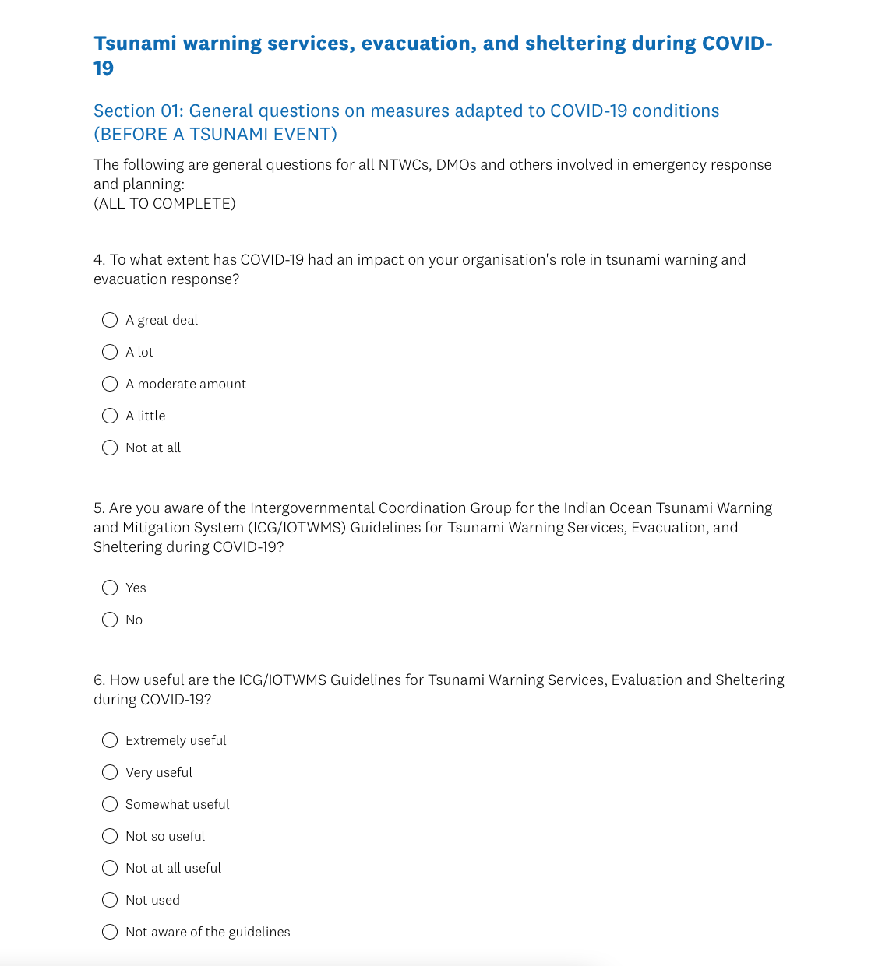
Survey structure
28 questions
Respondent information
Section 01: General questions on measures adapted to COVID-19 conditions (BEFORE A TSUNAMI EVENT)
Section 02: Tsunami preparedness measures adapted to COVID-19 conditions (BEFORE A TSUNAMI EVENT)
Section 03: Principles for tsunami warning and evacuation (BEFORE AND DURING A TSUNAMI EVENT)
Section 04: Principles for sheltering (DURING A TSUNAMI EVENT)

Slide 6
Responses
Disappointing response
A minimum of one response from eleven countries
  15 NTWC (11 countries)
  5 NDMO (3 countries)
  4 LDMO (1 country)
Several important sections of the survey are only relevant to N/LDMOs
Some of the responses are not complete
Summary
It is not possible to carry out meaningful analysis on such a low response rate / draw conclusions that would be representative
Doubtful that reissuing they survey would work – timeliness of survey etc.

Slide 7
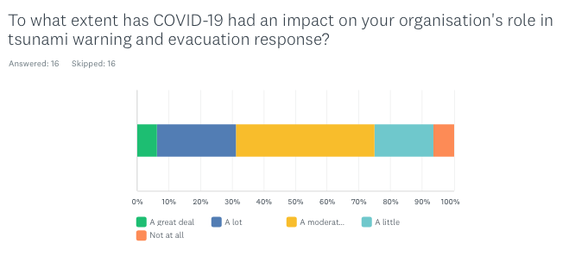
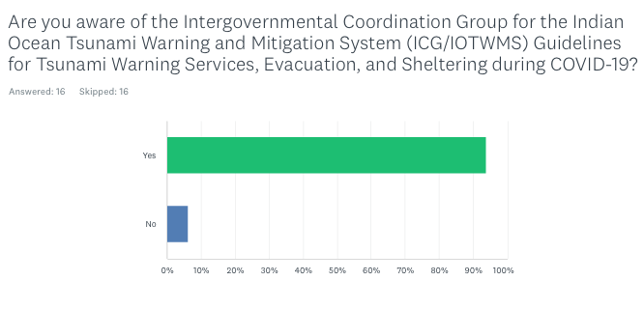
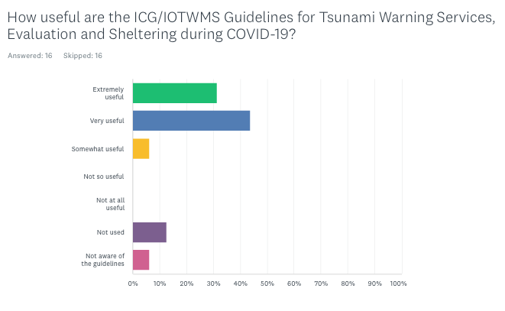
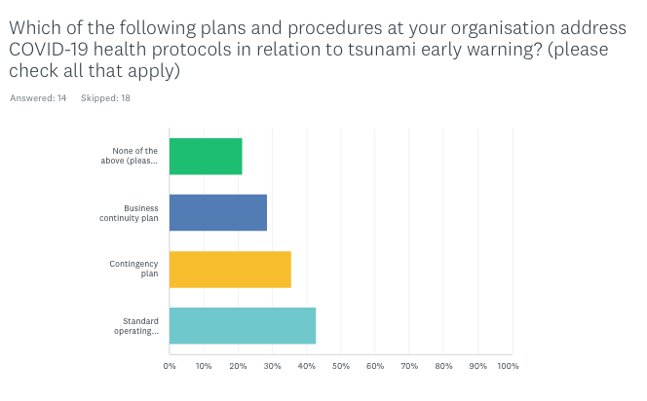

Slide 8
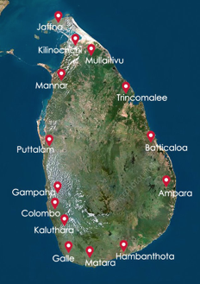

Sub-national survey in Sri Lanka
In In April/May, using the same instrument, the Sri Lankan DMC (NDMO) asked us to re-issue the survey
Targeted 14 coastal Districts: Ampara; Batticaloa; Colombo; Galle; Gampaha; Hambantota; Jaffna; Kalutara; Kilinochchi; Mannar; Matara; Mullaitivu; Puttalam; Trincomalee
Multiple responses from all 14 Districts, including Assistant Directors of DDMCUs and District Secretaries (Government Agent)
We are currently preparing a briefing note on the findings for the SL DMC

