Slide 1
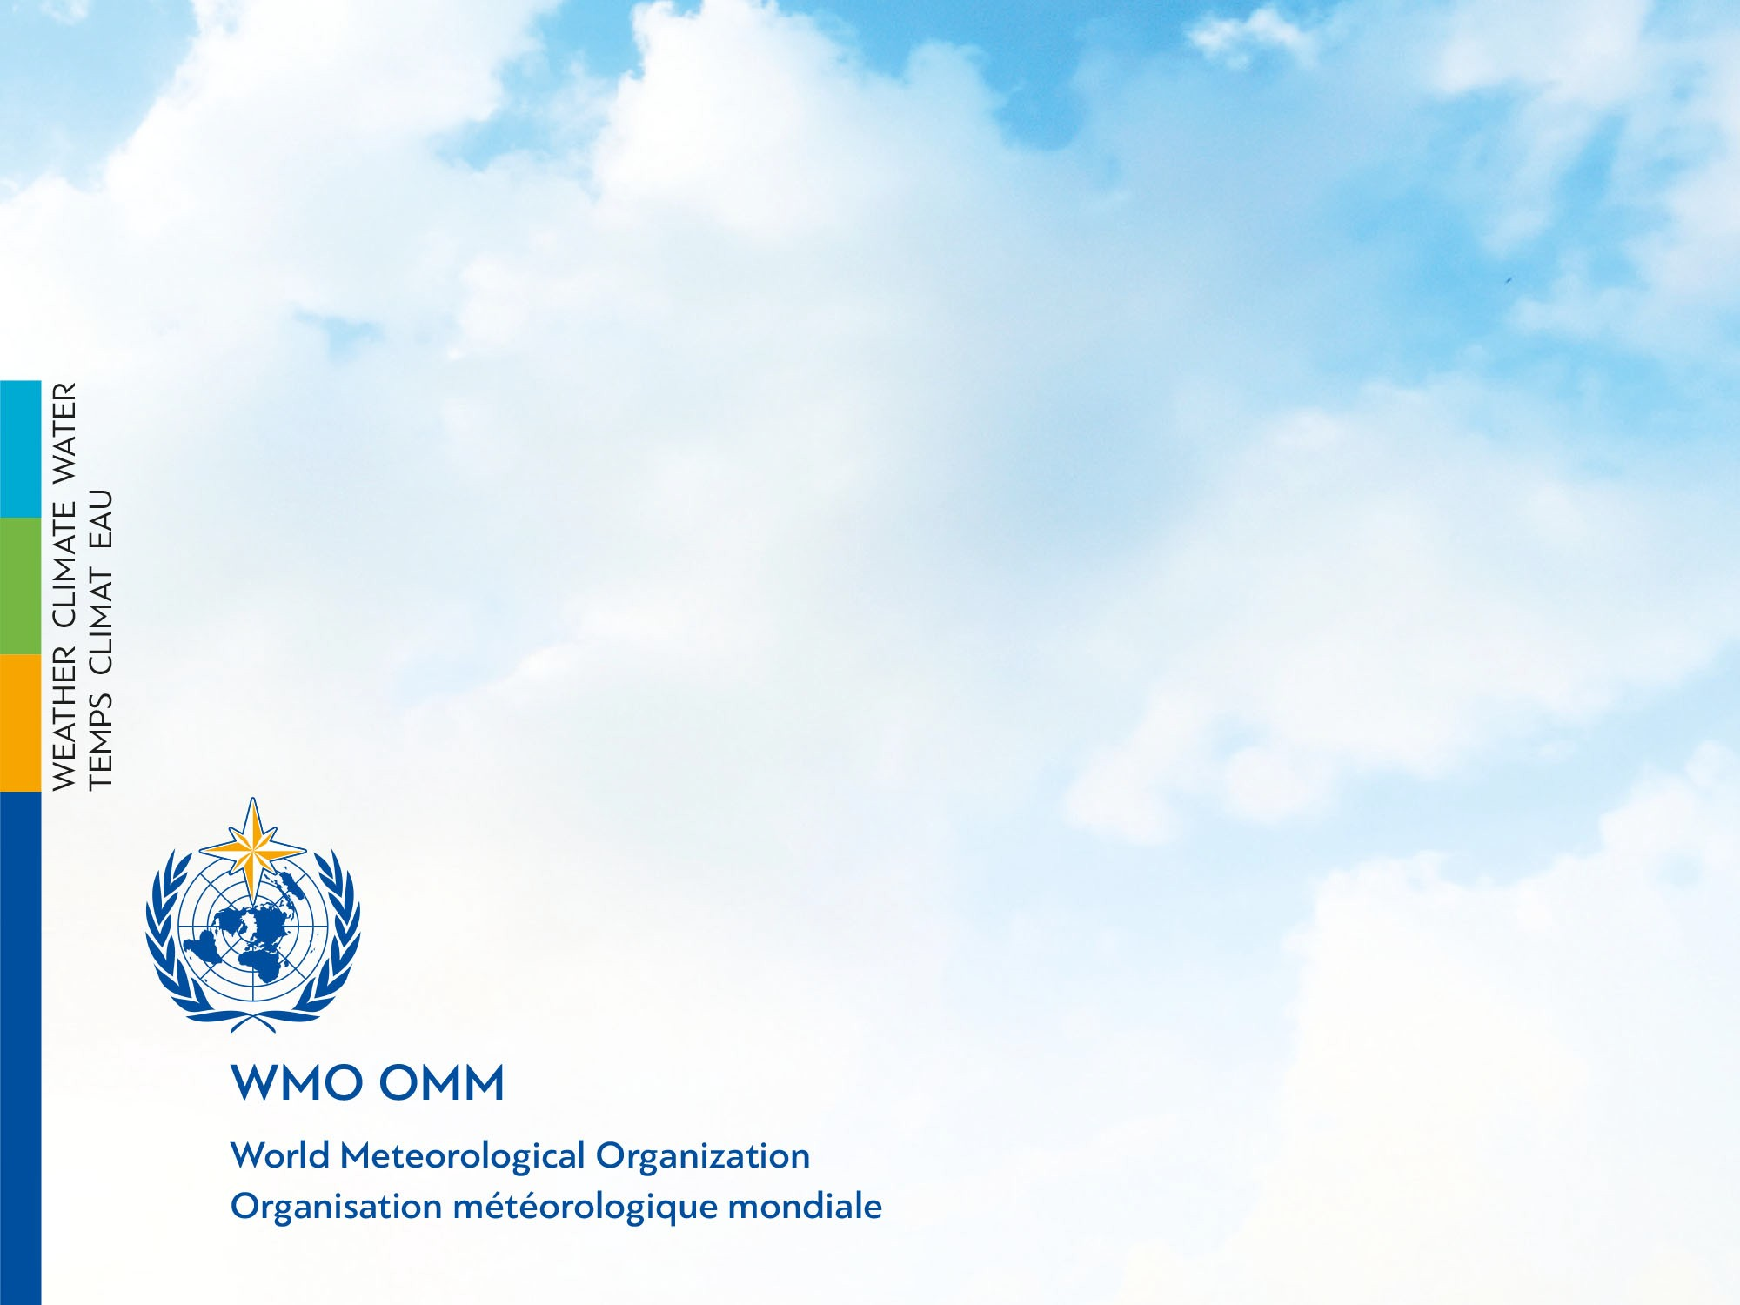
TOWS-WG-XV,
24-25 Feb 2022,
Virtual
Sarah Grimes, Marine Services
Hassan Haddouch, WIS
Cyrille Honore, DRR and Public Services

Slide 2
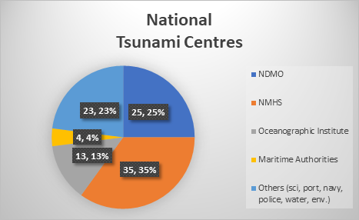
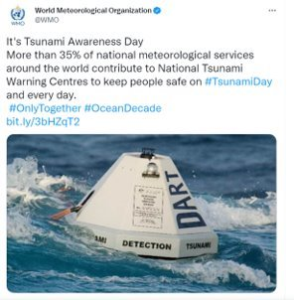
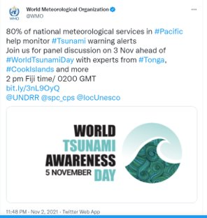
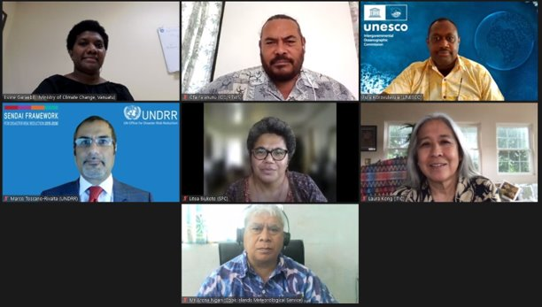
Met Services & Tsunami EWS
Multiple roles:
>35% Meteorological Services globally are Tsunami Service Providers – operational 24/7
Even more Meteorological services back up the National Service Provider, and/or support with infrastructure.
In some regions, majority of NMHS are involved in tsunami early warning process eg. 80% NMHS in the Pacific Islands

Slide 3

WMO & Tsunami EWS
2 Key areas where WMO supports the tsunami EWS process:
  Infrastructure, especially via the WMO Information System (WIS), and observations
  Early Warning Services, especially to strengthen the last mile of communication
WMO support NMHS, to strengthen their efforts in tsunami early warning, and maximise efficiencies eg. recent example with Tongan Met Service
Recap of relevant WMO structures:
SERCOM (SC-MMO* & SC-DRR), INFCOM*, Research Board* (*IOC rep)
WMO-IOC Joint Collaborative Board:
  Co-Chairs: Albert Martis (WMO), Srinivasa Kumar (IOC )
  Services Members: Alexander Frolov (IOC), John Parker (WMO)
  WMO-IOC Strategy approved by WMO & IOC, June 2021

Slide 4
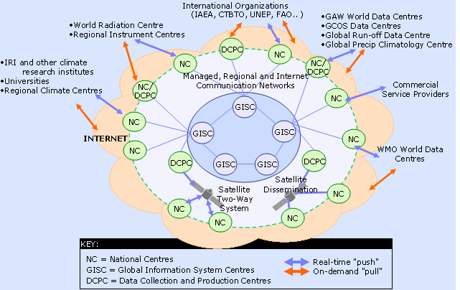

WMO Information System (WIS)
GTS is part of WIS: High availability is guaranteed through dedicated links
GISC (Global Information System Centers) provide access to a catalogue through a web portal
Through a GISC everyone can subscribe to a GTS data stream

Slide 5
Results from the report of IOTWMS communication test on 9 June 2021
Message Delivery Success Rates
21 Countries participating
Bangladesh, Comoros, Madagascar and Yemen did not receive GTS messages from any TSP (noting that Madagascar have no GTS connection)
Max 17 used GTS as exchange mechanism

Slide 6
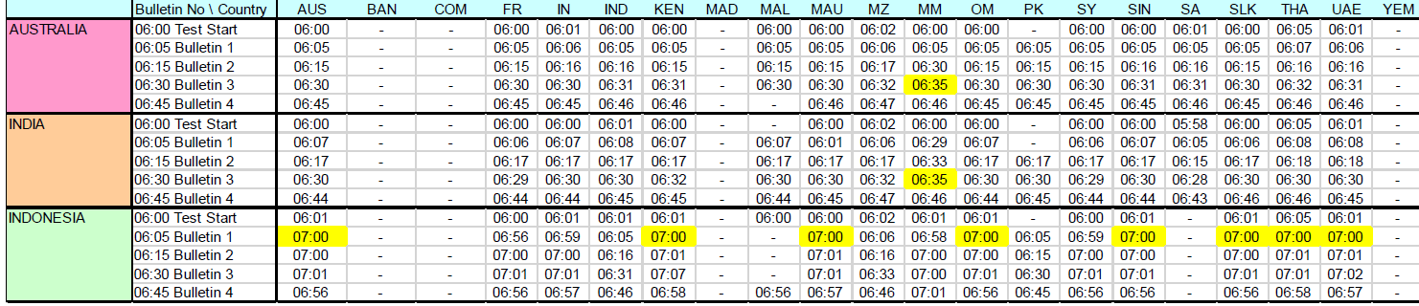
GTS Messages Received by each NTWC
GTS message delay times continued to be low in this test, with most messages received within 1-3 minutes of issuing
The longest delay was 55 minutes for most NTWCs to receive TSP Indonesia bulletin-1 notification message.

Slide 7
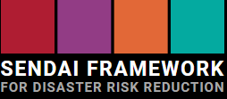
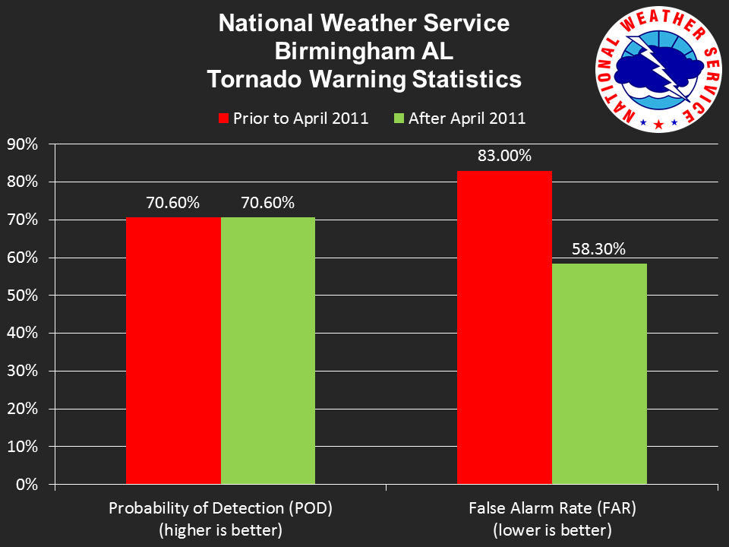
WMO-UNDRR project on MHEWS custom indicators for Sendai Monitor
A set of proposed custom indicators was developed with support from a multi agency expert group
UNDRR now developing guidance and training material, testing with pilot countries in the Caribbean and the Pacific
A presentation and training event to take place at the Global Platform for DRR in May 2022
Source : NWS, USA
Notes:
A follow up on what was announced last year :

Slide 8
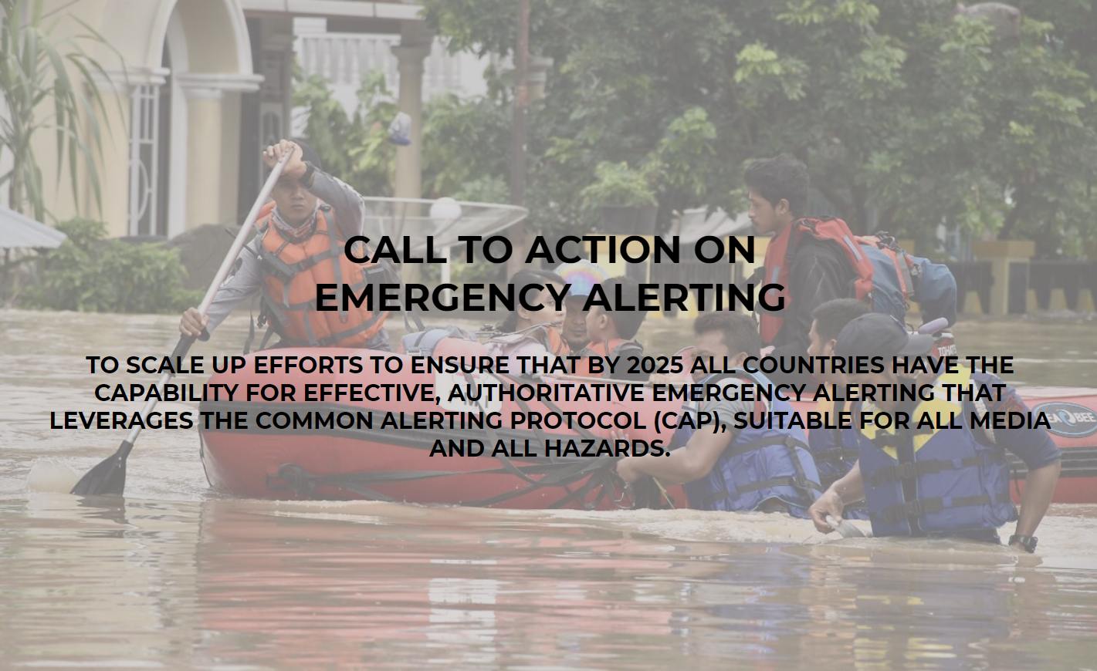
A joint Call to action on emergency alerting
Was launched on April 29th, 2021
Together with ITU, IFRC, UNDRR
Was endorsed by 15 organizations
Aims at promoting the adoption
of the Common Alerting Protocol ITU-T Recommendation X.1303,
Would UNESCO-IOC and its Members also endorse it ?
See : Emergency Alerting Call to Action
Stocktake and advocacy to be presented at GPDRR in May

Slide 9
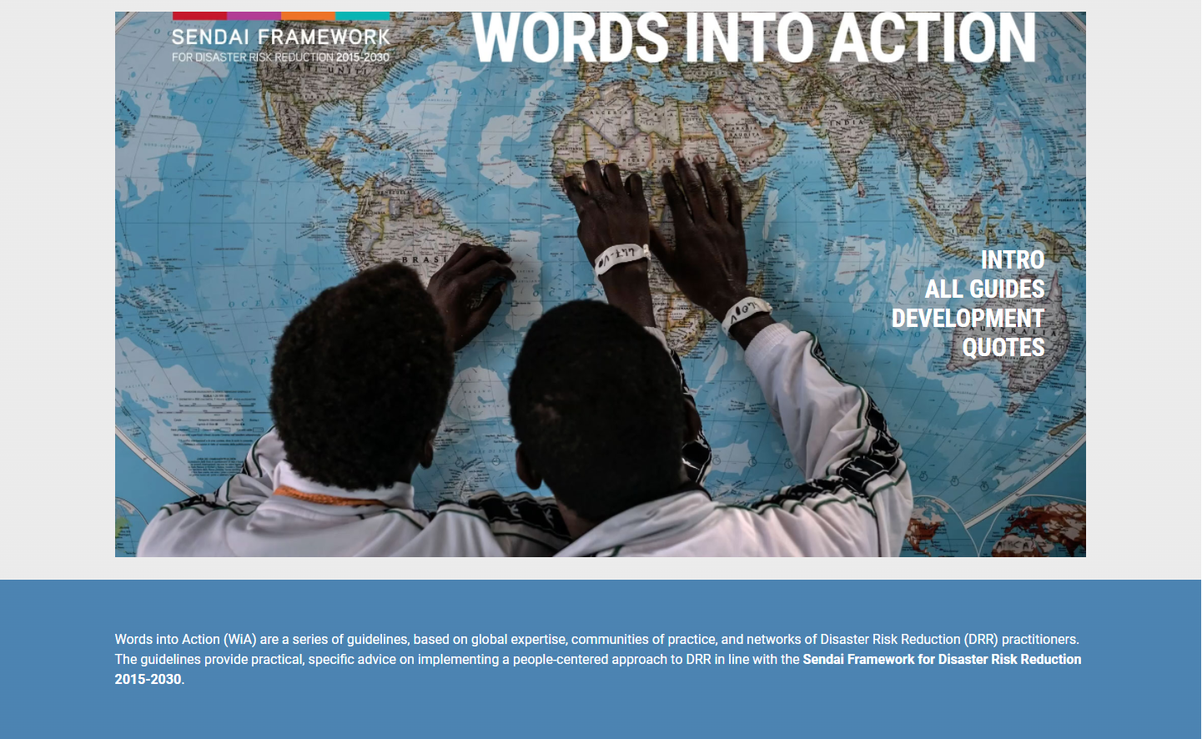
2022 events of interest
28 February deadline to submit a case of good practice to UNDRR as input to a Words into Action guide on MHEWS, launch on IDDRR Day 13 October
23 March : World Met Day, theme on DRR and MHEWS
23-24 May : MHEWC-III as a preparatory event of ..
25-27 May : … Global Platform for Disaster Risk Reduction 2022
17-21 October : WMO SERCOM ( GMAS etc. )

Slide 10
Thank you
Merci

