Slide 1
TOWS TT-DMP Meeting:
21-22 Feb 2022
Report to
TOWS-WG XV

Slide 2
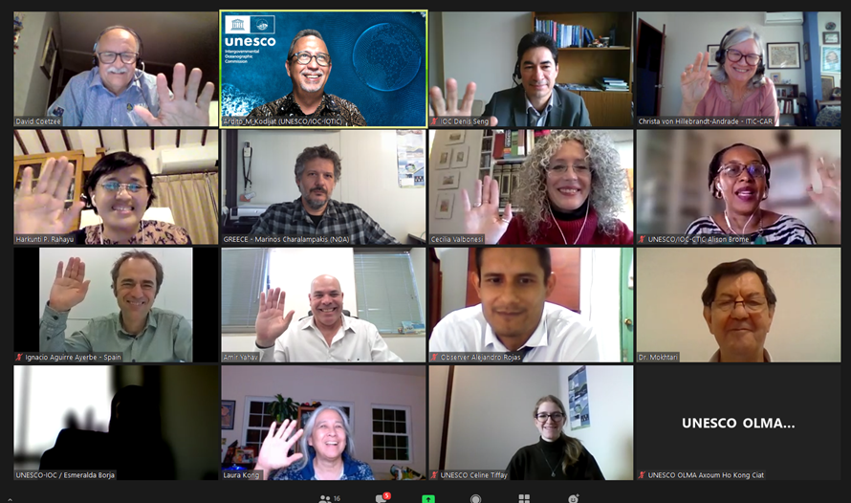
Attendance

Slide 3
Wave Exercises
Reports received from CARIBE EWS, IOTWMS, NEAMTWS, PTWS
TT-DMP met in 2021 to discuss sharing of lessons & coordination of exercises
Proposed recommendations:
Requests that the TT-DMP continue to work on coordination of the conduct and reporting of exercises with the aim of having standard practices among the ICGs
Requests the Secretariat to share reports and presentations regarding recent Wave exercises, outcomes, best practices and lessons learnt when received from ICGs
Requests the Secretariat to support the translation of MG 86 (Multi-Annual Community Tsunami Exercise Programme: Guidelines for the Tsunami and other Coastal Hazards Warning System for the Caribbean and Adjacent Regions) into French and Spanish.

Slide 4
World Tsunami Awareness Day (WTAD)
Theme for 2022 is Target G of the Sendai Framework: Substantially increase the availability of and access to multi‑hazard early warning systems and disaster risk information and assessments to the people by 2030
The TT-DMP noted that this theme aligns closely with the current focus of the TOWS-WG in the context of the UN Ocean Decade.
Proposed recommendations:
Notes that the 2022 WTAD theme will highlight Sendai Framework Global Target G: Substantially increase the availability of and access to multi‑hazard early warning systems and disaster risk information and assessments to the people by 2030, and that this theme aligns closely with the current focus of the TOWS-WG in the context of the UN Ocean Decade.
Recommends the continued strong collaboration between the UNESCO/IOC and UNDRR for the 2022 WTAD highlighting among other initiatives the UN Ocean Decade Tsunami Program goal for 100% Global Tsunami Ready for highly vulnerable communities,
Recommends highlighting the multi-hazard framework in WTAD activities.

Slide 5
Global Key Performance Indicators (KPI’s)
The Task Team (members of the CARIBE-EWS, IOTWMS, NEAMTWS, and PTWS) have developed a global framework with goals, targets and corresponding measures (currently in final review
The framework aligns with the Sendai Framework for Disaster Risk Reduction 2015-2030; United Nations Decade of Ocean Sciences for Sustainable Development – A Safe Ocean; IOC Tsunami Programme; Tsunami Ready; current ICG Strategies; and the ICG/PTWS KPI Framework completed in 2018/2019.
Proposed recommendations:
Agrees to the proposed approach with regards to the establishment of global KPIs, and
Requests the team to finalize documentation and user guidance for survey completion
Notes the Secretariat will resource working with industry experts to develop the on-line survey, and that the survey will be hosted on the IOC website.

Slide 6
NTWC Training Competencies
Dr Laura Kong provided a summary of the PTWS’s work to develop a National Tsunami Warning Centre (NTWC) Competency Framework. It proposes a tiered framework: for expert or basic levels; and for minimally viable or fully independent centres.
Proposed recommendations:
Notes with appreciation the work of the PTWS to develop a NTWC Competency Framework (2017), and the ITIC’s leadership to pilot training courses based on the Framework,
Noting the interest of other ICGs, requests the PTWS to share its document with other regions, and invite comments and feedback, and
Also noting the challenges in developing and implementing a global competency framework,
Requests the TT-DMP and the TT-TWO to continue to consider development of guidelines for a global NTWC competency framework, based on the available set of documents and Pacific input, noting that implementation can be at a regional level.

Slide 7
Tusami Glossary Update
Scientists of the IUGG Joint Tsunami Commission Working Group on Terminology have compiled preliminary recommended edits. Recommendations were also received from Member States, including for volcano tsunami.
Proposal to postpone next update to 2023 to be able to include Tsunami Ready and volcanic/non-seismic source terminology; also due to time constraints (due to recent tsunamis).
Proposed recommendations:
Notes with appreciation the contributions of the IUGG Joint Tsunami Commission Working Group on Terminology and Member States to update the 2019 Tsunami Glossary,
Agrees to postpone the next update of the Tsunami Glossary to 2023 to facilitate the incorporation of important changes,
Notes the importance of translating the Tsunami Glossary in local languages so local people and authorities can understand and use the consistent terminology,
Also notes the importance of having abbreviated definitions for key terms for use in social media and other abbreviated language communication tools.

Slide 8
Planning for Ocean Decade
Mr Mike Angove provided a brief on the development of a conceptual framework on “Protecting Communities from the World's Most Dangerous Waves: A Framework for Action under the UN Decade of Ocean Science for Sustainable Development”.
Dr Srinivas Kumar reported on the progress and plans following the initial meeting on 17th February 2022. He also introduced the ToR of the Scientific Committee and outlined a proposed timeline for the work of the Scientific Committee to prepare the 10-Year Research.
Mr David Coetzee reported on the meeting of the TT-DMP in October 2021, at the request of the Chair of the TOWS-WG, to advise on the composition and mandate of the Tsunami Ready Coalition.
Ms Christa von Hillebrandt-Andrade and Mr Denis Chang-Seng shared information from the Caribbean and Europe on Multi-Hazard Early Warning Systems (MHEWS) and the engagement and contributions of UNESCO IOC towards the organization of GP2022, the Third MHEWS Conference (MHEWS-III) and the preparation of the WiA Guide on Multi-Hazard Early Warning System.
Dr Harkunti P. Rahayu proposed to mainstream Tsunami DRR in urban planning for city/municipality level by linking Ocean Decade actions with SDG’s Goal 11 to make cities inclusive, safe, resilient and sustainable; as well as with Target 5 of the Sendai Framework by increasing the number of local DRR strategies.
Proposed recommendations:

Slide 9
Planning for Ocean Decade Proposals
(Remaining proposals that are not covered elsewhere):
Notes the report of Dr Kumar on the progress and plans following their initial meeting on 17th February 2022.
Notes with appreciation the efforts of the CARIBE-EWS and the Secretariat to coordinate and contribute to global initiatives related to MHEWS.
Encourages Member States, ICGs, IOC Tsunami Unit, Tsunami Information Centers and the UN Decade Tsunami Programme to purposely support, contribute to, and manage the integration of tsunami warning system capabilities with other coastal hazard early warning systems and services

Slide 10
Tsunami Ready: Summary of current status
Tools:
MG74 (Standard Guidelines for the Tsunami Ready Recognition Programme) now finalized, being processed for publication
Other IOC Manual and Guides (49, 58, 74, 76, 82, 86) and technical documents support tsunami inundation modeling and mapping, evacuation mapping, emergency response and evacuation planning, exercising
Tsunami Ready Logo: Finalized
Interactive map viewer: Completed & being reviewed by UNESCO Public Relations. Will be hosted by IOC
Tsunami Ready website: Hosted by ITIC - links to map viewer; other info www.tsunamiready.org
Promotion:
Board Game: Developed by IOTIC; 200 printed initially; templates available for production
Animation video series: Developed by IOTIC

Slide 11
Tsunami Ready (current status cont’d)
Training:
Tsunami Ready 4 courses training developed by IOTIC with the support of the Ocean Teacher Global Academy (OTGA) in collaboration with Indonesia BMKG: Introduction to Tsunami Ready, Tsunami Ready indicators, Implementing Tsunami Ready, Facilitating Tsunami Ready
ITIC developing 5 courses to support Tsunami Ready with the support of the OTGA Platform in 2023: Tsunami awareness, TEWS, TEMPP, TWC & TER SOPs, TWC competencies
Pilot implementation:
Updates received on pilot programmes in all regions
Tsunami Ready has now established itself as a globally popular and recognized tsunami preparedness tool
Tsunami Ready Coalition:
TT-DMP met in Oct 2021 to discuss & advise the Chair of TOWS-WG on the Coalition’s goal, objectives, scope and composition
Draft TOR developed (covered under Agenda item 5.2)

Slide 12
Tsunami Ready: Recommendation to transition to a Programme
Considering the status and growth of the Tsunami Ready Pilot Programme, the TT-DMP developed a Working Document to introduce a recommendation to the TOWS-WG-XV, and eventual endorsement by IOC at its next Governing meeting in June 2022, to transition from a Pilot to a Programme:
“The UNESCO/IOC Tsunami Ready Recognition Programme (UNESCO Tsunami Ready)”
For detail, refer to the document posted in the TT-DMP and TOWS-WG meeting websites

Slide 13
Tsunami Ready Recommendation to TOWS-WG XV
Recalling the first initiative for the Caribbean and the international community through the NWS and UNESCO/IOC TsunamiReady® pilot which recognized Anguilla as ‘TsunamiReady®’ in 2011; recalling further the approval of Tsunami Ready Guidelines by the ICG/CARIBE-EWS in 2015 at its 10th Session,
Recalling TOWS commendations (TOWS-WG-IX, 2016; TOWS-WG-X, 2017) calling on the ICGs and Member States to consider piloting the Caribbean guidelines with a view toward developing a harmonized consistent global guideline,
Having taken into account the feedback provided from piloting Tsunami Ready communities in the Caribbean, Indian, and Pacific Oceans to publish IOC Manual and Guides 74 (2022) Standard Guidelines for the Tsunami Ready Recognition Programme (in press),

Slide 14
Tsunami Ready Recommendation to TOWS-WG XV (cont’d)
Appreciating the creation of TsunamiReady Viewer, Tsunami Ready web site, Tsunami Ready Board Game and Information / Communication tools, development of online training through the Ocean Teacher Global Academy, as well as IOC Manual and Guides (49, 58, 74, 76, 82, 86) and technical documents to support tsunami inundation modeling and mapping, evacuation mapping, emergency response and evacuation planning, exercising, and available of awareness-raising materials developed and distributed through the IOC Tsunami Information Centres (TICs),
Appreciating the collaborative efforts with the UNDRR to promote awareness through World Tsunami Awareness Day every November 5, and the creation of many short videos showing communities and countries joining the Tsunami Ready global community in 2020 and 2021,
Recommends the establishment of a UNESCO/IOC Tsunami Ready Recognition Programme, as described by IOC TOWS-WG Task Team DMP Working document on the Tsunami Ready Recognition Programme of the UNESCO/IOC.
Recommends further the addition of the task to facilitate the UNESCO/IOC Tsunami Ready Recognition Programme to the Terms of Reference of each ICG Tsunami Information Centre (TIC).

Slide 15
Other Tsunami Ready Recommendations
Other related recommendations:
Requests that it be noted in the guidelines on the usage of the TR logo that only communities that have received recognition of Tsunami Ready receive automatic approval for the usage of the Tsunami Ready logo for the duration of their Tsunami Ready status in its official products and documents, and that any other entities (including National Tsunami Ready Boards) must request approval from UNESCO/IOC Secretariat to use the Tsunami Ready logo, and
Further requests that the automatic approval for the usage of the logo by Tsunami Ready communities be informed by the IOC Secretariat in the Tsunami Ready designation letter with regards to MG 74.
Requests ICGs and the IOC Tsunami Programme Secretariat to advise countries that are currently in the process of implementing Tsunami Ready, to now follow the MG74 when submitting/applying for Tsunami Recognition, and that MG74 will apply for all future applications.
Notes that there are Member States that have their own tsunami preparedness programmes that align closely with the UNESCO/IOC Programme, and therefore,
Requests the TT-DMP to consider a mechanism to equate those programmes to Tsunami Ready.

