Slide 1

Tsunamis and Other Coastal Hazards from the Caribbean Sea and Adjacent Regions
Dr.rer.nat. Silvia Chacón-Barrantes
Chair ICG/CARIBE-EWS
February 2022

Slide 2
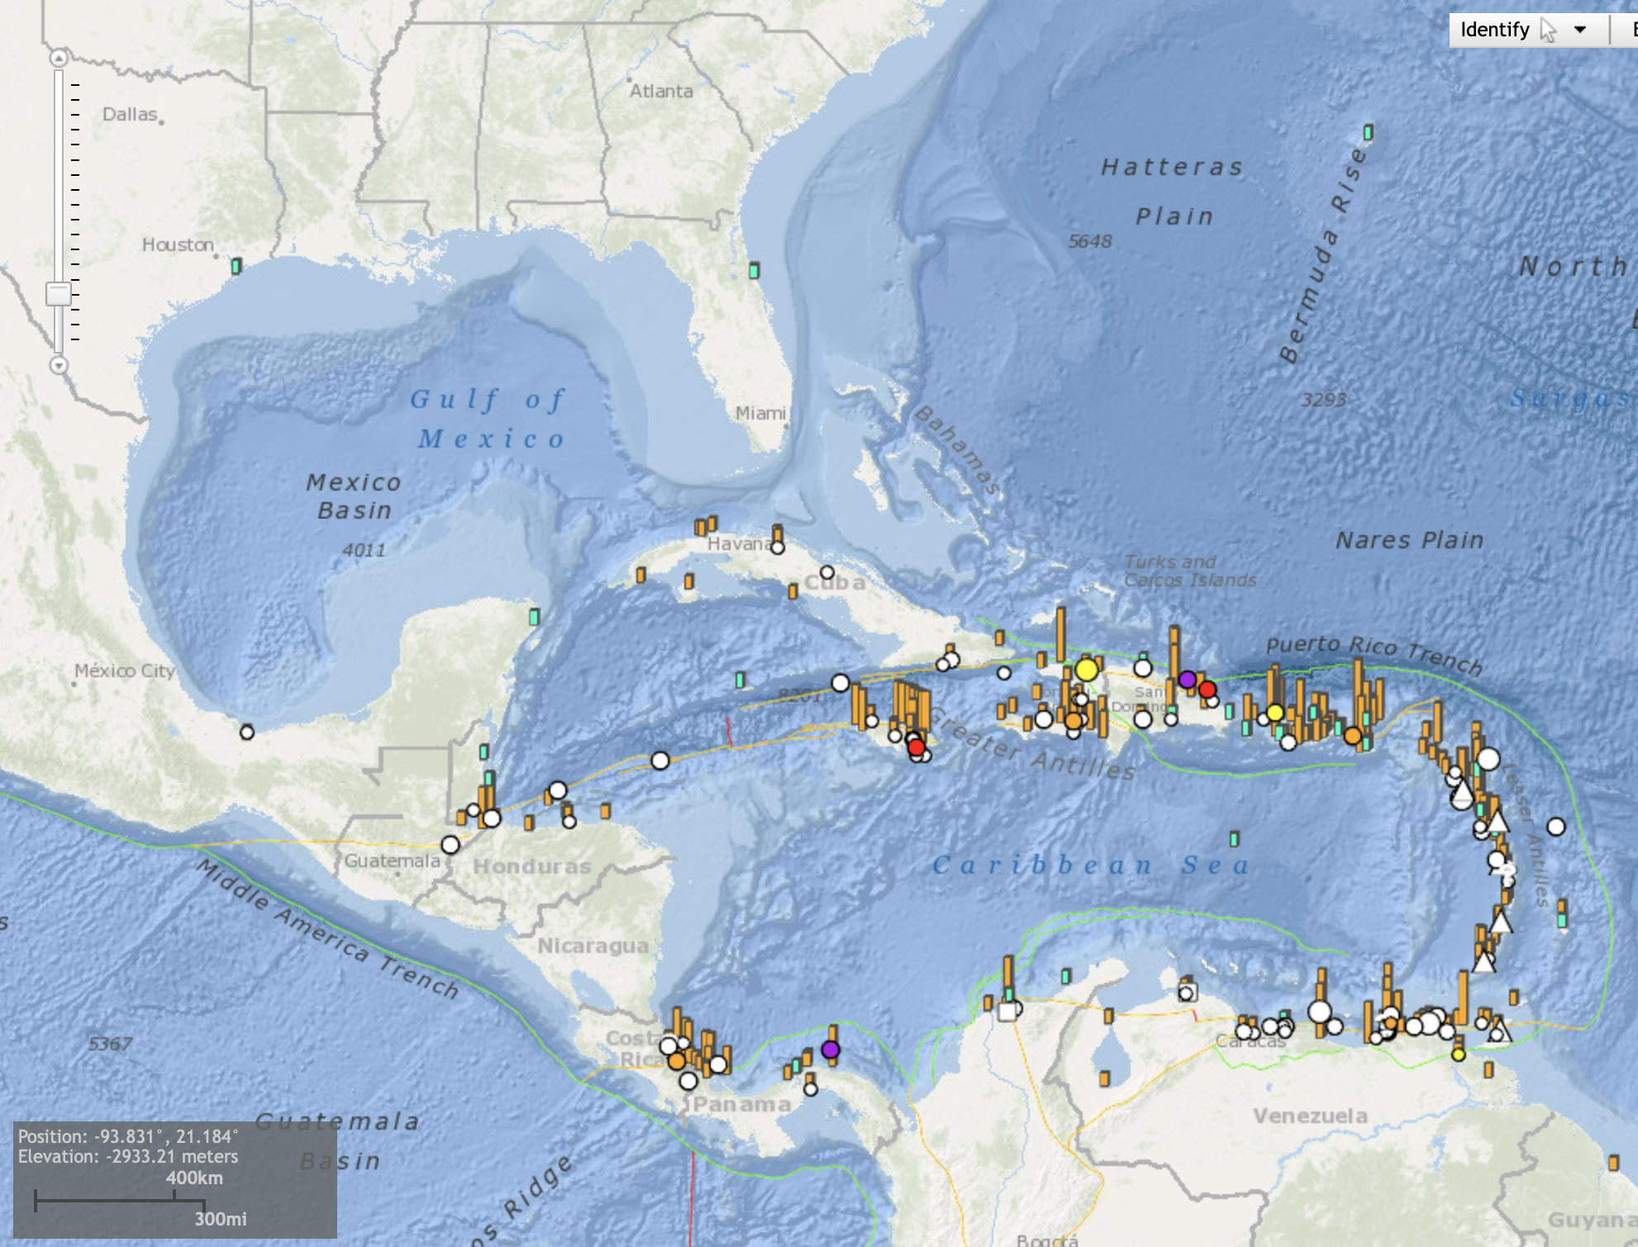
Tsunamis in the Caribbean and Adjacent Regions
Over the past 500 years more than 110 tsunamis have killed over 4,000 people

Slide 3
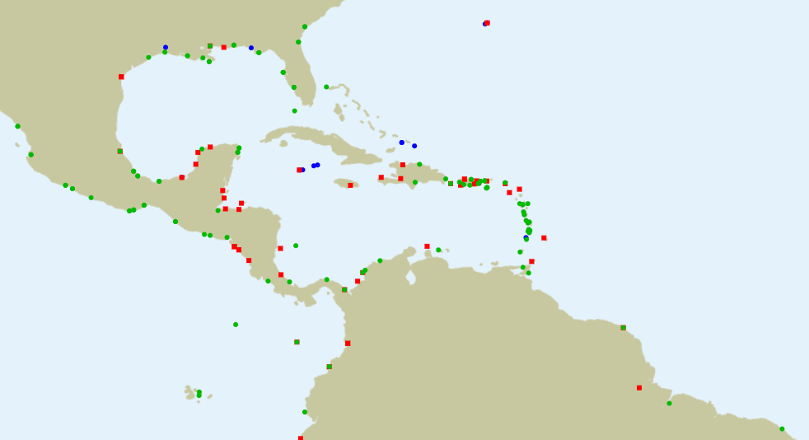
Tonga tsunami recorded in the Caribbean
44 SL stations recorded the tsunami

Slide 4
ICG/CARIBE-EWS-XV
Was held online in April 2021
ICG/CARIBE-EWS-XVI
Planned to be in Aruba in May 2022

Slide 5
WGs and TTs
TT CARIBE WAVE 22 – Elizabeth Vanacore (PRSN-US)
TT Volcanic Activity and potential Tsunamis – Valerie Clouard (France)
TT Tsunami Ready – Matthieu Peroche (France) and Fabian Hinds (Barbados)
TT Evacuation Maps – Norwin Acosta (Nicaragua)
TT ImP – Mary Rengifo (Colombia)
Group of Experts for Other Coastal Hazards – TBD
TT Ocean Decade – France (TBD), US (Mike Angove) and Venezuela (Ileana Osorio)
WG 1- Tsunami Monitoring and Detection Systems – Dan McNamara (US)
WG2 - Tsunami Hazard Assessment – Nic Arcos (US)
WG 3 - Tsunami Related Services – Emilio Talavera (Nicaragua)
WG 4 - Preparedness, Readiness and Resilience – Christa von Hillebrandt-Andrade (CTWP, Puerto Rico - US)

Slide 6
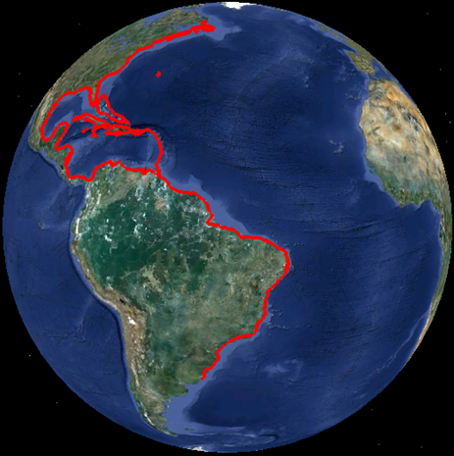
Current Participation in the CARIBE-EWS
1. Bahamas
2. Barbados
3. Belize
4. Brazil
5. Colombia
6. Costa Rica
7. Cuba
8. Dominica
9. Dominican Republic
10. France (Guadeloupe, Guyane, Martinique, Saint Martin, St. Barthelemy)
11. Grenada
12. Guatemala
13. Guyana
14. Haiti
15. Honduras
16. Jamaica
17. Mexico
18. Netherlands (Aruba***, Bonaire, Curacao***, Saba, Sint Maarten***, Sint Eustaius).
19. Nicaragua
20. Panama
21. Saint Kitts and Nevis
22. Saint Lucia
23. Saint Vincent and the Grenadines
24. Suriname
25. Trinidad and Tobago
26. United Kingdom of Great Britain & Northern Ireland (Anguilla***, Bermuda, British Virgin Islands***, Cayman Islands***, Montserrat***, Turks and Caicos)
27. United States (Puerto Rico and US Virgin Islands)
28. Venezuela (Bolivarian Republic of)
Observers
1. Antigua and Barbuda
2. Canada
3. Peru
Notes:
32 member states and 16 territories (6 associate member states of Unesco), including 16 Small Islands Developping States
All countries and territories but one have designated their TWFP and TNC
Half of the countries and territories have nominated a NTWC

Slide 7
ICG/CARIBE-EWS
Mission
To facilitate Tsunami Monitoring, Hazard and Risk Assessment, Warning and Public Awareness and Education in the Member States within a coordinated and harmonized regional framework
Vision
All Member States of ICG CARIBE EWS are resilient and prepared for tsunamis and other coastal hazards

Slide 8
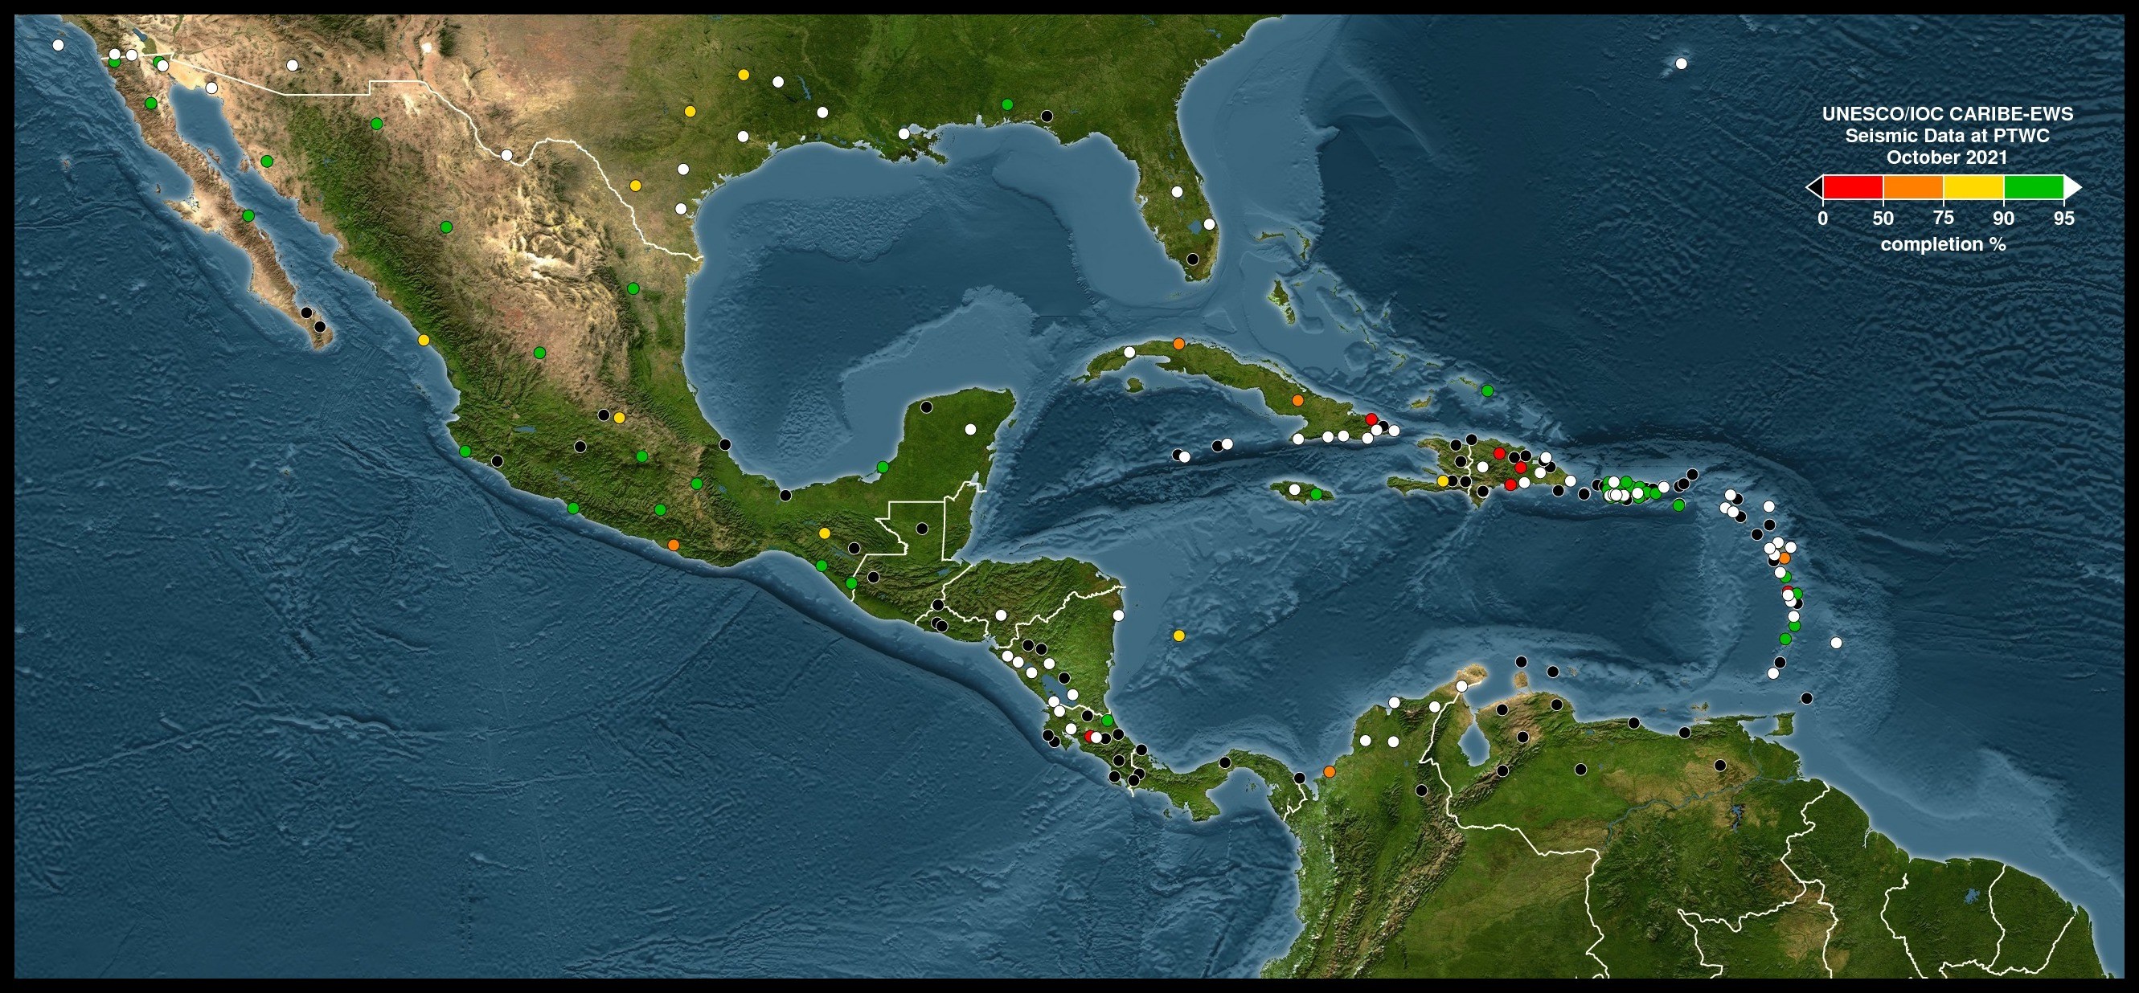
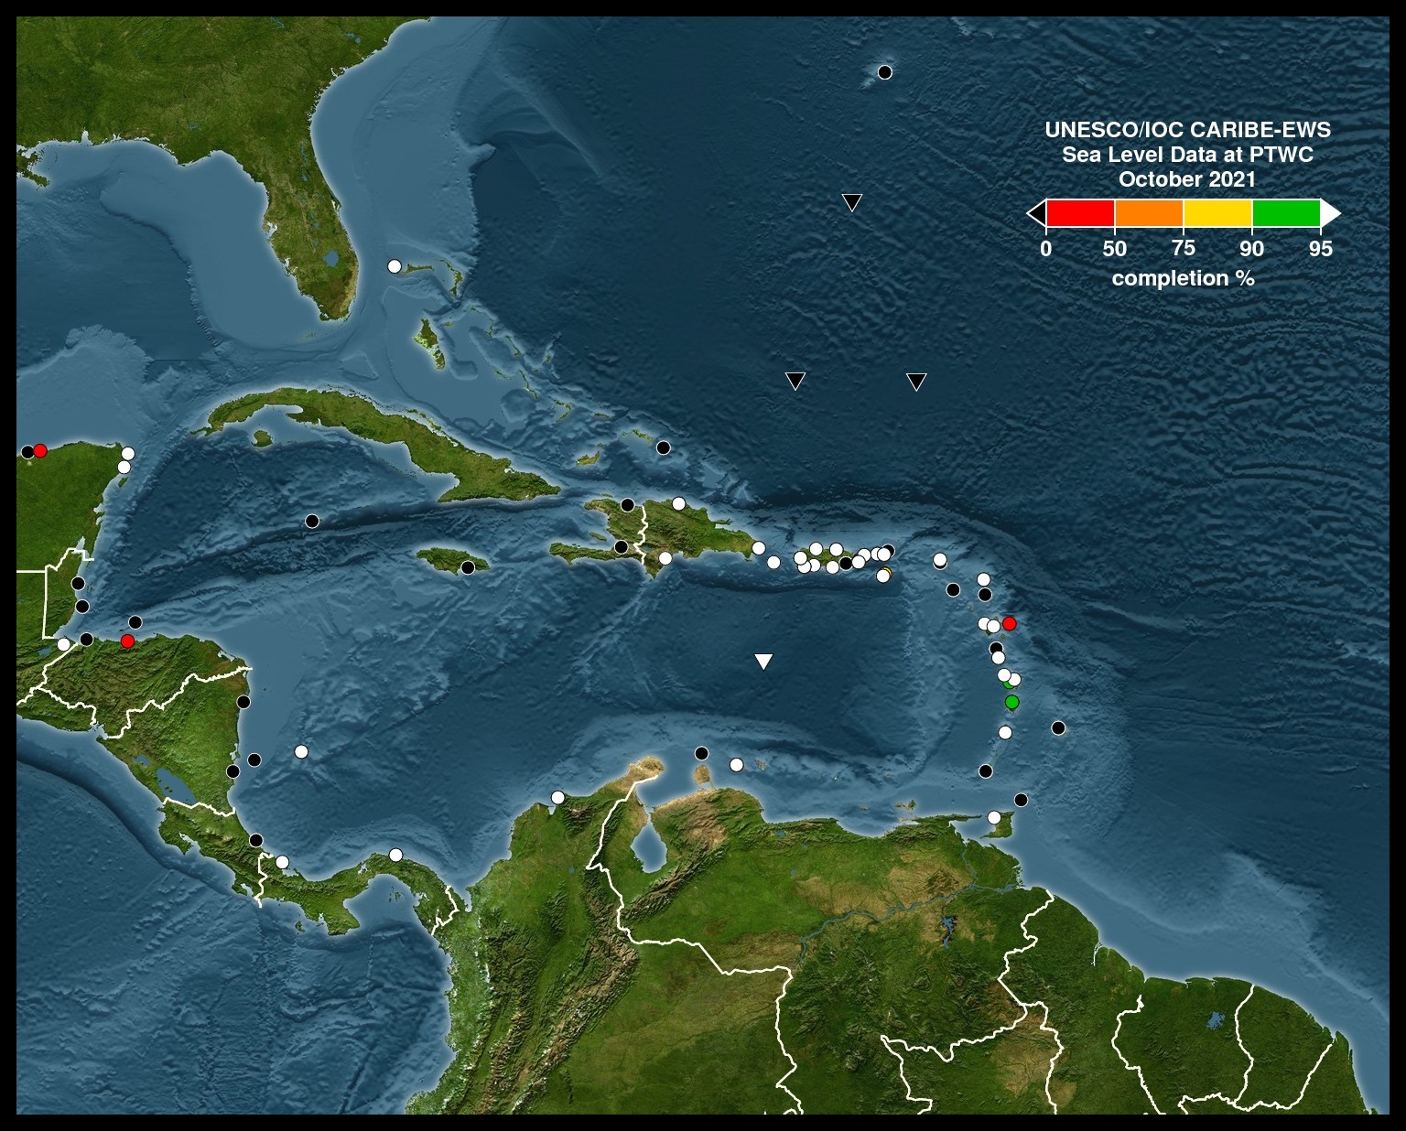
WG1: Monitoring & Detection Systems
Continue rebuilding stations
Pandemic delayed station maintance and repair, but slowly starting again
PTWC generating status station maps
150 new seismic stations in Central America
10 new seismic stations in Cuba
NOAA DART buoys are back on site and transmitting
New TG deployed near to active volcanoes

Slide 9
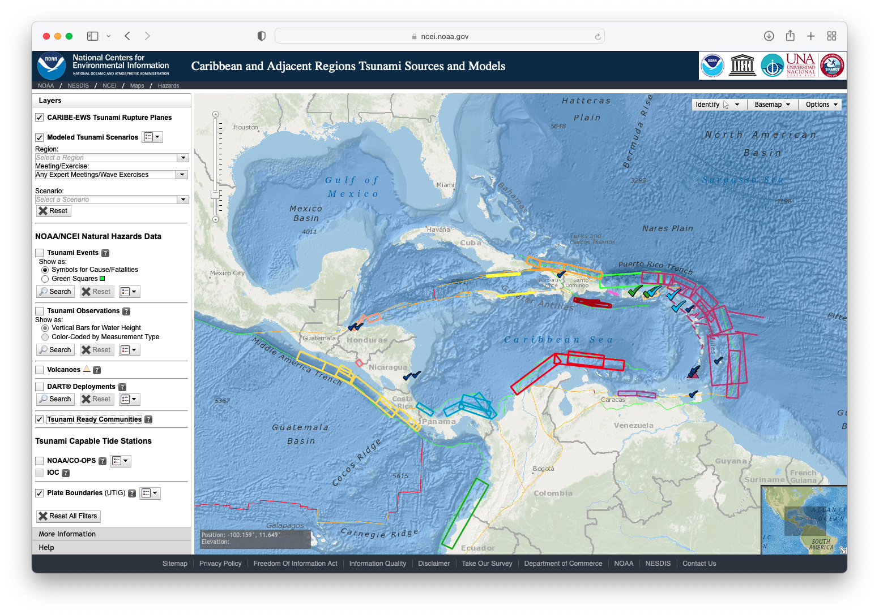
WG2: Hazard Assessment
Created doc on min topo/bathy requirements
CATSAM update, includes TR communities in the Caribbean
CMA might be data trust for the región
TsuCAT update

Slide 10
WG3: Tsunami Related Services
Sub-regional TSP:
Central American Tsunami Advisory Center (CATAC), Nicaragua
  Issued experimental products for CaribeWave21
Worries about high dependence on internet
  Some in WMO, Penguin, Geonet, fax and RSS
  Need to collaborate with MetOffices to increase satellite systems
  40% NTWC are MetOffices and still not using them
To organize a webinar or roundtable on alternative communication methods

Slide 11
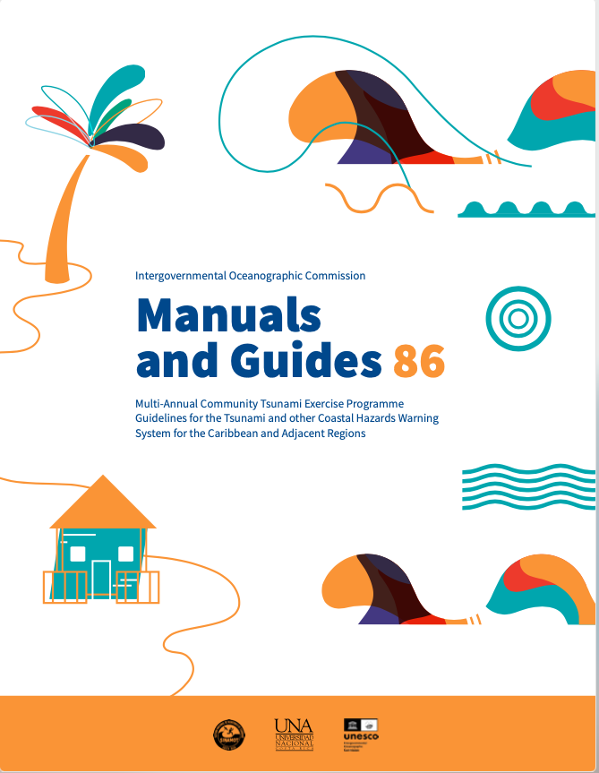
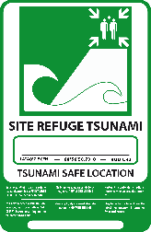
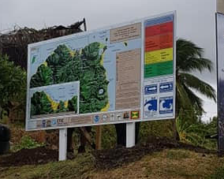
WG4: Preparedness, Readiness & Resilience
COVID-19 Guidance
“Multi-Annual Community Tsunami Exercise Programme Guidelines” finished
  Translation to Spanish and French in process
Update inventory of tsunami evacuations signs and symbols used in the region as well as internationally (including the ISO 20712) including blue line
development of an online tool to order tsunami educational and outreach materials from ITIC or CTIC
1st version of database of Social Scientists on DRR

Slide 12
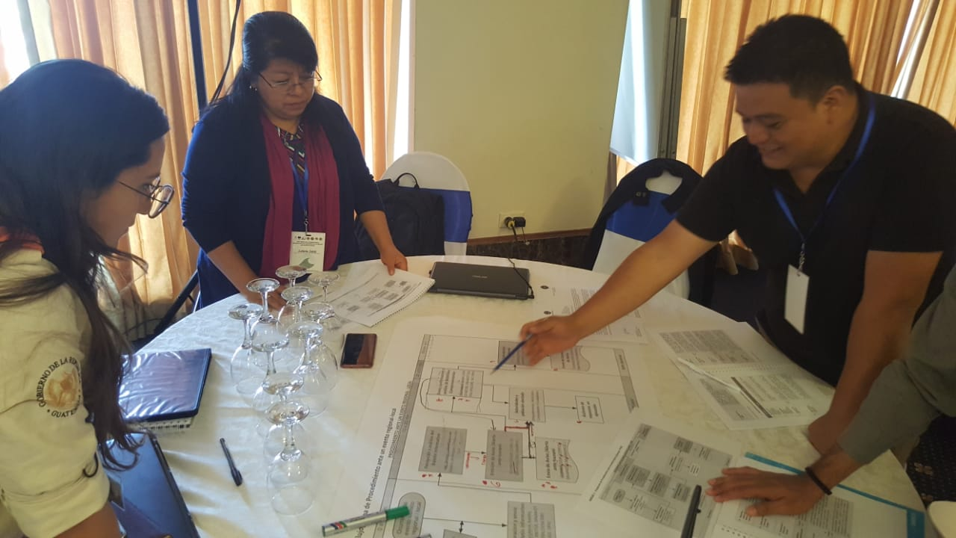
TT Tsunami Ready
99% of MS interested on piloting
Proposal for new DIPECHO projects rejected
USAID project got extension to 2021
DIPECHO-LA finished
Some communities pending
Recommended to have bathy/topo data before community selection to avoid delays

Slide 13
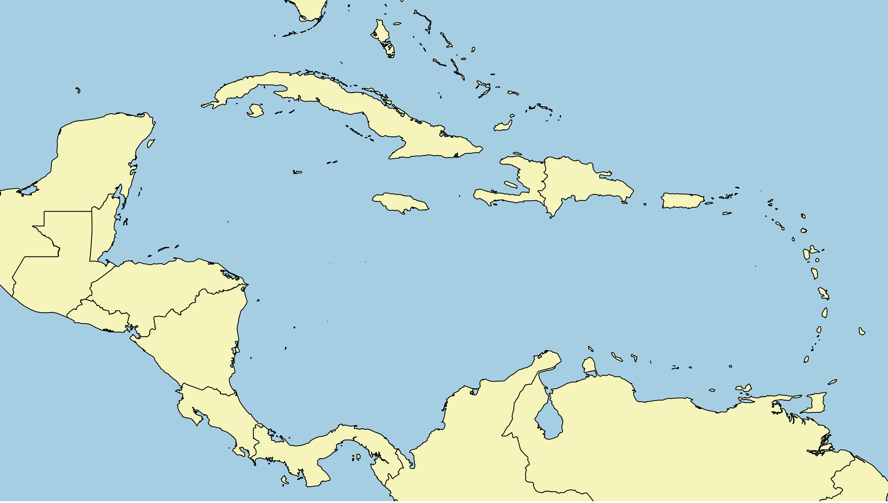
3 US or UNESCO/NOAA TsunamiReady
Haiti
Dominican Republic
PR
BVI
Anguilla
Antigua & Barbuda
Jamaica
USVI
Belize
St. Kitts & Newis
Guatemala
CARIBE-EWS Tsunami Ready
in progress (DIPECHO & USAID)
Honduras
St. Vincent
& the Grenadines
El Salvador
Nicaragua
Barbados
Grenada
Costa Rica
Trinidad & Tobago
7 PTWS Tsunami Ready
In progress
Panamá

Slide 14
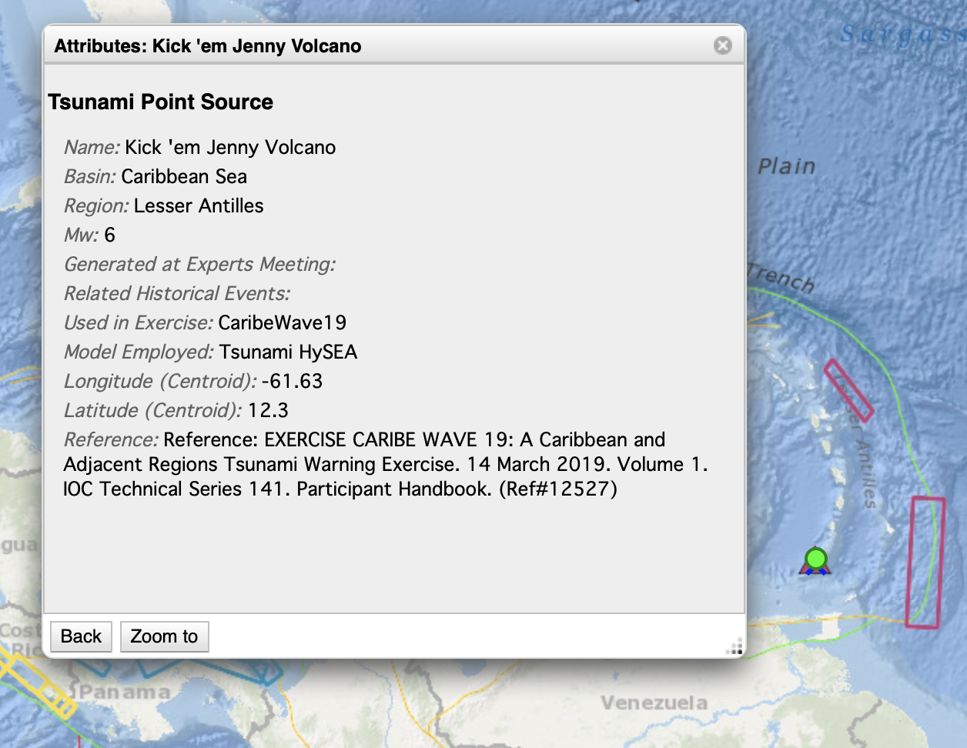
TT Volcanic Sources
Working on products from TSPs
Piloting collaboration mechanisms between TSPs and Volcanic Observatories

Slide 15
Other
TT Implementation plan
To be reshaped in terms of Key Performance Indicators (KPI) and Sendai Framework
Survey to be done
Decissions for next ICG

Slide 16
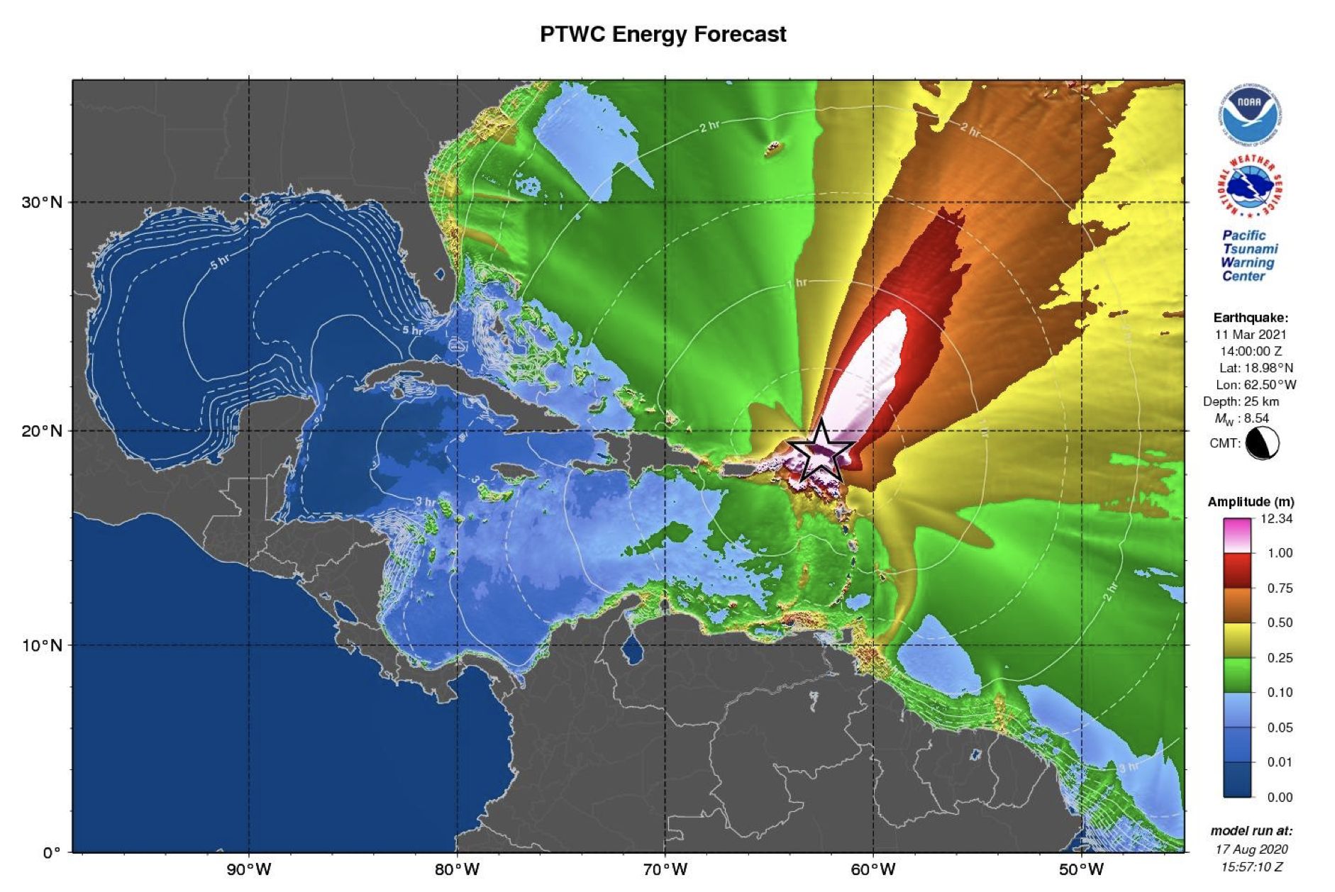
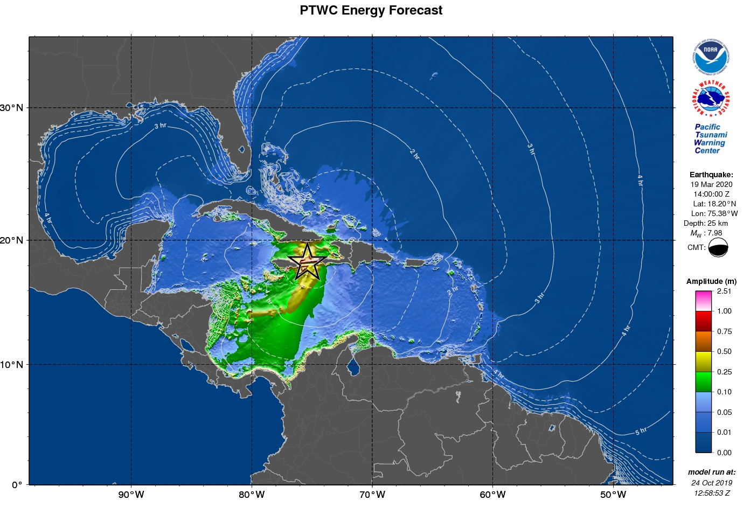
CARIBE WAVE 21
11 March 2021 14 UTC
2 scenarios: Jamaica & Lesser Antilles
47/48 MS participated
333,515 people

Slide 17
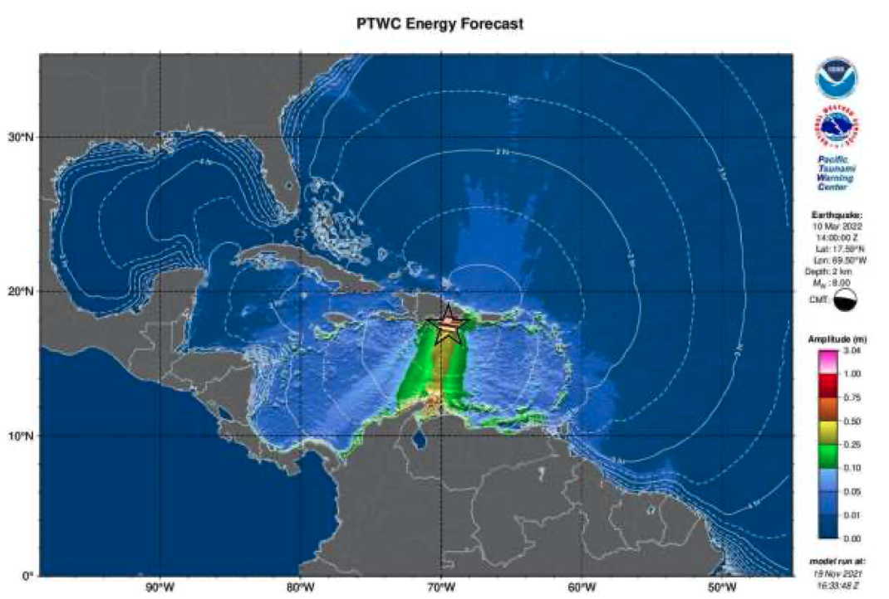
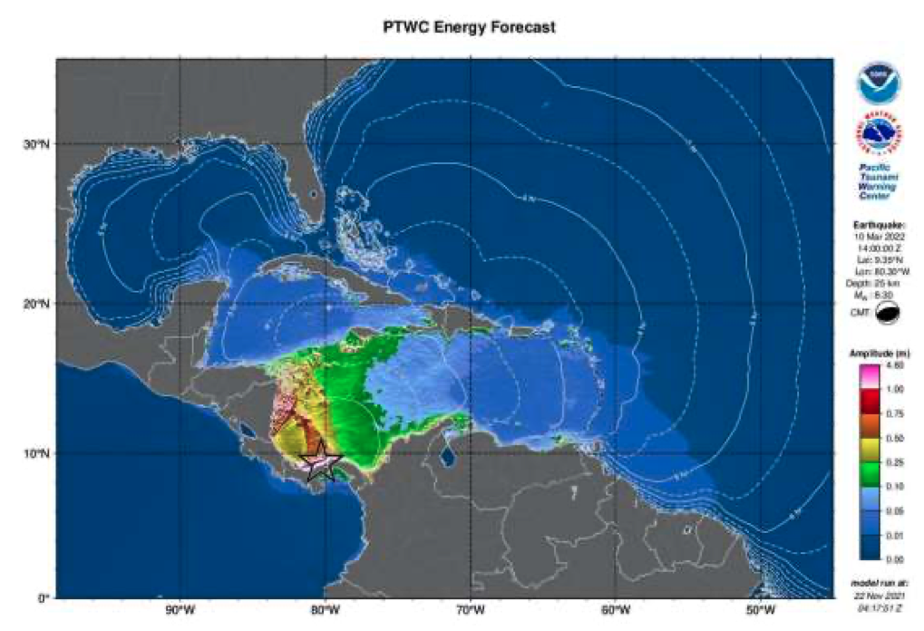
CARIBE WAVE 2022
EQ along Western Muertos Trench
EQ northern Panamá
Discarded: flank collapse at Cumbre Vieja due to recent increased volcanic activity

Slide 18
Thank you!
Silvia Chacón-Barrantes
silviach@una.ac.cr
+506-8309-6690

