Slide 1
• 5.4 Review of contributions to the Decade
“Inventory of actions being considered under the United Nations Decade of Ocean Science for Sustainable Development (2021–2030) in the field of tsunamis and other sea-level related hazards warning and mitigation”
CL-2825 (6 January 2021) invited Member States and Observers to contribute information (by 15 February 2021) - using a dedicated questionnaire - on UN Decade tsunami-related specific actions promoted/requested that align with the components of UNDRR People-Centered Early Warning Systems including:
  1. Risk Knowledge.
  2. Monitoring and Warning.
  3. Warning Dissemination and Communication.
  4. Response Capability, and
  5. Capacity Development and Attention to SIDS and LDCs.

Slide 2
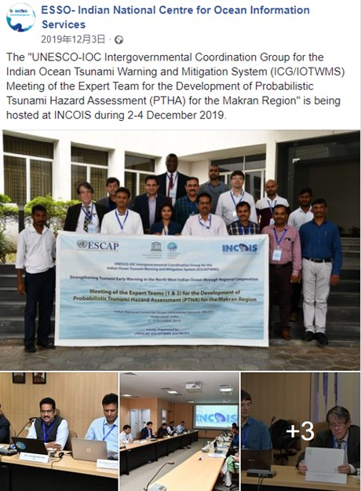
Risk Knowledge
Understanding the risk and developing a plan to mitigate the risk is what saves lives. While tsunamis are infrequent, and the catastrophic ones rare, historical record shows that tsunamis have the potential to hit every coast around the world – we don’t know when, where, or how big.
Member States identified in their responses several elements of ongoing programmes (PTHA in the Indian Ocean - Makran and South West Pacific) and/or specific requests to improve national capabilities to perform hazard and risk assessment.

Slide 3
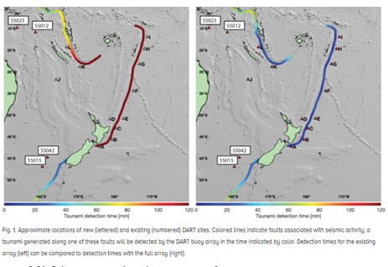
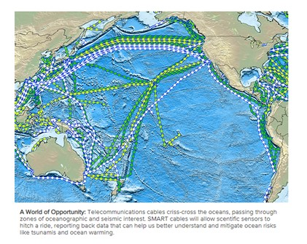
2.- Monitoring and Warning
To improve through faster tsunami detection and more accurate tsunami threat assessment and impact forecast, Member States identified the requirement for denser real-time, multi-faceted sensor networks, and faster, integrated algorithms to quickly characterize the tsunami source (seismic and atypical sources) and compute tsunami inundation forecasts for their coasts. Sensors include singly or array-deployed high-quality seismometers and accelerometers, coastal sea level gauges and deep-ocean pressure systems (DART), dedicated seafloor observatories and trans-basin undersea cables (such as SMART), and GNSS land and sea elevation buoys. High-resolution coastal bathymetry and topography (DEM) contributions were identified (SEABED 2030, LIDAR).

Slide 4
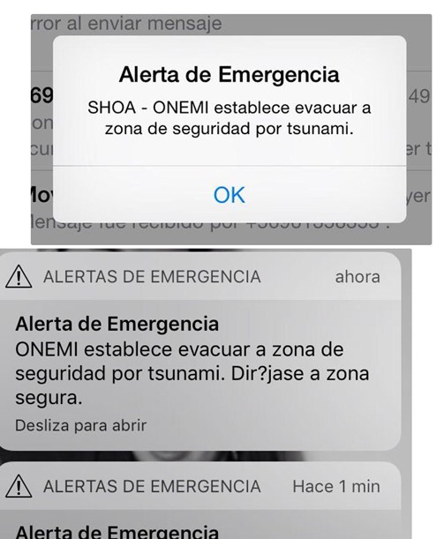
3.-Warning Dissemination and Communication
A tsunami warning and evacuation advice is only effective when it reaches a person on the coast in time before a destructive wave hits. Both the dissemination (its timeliness and reliability) and the communication of the advice (what the message says) must be successful or lives may be unnecessarily lost. Member States identified the strengthening and enhancing of their end-to-end warning chains. Additionally, incorporating tsunami warning dissemination (which may be infrequent) into Multi-Hazard communication systems will help to ensure sustainability and readiness.

Slide 5
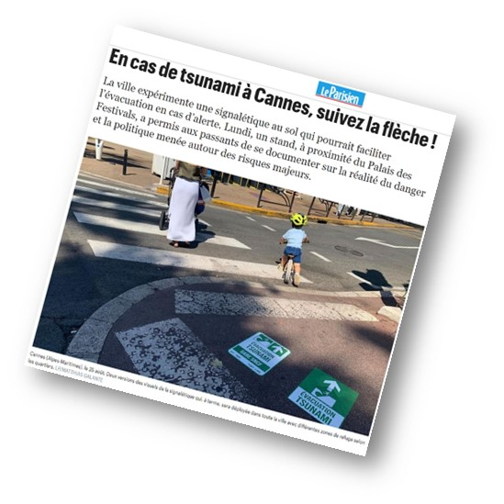
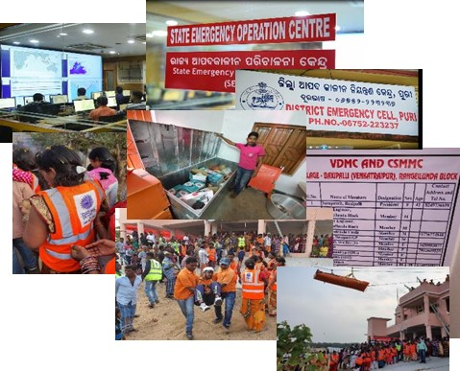
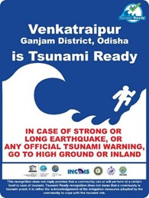
4. Response Capability
As disasters are foremost local, it will be coastal communities that suffer the brunt of impact from the next tsunamis. The UNESCO IOC Tsunami Ready programme motivates communities to take common-sense preparedness actions, that include hazard assessment, inundation and evacuation mapping, awareness and education and exercises. Tsunami Ready was identified by most of Member States as a priority activity. Novel initiatives like the Blue-Line project around New Zealand coastlines may also be disseminated in the context of Tsunami Ready. Last but not the least the World Tsunami Awareness Day (WTAD) was also mentioned by Member States as a mean of increasing awareness and preparedness.

Slide 6
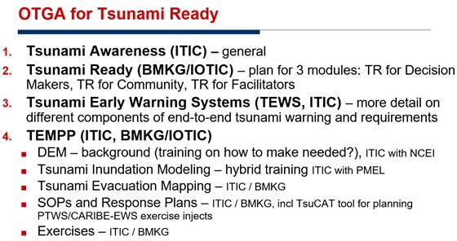
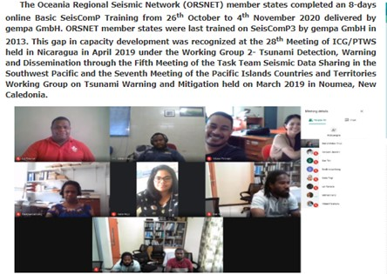
5. Capacity Dev. and Attention to SIDS and LDCs
Capacity Development to mitigate against tsunamis continues to be a critical need for SIDS and LDCs. Training has been organized and conducted by the IOC and regional organizations, but it has not been frequent-enough to meet their requests. The development of online, on-demand, and hybrid training, such as through the IOC Ocean Teacher Global Academy (OTGA), will help to significantly broaden the audience reach and availability of trainings globally.
Multi-sectoral tsunami exercises, complemented by education and awareness campaigns, have been embraced by Member States contributions as key preparedness activities that test warning and response procedures, alerting, and community evacuation responses. SIDS Member States identified the need for Regular technical training (i.e. SeisComP for seismic monitoring) and promotion of Wave exercises, National Drills and WTAD

Slide 7
Upon the deadline, 15 February 2021, the IOC Tsunami Unit received input from 44 Member States and Observers, 13 Indian Ocean Member States 19 Pacific Member States and 9 Caribbean Member States.
The Secretariat recommends to re-issue the Circular Letter when a first draft of the SC Plan become available. This would provide a more clear framework for submissions.

