Slide 1

MEETING OF THE INTER-ICG TASK TEAM ON DISASTER MANAGEMENT AND PREPAREDNESS
INTERGOVERNMENTAL OCEANOGRAPHIC COMMISSION UNESCO.
TOWS Task Team on Disaster Management Preparedness (TT-DMP) Members 21 - 22 February 2022 - On-line
DEVELOPING TSUNAMI READY PROGRAMME IN NEAM REGION
Cecilia Valbonesi
University of Florence, Italy
INGV, Italy

Slide 2
TSUNAMI READY COMMUNITIES
IN NEAM REGION
SPAIN: Chipiona
FRANCE: Cannes
ITALY: Palmi, Minturno, Marzamemi
TURKEY: Bodrum, Didim, Marmaris, Fethiye and Kaş were identified potential Tsunami Ready candidates
The contribution of Last Mile Project to TR
IOC EU ECHO NEAMTWS - CoastWave Project

Slide 3
TSUNAMI READY IN SPAIN:
CHIPIONA
IHCantabria is finalizing the first phase of a project, with the support of the University of Malaga and sponsored by the Municipality of Chipiona, aimed at preparing the municipality of Chipiona for a potential tsunami event.
The project is framed within the internationally recognized Tsunami Ready program,

Slide 4
TSUNAMI READY IN SPAIN:
CHIPIONA
Throughout this first phase of the project, coordinated by IHCantabria experts Ignacio Aguirre Ayerbe and Mauricio González, several activities have been carried out with the purpose of obtaining such recognition.
First, tsunami inundation and evacuation maps were modelled and produced for the municipality and the preliminary results of these maps were presented last September to a group of key stakeholders in the municipality at an on-site desk validation workshop.
The work developed also included an exercise, held last October, in which the time needed for the population to move on foot to a safe area along the evacuation routes was analysed. This took into account, on the one hand, different types of population and on the other hand, different conditions of the routes, in terms of limitations and intensity of use.

Slide 5
TSUNAMI READY IN SPAIN:
CHIPIONA
The regional drill "RespuestA 21" took place, coordinated by the Junta de Andalucía, where the mechanisms and response times in terms of communication in the municipality of Chipiona were examined, in the event of a potential tsunami event.
Finally, with the support of the tsunami team of IHCantabria, the municipality of Chipiona inaugurated last November 3, 2021, a Tsunami Ready office with a permanent exhibition open to the public to raise awareness and thus to contribute to the preparation of the community for such events.

Slide 6
TSUNAMI READY IN SPAIN:
CHIPIONA
Since the XVII ICG Session (November 2021) the first phase of the project has already finished and the evacuation maps have been already submitted to the local authorities.
Chipiona is currently preparing to move forward with the Tsunami Ready program through the CoastWave project.

Slide 7
TSUNAMI READY IN FRANCE:
CANNES
The TR pilot site for France is the municipality of Cannes. ➯Five main actions have been carried out all year long:
1. Experiments on the population alert capacities: testing of the different channels for broadcasting an alert (siren, loudspeakers, SMS/Calls) and improvement of the alert messages broadcasted to the population;
2. Finalization of evacuation plans and the online publication of an interactive map;
3. Validation of a tsunami signage with the representatives (after having presented several samples of different supports);
4. Extension of the tsunami Charter to hotel owners: it was signed on November 5th during a seminar led by the Cannes Mayor’s
office;
5. Exercise on November 5 ( signposting of two tsunami evacuation routes, testing of messages via loudspeakers) which mobilized the Civil Security Reserve of the city of Cannes, students from the University of Montpellier 3 and passers-by.

Slide 8
TSUNAMI READY IN FRANCE:
CANNES
At the national level, it is going to be created the French regional committee (with the TNC and a representative of CEA/CENALT). We hope to submit the composition to UNESCO soon, following the model of what has been done by Italy.
A funding is being requested in order to work on the prevention of tsunami risk in France according to a particular axis around the maritime domains and the specific stakes of tourist accommodations.

Slide 9
TSUNAMI READY IN FRANCE:
CANNES
Other actions carried out this year :
1. Every month, the tsunami alert chain is tested by the national civil security (DGSCGC).
2. Every three months, local authorities are associated. This is an opportunity for the municipalities to work on their procedures and to think about prevention actions.
3. The standard operating procedures of the Bouches-du-Rhône department were reviewed and tested during an exercise that took place on November 4. This exercise involved the city of Marseille (2nd French city!) and industrial sites with high technological risks.
4. France participate in the CoastWave project.

Slide 10
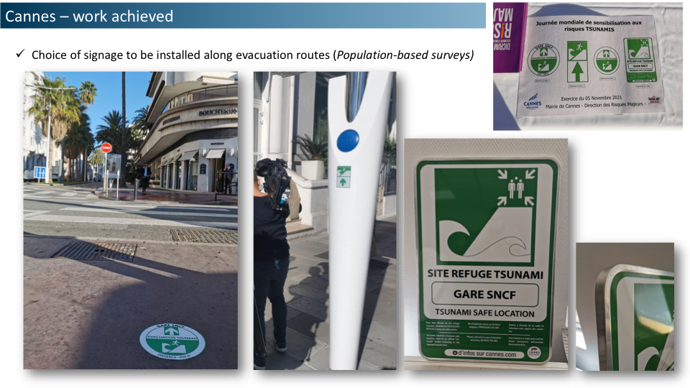
TSUNAMI READY IN FRANCE:
CANNES
Other actions carried out this year :
1. Every month, the tsunami alert chain is tested by the national civil security (DGSCGC).
2. Every three months, local authorities are associated. This is an opportunity for the municipalities to work on their procedures and to think about prevention actions.
3. The standard operating procedures of the Bouches-du-Rhône department were reviewed and tested during an exercise that took place on November 4. This exercise involved the city of Marseille (2nd French city!) and industrial sites with high technological risks.
4. France partecipate in the CoastWave project.

Slide 11
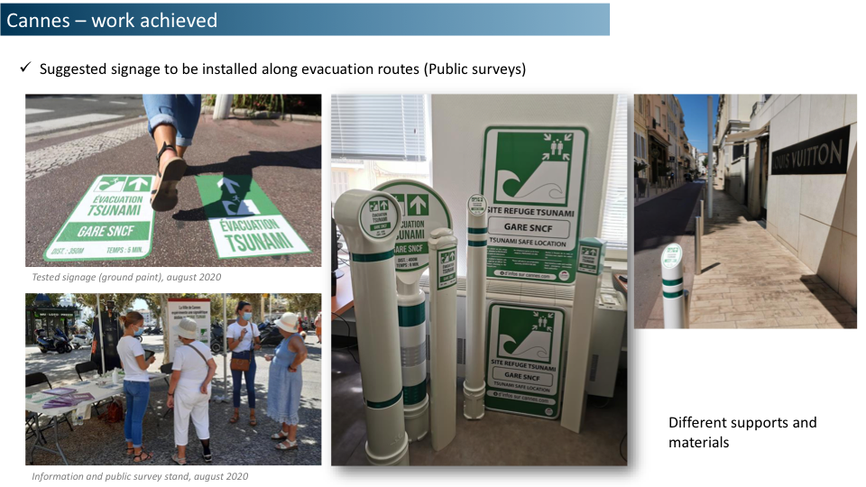
TSUNAMI READY IN FRANCE:
CANNES
Other actions carried out this year :
1. Every month, the tsunami alert chain is tested by the national civil security (DGSCGC).
2. Every three months, local authorities are associated. This is an opportunity for the municipalities to work on their procedures and to think about prevention actions.
3. The standard operating procedures of the Bouches-du-Rhône department were reviewed and tested during an exercise that took place on November 4. This exercise involved the city of Marseille (2nd French city!) and industrial sites with high technological risks.
4. France partecipate in the CoastWave project.

Slide 12
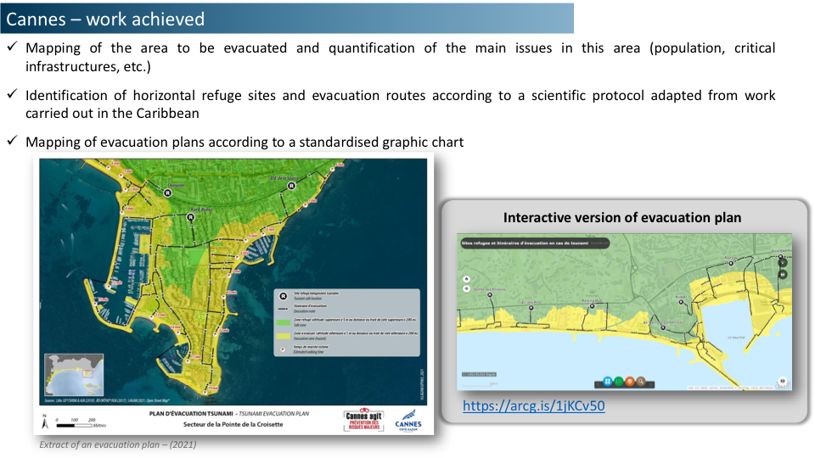
TSUNAMI READY IN FRANCE:
CANNES
Other actions carried out this year :
1. Every month, the tsunami alert chain is tested by the national civil security (DGSCGC).
2. Every three months, local authorities are associated. This is an opportunity for the municipalities to work on their procedures and to think about prevention actions.
3. The standard operating procedures of the Bouches-du-Rhône department were reviewed and tested during an exercise that took place on November 4. This exercise involved the city of Marseille (2nd French city!) and industrial sites with high technological risks.
4. France partecipate in the CoastWave project.

Slide 13
TSUNAMI READY IN FRANCE:
CANNES
Other actions carried out this year :
1. Every month, the tsunami alert chain is tested by the national civil security (DGSCGC).
2. Every three months, local authorities are associated. This is an opportunity for the municipalities to work on their procedures and to think about prevention actions.
3. The standard operating procedures of the Bouches-du-Rhône department were reviewed and tested during an exercise that took place on November 4. This exercise involved the city of Marseille (2nd French city!) and industrial sites with high technological risks.
4. France partecipate in the CoastWave project.

Slide 15
TSUNAMI READY IN GREECE: SAMOS
The progress Greece has made on the Tsunami Ready implementation can be summarized in these bullets:
The town of Samos has been identified as the community to implement the CoastWAVE/UNESCO project activities in Greece.
The municipality of Eastern Samos has agreed to participate in the project.
Currently they are preparing the project implementation work plan and schedule.

Slide 16
TSUNAMI READY IN GREECE
The progress Greece has made on the Tsunami Ready implementation:
The town of Samos has been identified as the community to implement the CoastWAVE/UNESCO project activities in Greece.
The municipality of Eastern Samos has agreed to participate in the project.
Currently at the stage of preparing the project implementation work plan and schedule.

Slide 17
TSUNAMI READY IN ITALY: PALMI
PALMI (Tyrrhenian Sea, CALABRIA):
On December 30, 2020, the Municipal Council of Palmi decided officially to participate in the TR programme The Municipal Council nominated the Tsunami Ready Local Committee
On November 15, 2021, a new Regulatory Plan and Civil Protection Plan was officially approved
Several of the TR 12 indicators are completed

Slide 18
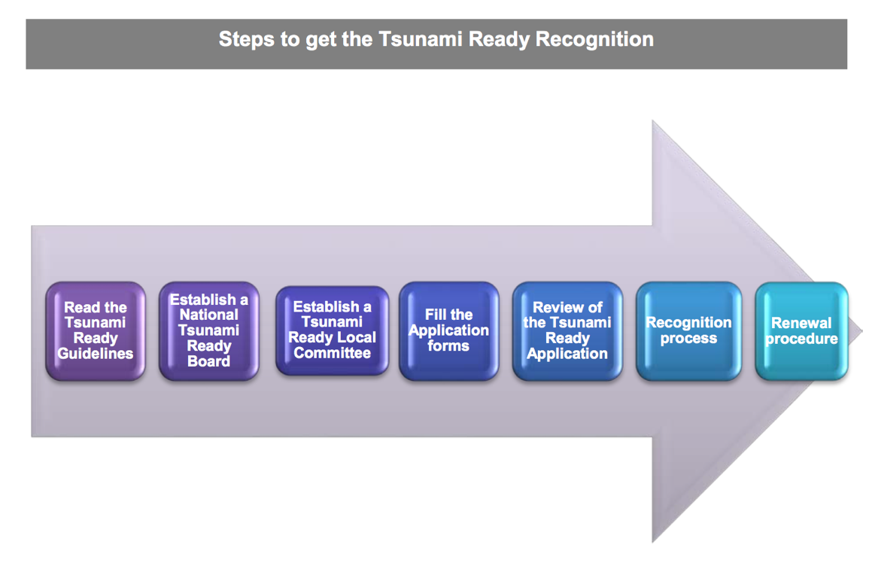



Tsunami Ready in Italia
3 - TSUNAMI READY in Italy
3 pilot sites: Minturno (Lazio), Palmi (Calabria), Pachino (Sicilia)
2021 achievements:
- First TRNB in the NEAM region (DPC+INGV+ISPRA)
- Three TR Local Committees established

Slide 19
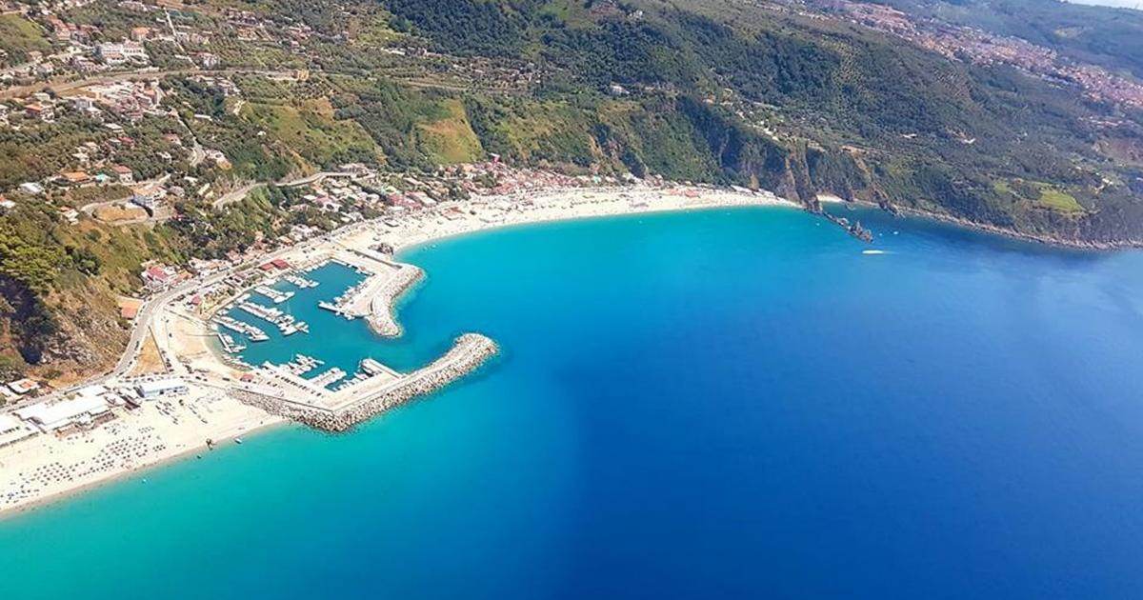
TSUNAMI READY IN ITALY: PALMI
On December 30, 2020, the Municipal Council of Palmi decided officially to participate in the TR programme
On May 10, 2021, he Municipal Council nominated the Tsunami Ready Local Committee
On November 15, 2021, a new Regulatory Plan and Civil Protection Plan was officially approved (including tsunami risk)
Several of the 12 TR indicators are completed (see next slides)
A 32 pages booklet on the TR project has been published, it will be distributed to students and in the coastal facilities

Slide 20


TSUNAMI READY IN ITALY: PALMI

Slide 21
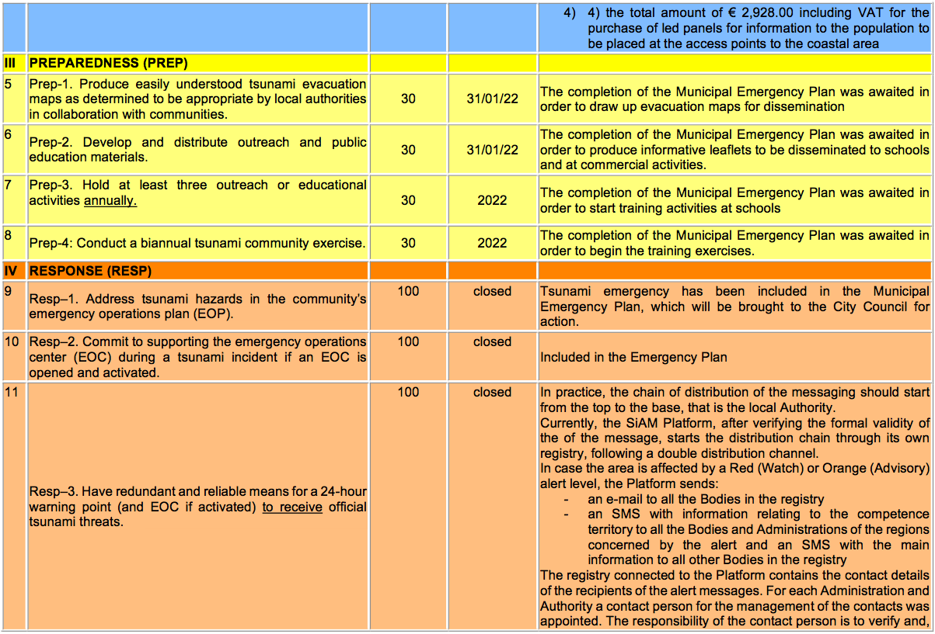
TSUNAMI READY IN ITALY: PALMI

Slide 22
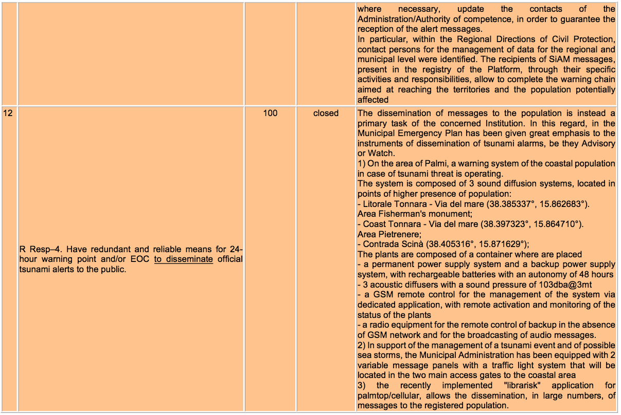
TSUNAMI READY IN ITALY: PALMI

Slide 23
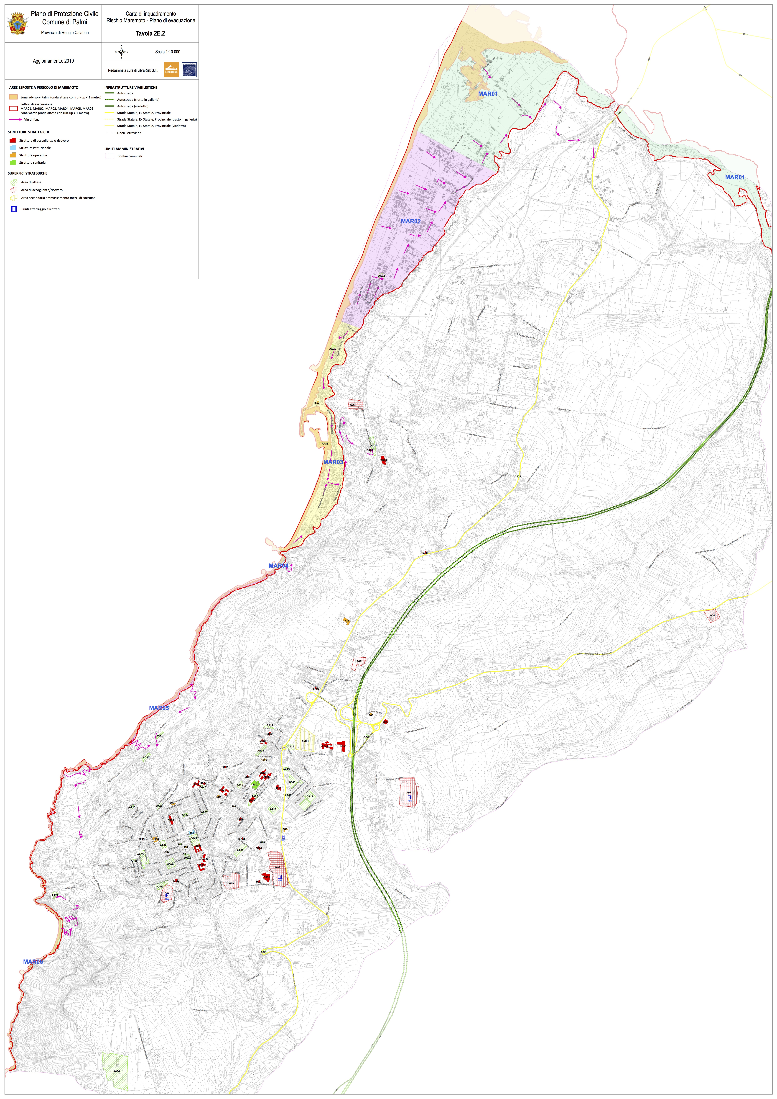
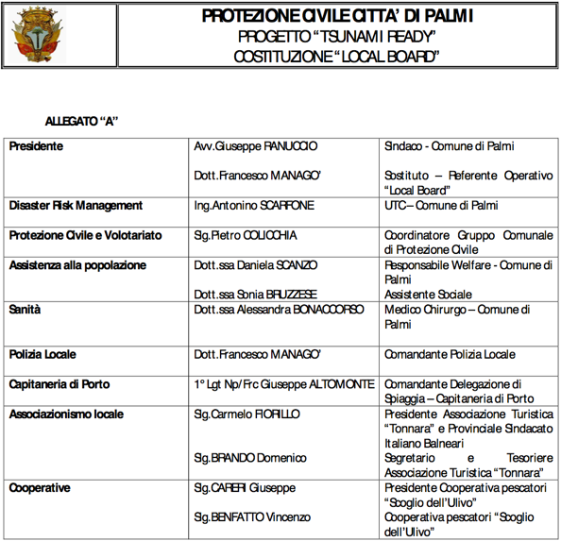
TSUNAMI READY IN ITALY: PALMI

Slide 24
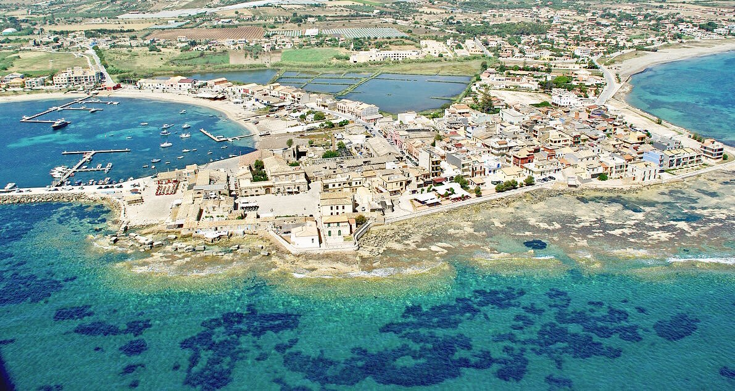
TSUNAMI READY IN ITALY:
PACHINO (MARZAMEMI)
MARZAMEMI (Ionian Sea, SICILY)
On April 28, 2021, Marzamemi officially joined the project with a Municipal Council resolution
Note: The municipality was commissioned until October 2021. In a meeting last December the newly elected Mayor has declared her will to pursue the TR objective. Contacts are going on.

Slide 25
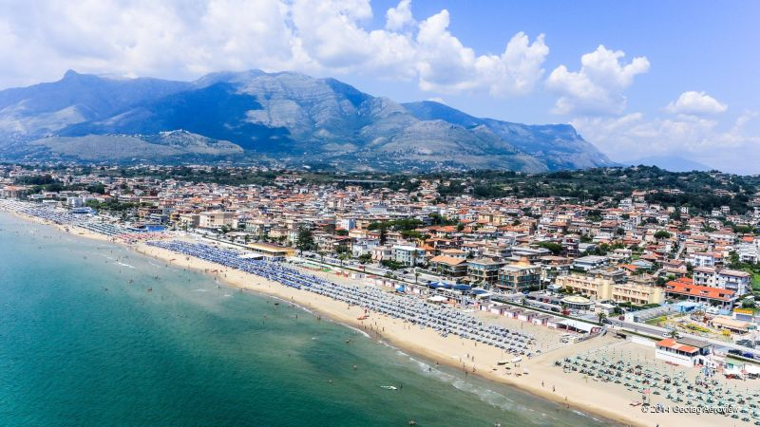
TSUN TSUNAMI READY IN ITALY: MINTURNO
PALMI
a) On March 3, 2021, the TR Local Committee was nominated (see the document in next slide).
b) During the NEAMWAVE exercise on 9 March 2021, sirens and warning lights were tested, as well as the operation level of the APP Alert System.
c) The vertical evacuation of the school was also a very valuable moment because it led to the pupils asking a lot of questions and overall asking to be informed about tsunami risk. A specific educational project is being prepared to follow up on these questions.
d) Most part of Tsunami Ready indicators will be soon completed (see next slides)

Slide 27
TSUN TSUNAMI READY IN ITALY: MINTURNO
PALMI

Slide 28
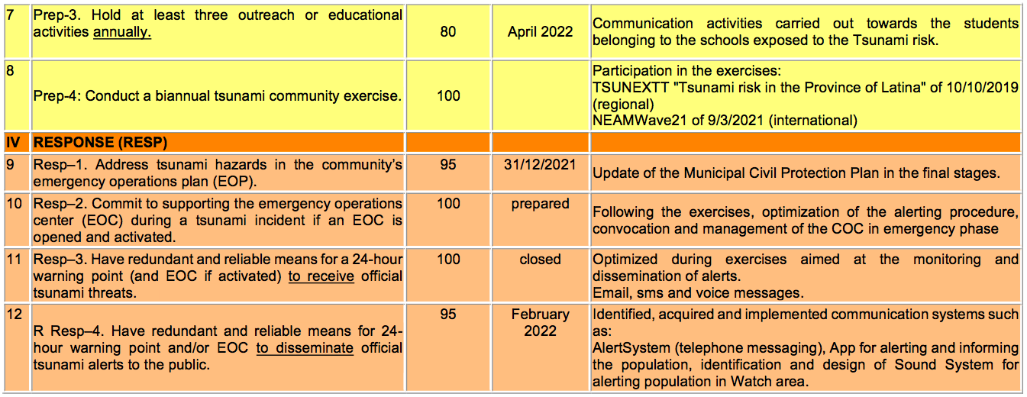
TSUN TSUNAMI READY IN ITALY: MINTURNO
PALMI
General Score: 1050 / 1200 = -150

Slide 29
TSUNAMI READY IN TURKEY
Bodrum has a great potential to be identified as a possible Tsunami Ready location in Turkey.
Due to their geographical proximity and degree of similarity in tsunami risk, Didim, Marmaris, Fethiye and Kaş were identified as additional potential Tsunami Ready candidates.
In addition, significant progress has been made in Istanbul, where tsunami modelling, vulnerability and hazard analysis reports have been prepared for each coastal municipality and published online by the Istanbul Metropolitan Municipality in close cooperation with METU.
unam-blg-ktapiklari

Slide 30
TSUNAMI READY IN TURKEY
As communicated during the second meeting of WG4-Tsunami Ready Group on 30 June 2021, Prof. Dr. Ahmet Cevdet Yalçıner from METU was nominated on 5 July 2021 as an additional member of WG4-Tsunami Ready Group (now TT on Tsunami Ready).
In September 2021, Istanbul Metropolitan Municipality started the installation of tsunami evacuation signages in Büyükçekmece district in the European part of Istanbul as a pilot project.
The municipality aims to finalize the installation of tsunami evacuation signages in all coastal districts facing Marmara Sea by the end of 2022.

Slide 31
TSUNAMI READY IN PORTUGAL
Tsunami Awareness Day, 5th November 2021
ANEPC organized a webinar on “Management of Tsunami Risk: Alert, Warning and Evacuation”.
The same day ANEPC announced the publication of the “Reference Guide for Tsunami Evacuation Planning” available online in the collection of technical documents PROCIV: http://www.prociv.pt/bk/EDICOES/CADERNOSTECNICOS/Documents/CT_28_Guia%20de%20Refer%C3%AAncia%20para%20Planeamento%20de%20Evacua%C3%A7%C3%A3o%20em%20caso%20de%20Tsunami.pdf
Many institutions (IDL, IH, UC, LNEC, IPMA, CERU) followed the recommendations of the Portuguese IOC Delegation and advertised publicly the day and distributed the tsunami leaflet on Tsunami Risk prepared in 2019 by CERU available at http://www.ceru-europa.pt/pt/downloads/Folheto_Tsunami_v6.pdf

Slide 32
TSUNAMI READY IN PORTUGAL
NEAMWAVE’21 Exercise
ANEPC participated on all exercise phases aiming to test the effectiveness of the information transmission procedures as defined by the Operational Directive (4105/2018) regarding the reception of the tsunami alert messages produced by the Tsunami Service Providers in the NEAM region operational at the time of the exercise.
ANEPC tested the procedures that consider a simultaneous notification of the information provided by IPMA to the headquarters (CNEPC) and to the Regional Commands for Relief Operations (CDOS).
The exercise was conducted by ANEPC in mode CPX (Command Post Exercise) involving all coastal districts from North to South of Portugal mainland. Several notification methods were tested, namely SMS, e-mail, fax and voice, between the National Command for Emergency and Civil Protection (CNEPC), the District Commands (CDOS), the Municipality Services for Civil Protection (SMPC), the Firefighters Brigades, the General Direction for the Maritime Authority (DGAM), the National Maritime Search and Rescue service (MRCC) and 8 entities responsible for critical infrastructures and to provide essential services.

Slide 33
TSUNAMI READY IN PORTUGAL
The Regional Services for Emergency and Civil Protection from Madeira and the Azores participated for the first time on a tsunami exercise.
IPMA and CENALT were the agencies at ICG/NEAMTWS responsible for the preparation of the tsunami scenario that was run in Portugal and other participating countries in the NE Atlantic.
IPMA, as a Tsunami Service Provider for the NE Atlantic and the National Authority for Tsunami Warning, issued the Tsunami Alert Messages according to the scenario, using the established communication protocols to the service subscribing countries, among others, Morocco, Spain, United-Kingdom, Denmark, France, Germany, Ireland.

Slide 34
TSUNAMI READY AND
LAST MILE IN MALTA
During the final exercise of theTsunami Last Mile 2 project in Malta (of 5 November 2021, i.e. the Tsunami World Awareness Day ):
all the newly installed devices for tsunami warning of the local community were tested (2 seismographs; 2 IDSLs – Inexpensive Devices for Sea Level monitoring; 2 TADs – Tsunami Alerting Devices; 1 long-range siren)
the alert messages from the regional tsunami service provider (CAT-INGV) were received and integrated in the draft tsunami emergency protocol (SOP) at test during the exercise
all the emergency response system, local and national, was mobilized
all the residents in the expected inundation area of Marsaxlokk were invited to evacuate via newly identified evacuation routes, following the tsunami evacuation signs (temporarily installed for the exercise), towards the meeting/assembly points.
AN ANALYSIS OF THE EXERCISE OUTCOMES AGAINST THE TSUNAMI READY INDICATORS WILL ALSO BE PERFORMED.

Slide 35
LEGAL IMPLICATIONS OF PILOTING TSUNAMI READY-INITIATIVES
A study on the impact of TR guidelines on the responsibilities of scientists, public administrators and civil protection officers has been completed. ⬇︎
⬇︎⬇︎⬇︎⬇︎☟
The research started from Italy regulatory framework
It could be extended to other NEAM COUNTRIES

Slide 36
LEGAL IMPLICATIONS OF PILOTING TSUNAMI READY-INITIATIVES
The following issues were analysed:
1. Nature of regulatory source: guidelines-soft law
2. Positioning of soft law guidelines in national legal framework.
3. Relationship with national legislation on risk: D.lgs. 1/2018 and guidelines of 2018 of the Department of Civil Protection on tsunami risk: although TR guidelines are an international soft law, they have a supplementary role in the legislation as to the prescriptions that must be adopted.
4. The responsibility of the local board: the members have a recognition role. It means that there is no direct responsibility on their part, unless they directly take civil protection decisions, "de facto" supporting the measures taken by the mayor or the civil protection manager. Those who who are in charge in national and local civil protection, remain responsible for their tasks.
5. The TR National Board has a role of recognition that does not involve a direct responsibility unless its members do not interfere in the choices of municipality’ civil protection .
6. The adoption of the TR program is a voluntary choice. However, its dissemination and accreditation around the world may represent a paradigm of behaviour for mayors and local civil protection authorities, whether or not they have joined the program.

Slide 37
TSUNAMI READY: some thoughts based on the Italian experience
Enthusiastic response of the municipalities (due to the interest of international, national, regional authorities and scientific institutions)
It takes time to have the burocracy done (letters, formal decisions, etc.) but it is extremely important to have formal commitments
The role and attitude of the Mayors is very important
The presence of a delegate reference person is crucial
This delegate must be smart, enthusiast, and must have the power to decide (delegated by the Mayor and the municipal council)
”Competition” among municipalities could be good (with caution)
Appraisal of the legal responsibilities is also important

Slide 38
Tsunami Ready: criticalities
Many (too many?) administrative levels
Burocracy (needs simplification)
Other priorities (COVID19, but also tourism, other risks, etc.)
Limited amount of money available
Change of Mayor, Council etc.
Schools (higher degrees) are important
Reaching ALL citizens (+ visitors): impossible?

Slide 39
Tsunami Ready: what we need
Formal involvement of all administrative levels
Continuous interactions among scientists and CPA
An enthusiastic Mayor
A reference/contact person
Patience (burocracy, slowness, other priorities)
Money (≈ a few tens of K€ for a 10K-100K citizens’ municip.)
Continuity (of contacts, requests, meetings)
Redundant information channels

Slide 40
THANK YOU FOR YOUR ATTENTION

