Slide 1
Propose additional actions for concept paper
IOC Circular letter, 2825:
Protecting Communities from the World’s Most Dangerous Waves: A Framework for Action under the UN Decade of Ocean Science for Sustainable Development
Harkunti Pertiwi Rahayu
Member of TOWS TTDMP

Slide 2
Propose additional actions for concept paper
(IOC Circular letter, 2825 )
Risk Knowledge:
  Fully understand the impacts to the built environment (cities) and know how to minimize them through tsunami DRR based urban planning.
Response Capability:
  Ensure plans to minimize impacts to built environment are in place to enable quicker post-tsunami restoration of basic services.

Slide 3
Rationale for proposing additional actions
Complying UN Decade of Ocean Science for Sustainable Development with SFDRR (Sendai Framework for DRR) and SDGs (Sustainable Development Goals) #11

Slide 4
Seven Global Targets of SFDRR (2015-2030)
Substantially Reduce by 2030:
Global disaster mortality → 100,000 global mortality rate.
Number of affected people globally → 100,000 people.
Direct disaster economic loss in relation to global Gross Domestic Product (GDP)
Disaster damage to critical infrastructure and disruption of basic services, among them health and educational facilities, including through developing their resilience
Substantially Increase by 2030:
Number of countries with national and local DRR (disaster risk reduction) strategies.
International cooperation to developing countries through adequate and sustainable support to complement their national actions for implementation of this Framework.
Access to multi-hazard early warning systems (MHEWS) and disaster risk information and assessments

Slide 5
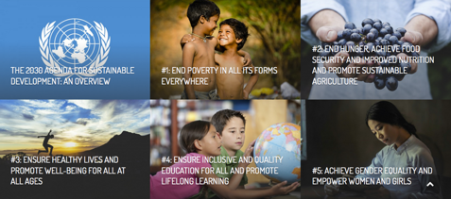
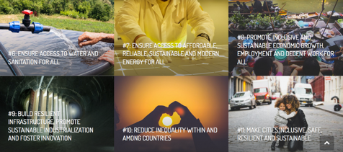
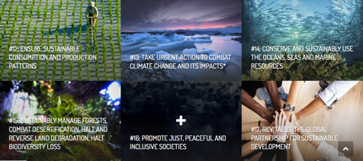
SDGs
Each goal is
important
in itself …
And they
are all
connected
Realizing sustainable and resilient development, which focuses on aspects of human (people), environment (planet) and prosperity (prosperity).

Slide 6
Role of SFDRR in SDGs
#11: Make cities inclusive, safe, resilient and sustainable
Goal 11 is to make cities and human settlements inclusive, save, resilient and sustainable
  By 2030: significantly reduce number of deaths, number of people at risk, and direct economic losses caused by disaster, including water-related disaster.
  By 2020: goal 11 targets on substantially increase number of cities and human settlement in adopting and implementing integrated policies and plans toward inclusion, resource efficiency, mitigation and adaptation to climate change, resilience to disasters, and develop and implement holistic disaster risk management at all levels.
→ The important of mainstreaming Tsunami DRR in urban planning

