Slide 1
World Tsunami Awareness Day (WTAD) 2022
Rosalind Cook
Head, Campaigns and Community, Communications Unit, UNDRR
TT DPM meeting February 2022

Slide 2
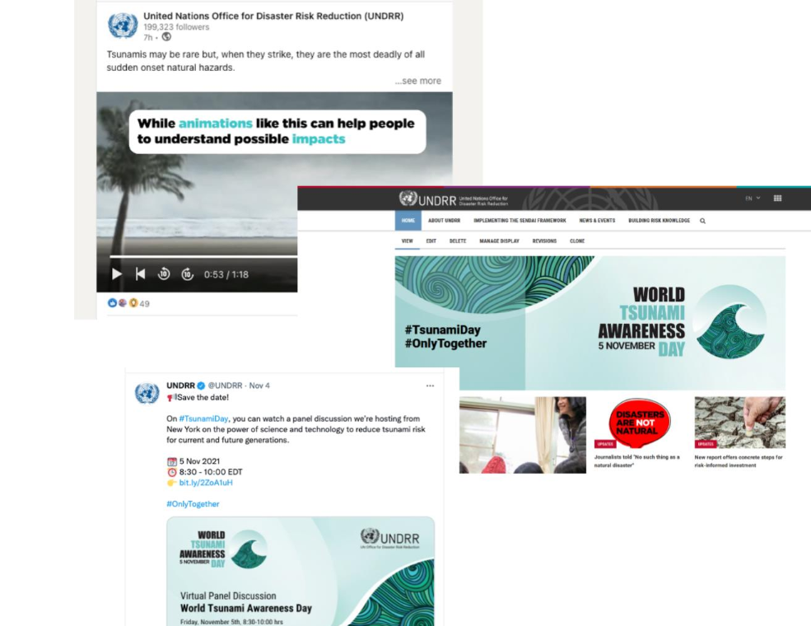
2021 WTAD Highlights
Major events in New York, Asia Pacific, Africa and the Caribbean
World Tsunami Awareness Day campaign had 194 million impressions
Videos inc on Facebook about Japan using virtual reality to train children. It generated 1.1 million views, and over 54,000 reactions and shares.
#TsunamiDay was used by nearly 3,400 accounts including @UN and @UNESCO and mentioned by almost 6,000 times.

Slide 3
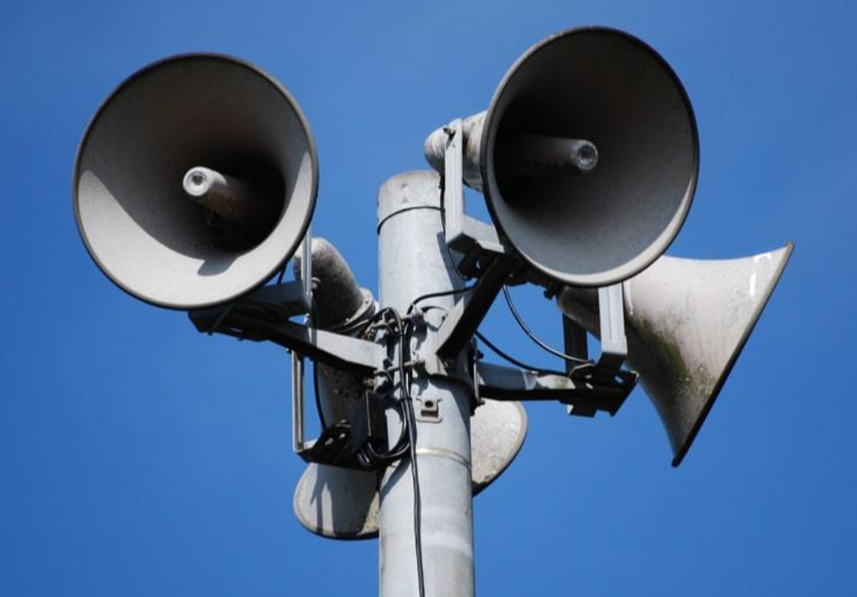
2022 WTAD Theme
Global target G: Substantially increase the availability of and access to multi‑hazard early warning systems and disaster risk information and assessments to the people by 2030.

Slide 4
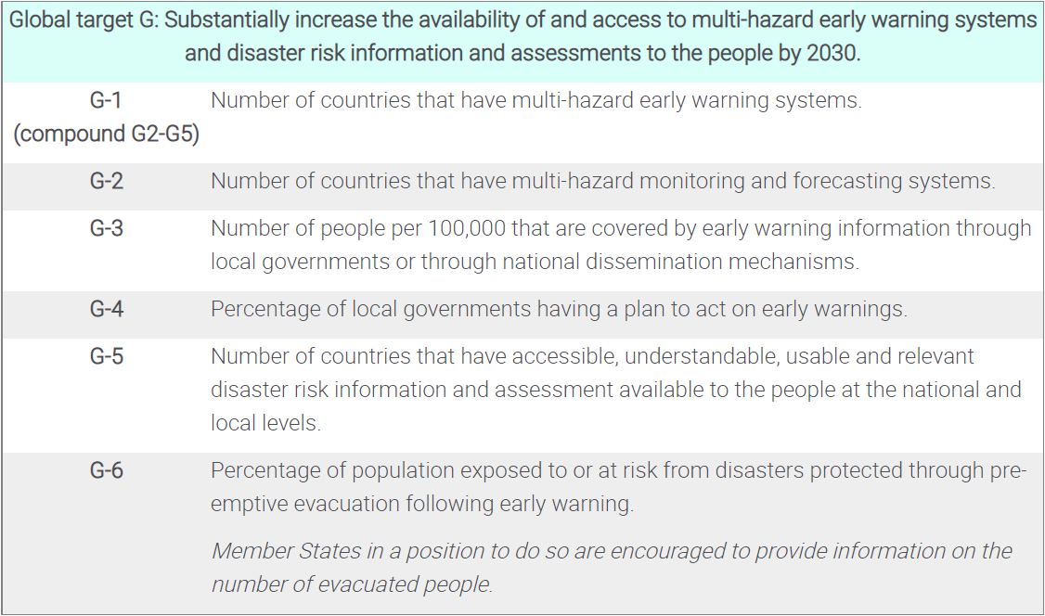
Sendai FW target G: multi‑hazard early warning systems

Slide 5
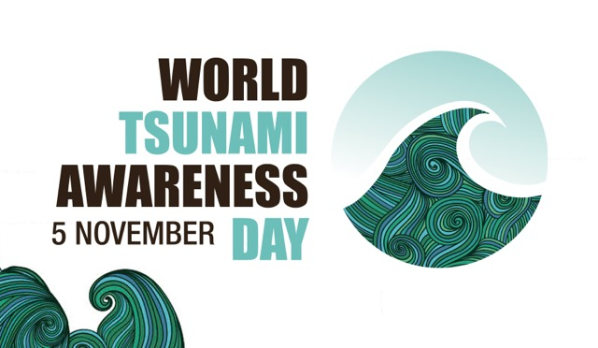
2022 Calendar
World Meteorological Day 23 March 2022
Global Platform for Disaster Risk Reduction, Bali Indonesia
United Nations Ocean Conference 27 June to 1 July 2022
International Day for Disaster Risk Reduction 13 October 2022
World Tsunami Awareness Day 5 November 2022
Words into Action Call for Good Practices and Lessons Learned on Early Warning Systems with focus on Multi-hazards 28 February

Slide 6
The Four Objectives for 2022 WTAD
PROMOTE: good practice on increasing the availability of access to multi‑hazard early warning systems to reduce tsunami risk in line with Target (g) of the Sendai Framework;
ADVOCATE: follow on the advocacy of IOC-UNESCO Tsunami Ready programme across the four regions, Indian Ocean, Pacific Ocean, Caribbean, North-East Atlantic, Mediterranean and Connecting Seas as a key element of the UN Ocean Decade;
RECOGNISE: focus on communities which are increasing access to multi‑hazard early warning systems and raising public awareness through schools, museums, and other communication channels;
CAMPAIGN: launch WTAD campaign focusing on Sendai Framework Target (g), encouraging improved access to multi‑hazard early warning systems, with a focus on tsunami and ocean-related risk, linking with the UN Ocean Decade.

Slide 7
Rosalind.cook@un.org

