Slide 1




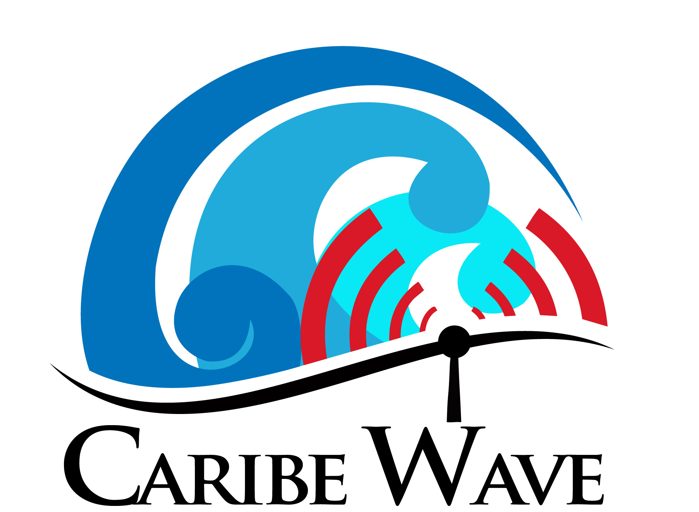
CARIBE WAVE Exercise
JOINT MEETING OF THE INTER-ICG TASK TEAMS ON DISASTER MANAGEMENT AND PREPAREDNESS and TSUNAMI WATCH OPERATIONS
Agenda Item J3
VIRTUAL
February 21, 2022
Alison Brome
Coastal Hazards Officer
CTIC, UNESCO/IOC
Christa G. von Hillebrandt-Andrade
Deputy Director, NOAA NWS ITIC Caribbean Office
ICG CARIBE-EWS WG IV Chair
Dr. Elizabeth A. Vanacore
Seismologist, Puerto Rico Seismic Network
ICG CARIBE-EWS CARIBE WAVE TT CHAIR

Slide 2
CARIBE WAVE Exercise Objectives
1. Exercise and evaluate communications between Regional Tsunami Service Provider and Members States/Territories.
A. Validate the issuance of tsunami products from the PTWC.
B. Validate the receipt of tsunami products by CARIBE-EWS Tsunami Warning Focal Points (TWFPs) and/or National Tsunami Warning Centers (NTWCs).
2. Evaluate the tsunami procedures and programs within Members States/Territories.
A. Validate readiness to respond to a tsunami.
B. Validate the operational readiness of the TWFPs/NTWCs and/or The National Disaster Management Office (NDMO).
C. Improve operational readiness. Before the exercise, ensure appropriate tools and response plan(s) have been developed, including public education materials.
D. Validate that the dissemination of warnings and information/advice by TWFPs and NTWCs, to relevant in-country agencies and the public is accurate and timely.
E. Evaluate the status of the implementation of the pilot CARIBE-EWS TsunamiReady
recognition program.

Slide 3
CARIBE WAVE Task Team
Person | Telephone # | Email
Elizabeth Vanacore, PRSN CARIBE WAVE Chair | 1-787-833-8433 | elizabeth.vanacore@upr.edu
Silvia Chacón-Barrantes, CARIBE EWS Chair; SINAMOT Costa Rica | 506-830-96690 | silviach@una.ac.cr
Dan McNamara Chair WG 1 Monitoring and Detection Systems | 303-273-8550 | mcnamara@usgs.gov
Nicolas Arcos Chair WG 2 Hazard Assessment | 1-303-497-3158 | nicolas.arcos@noaa.gov
Emilio Talavera Chair WG 3 Tsunami Related Services | 505-224-92761 ext. 102 | emilio.talavera@gf.ineter.gob.ni
Christa von Hillebrandt-Andrade Chair WG 4 Preparedness, Readiness and Resilience Deputy Director ITIC-CAR | 1-787-249-8307 | christa.vonh@noaa.gov
Alberto López Scientific Experts – Muertos Trough Scenario |  | alberto.lopez3@upr.edu
Natalia Zamora Scientific Expert – Northern Panama Scenario |  | natalia.zamora@bsc.es
Elizabeth Riley Director A/I CDEMA | 246-425-0386 | Elizabeth.Riley@cdema.org
Claudia Herrera Melgar Executive Secretary CEPREDENAC | 502-2390-0200 | iajche@cepredenac.org memendez@cepredenac.org
Major Roselly Pepin Deputy Chief EMIZ Antilles | 596-59-05-81 | roselly.pepin@martinique.pref.gouv.fr
Bernardo Aliaga Technical Secretary UNESCO | 33-1-45683980 | b.aliaga@unesco.org
Charles McCreery Cindi Preller Director PTWC | 1-808-689-8207 1-808-725-6306 | charles.mccreery@noaa.gov cindi.preller@noaa.gov
David Wald, USGS Scientific Expert – Earthquake Impact Products | 1-303-273-8441 | wald@usgs.gov
Alison Brome Programme Officer, CTIC | 246-243-7626 | a.brome@unesco.org

Slide 4
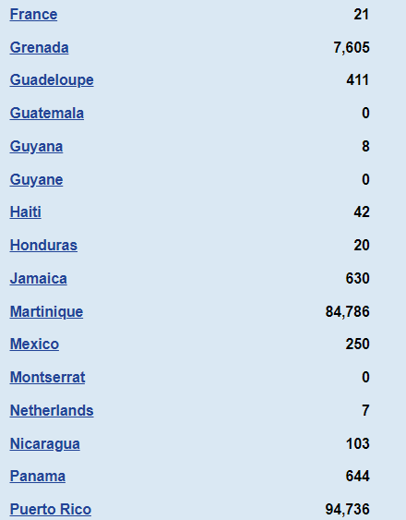
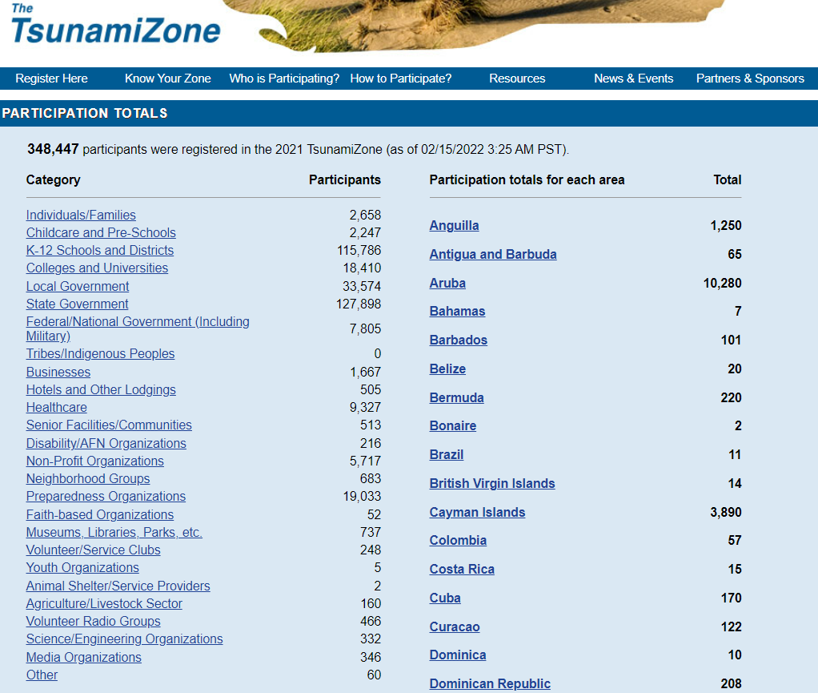
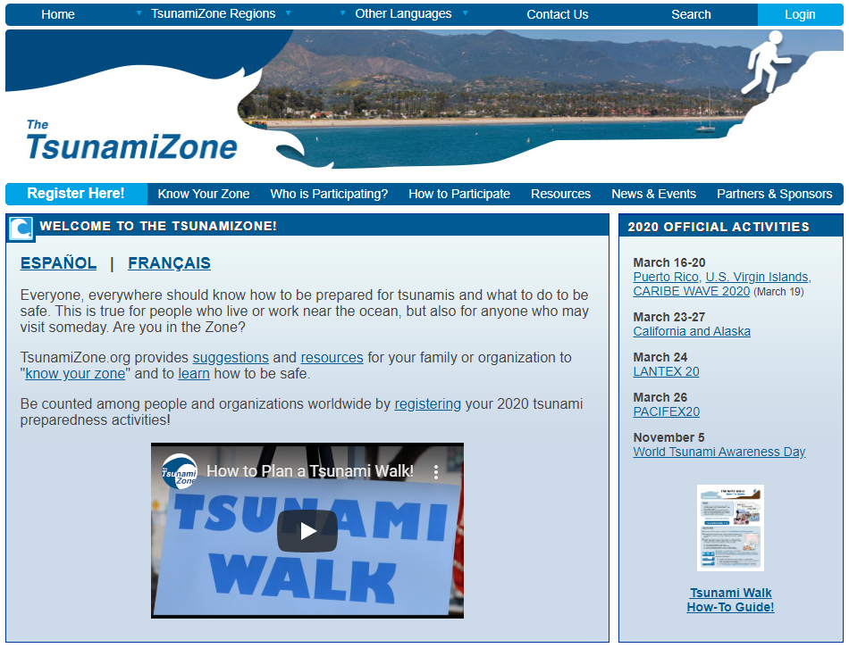
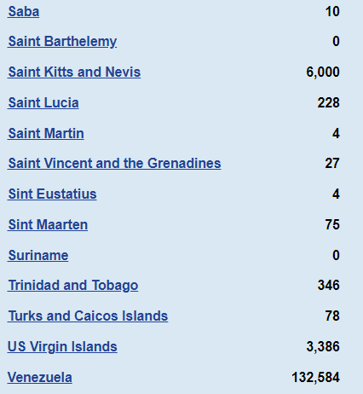
Member State Participation
The TsunamiZone Registration
TsunamiZone registration is used to track the number of people and organizations participating in the exercise.
TWFP and NTWC should register on TsunamiZone to be part of the statistical count. Independent of registering, they will receive the simulated bulletins from PTWC.
Notes:
*Need to update image once Tsunami Zone updates their website on January.

Slide 5
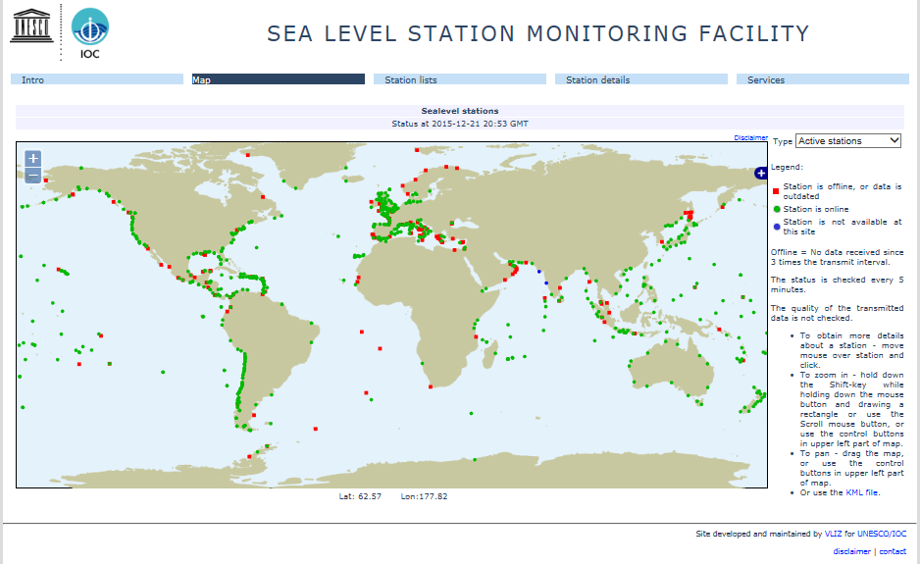
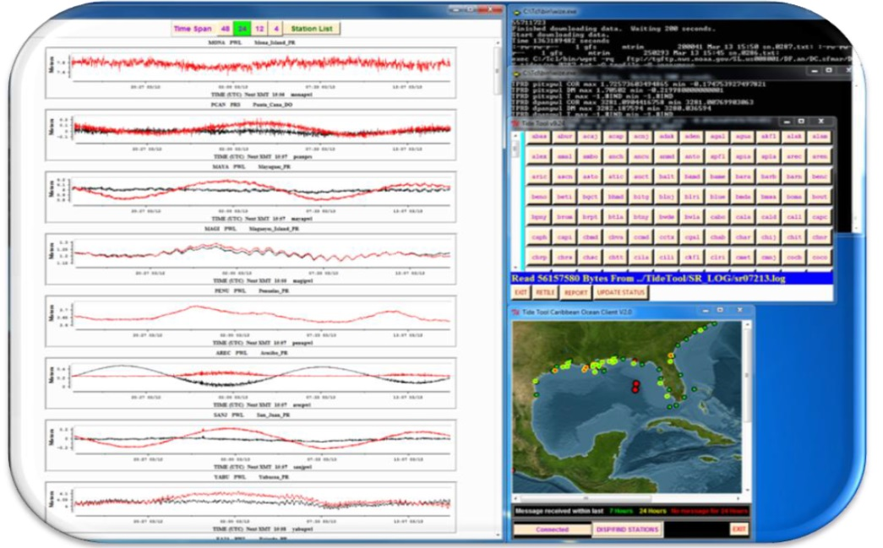
Sea Level Monitoring
As good practice for the exercise, corresponding authorities are encouraged to check out sea level readings in real time on the IOC Sea Level Monitoring Facility and Tide Tool which can also be run with the earthquake parameters.
IOC Sea Level Monitoring Facility
http://www.ioc-sealevelmonitoring.org/
Tide Tool
stuart.weinstein@noaa.gov
For CW 21 60% of the sea level stations that were listed in the PTWC simulated messages were online with data on the IOC Sea Level facility during the exercise period. Similarly, the Tide Tool system 46% of stations listed in the PTWC messages had data available.

Slide 6
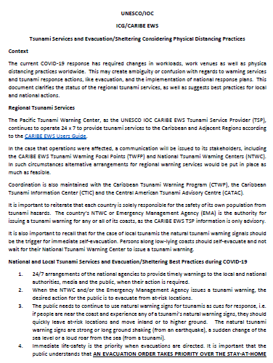
COVID Considerations (2020 – present)
Note that social/physical distancing and quarantine/lock down measure may still be in effect.
It is encouraged that MS consider on-line/virtual events or activities to engage the public.
Participation by the public does not need to be a full tsunami walk, encourage people to check their emergency plan/tsunami route/supplies and register on tsunamizone.org
Note the CARIBE EWS guidance for Tsunamis - http://www.ioc-tsunami.org/index.php?option=com_oe&task=viewDocumentRecord&docID=26796

Slide 7
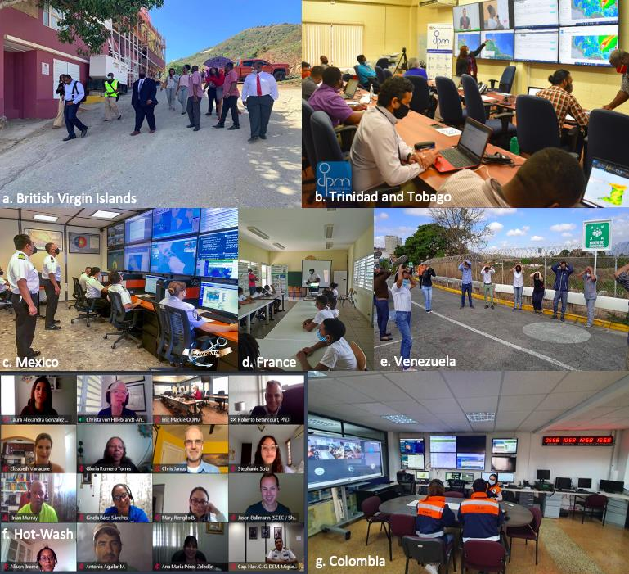
CARIBE WAVE 2021
CARIBE WAVE 21 was held under the circumstances of a pandemic on 11 March 2021. It was left up to the Member States and Territories to determine if any additional activity would be carried out and whether to use the simulated messages for one of the two scenarios.
In the Caribbean and Adjacent Regions, 47 Member States and Territories participated in this exercise with a total of over 300,000 people engaged.
The participation of MS represents a rate of 98% (up from 92% in 2020).
b
CARIBE WAVE 21: British Virgin Islands (a) , Trinidad and Tobago (b) , and Mexico (c), France (d), Venezuela (e) Hot-wash (f), Colombia (g).
a

Slide 8
Goals / Metrics - Success/Evaluation Criteria
Goals | 2016 Results | 2017 Results | 2018 Results | 2019 Results | 2020 Results | 2021 Results | 2022 Metrics
TWFP receive the dummy message | 84% | 95% | 100% | 89% | 97% | 97% | 100%
Participation of Member States of ICG/CARIBE-EWS with designated focal warning point | 100% | 100% | 97% | 100% | 92% | 98% | 100%
Community involvement (including agencies beyond TWFP) | 73% | 82% | 77% | 66% | 38% | 56% | 95%
Number of participants* | 332,812 | 679,985 | 643,403 | 793,353 | 4,622 | 333,518 | +10%
Countries who participate submit exercise questionnaire | 100% | 100% | 91% | 82% | 92% | 95% | 100%
Members State and territories are satisfied with exercise |  |  |  | 82% | 76% | 96% | 100%

Slide 9
CARIBE WAVE Exercise Best Practices
Co-Design - Consulting with local scientists, experts technical agencies on tsunami sources and development of Exercise Handbook
Online registration system – facilitates registration by authorities and public - creates greater awareness beyond NTWCs/TWFPs
Online evaluation surveys - help create graphs and gather critical information on strengths and weaknesses at regional and national levels - 1 per country
2 Webinars in the three main languages - each with different focus (eg. overview in first and comms and surveys in second) – if translation were available could have just one delivery of each webinar
PTWC issues simulated exercise products in real time - helps engagement, creates awareness on products, identifies gaps/issues with comm systems, now including Central American Tsunami Advisory Center (CATAC) for 2022
Annual frequency - supports TR nomination and renewal requirements and timing allows for reporting to ICG/CARIBE EWS and takes cognizance of Atlantic Hurricane Season which would negatively impact MS participation
Consideration of co-occurring events - Inclusion of impact of main event, EQ

Slide 10
CARIBE WAVE Exercise Lessons Learned/Future Directions
Social Media is important for engagement #CARIBEWAVE, #TSUNAMIREADY
For 100% feedback - individualized follow up is necessary
Pictures (and videos) are important to convey the story, would be nice to have a good way for these to be shared
Its a LOT of work - Caribbean office has a person work part time for like 3/4 year to support handbook, presentations (webinars), website and reporting.
Hot wash provides an additional avenue for evaluation and discussion with MS
CARIBE WAVE video will support promotion at all levels
Continued engagement re: enhanced redundancy for communications
Inclusion of social science, people with disabilities

Slide 11
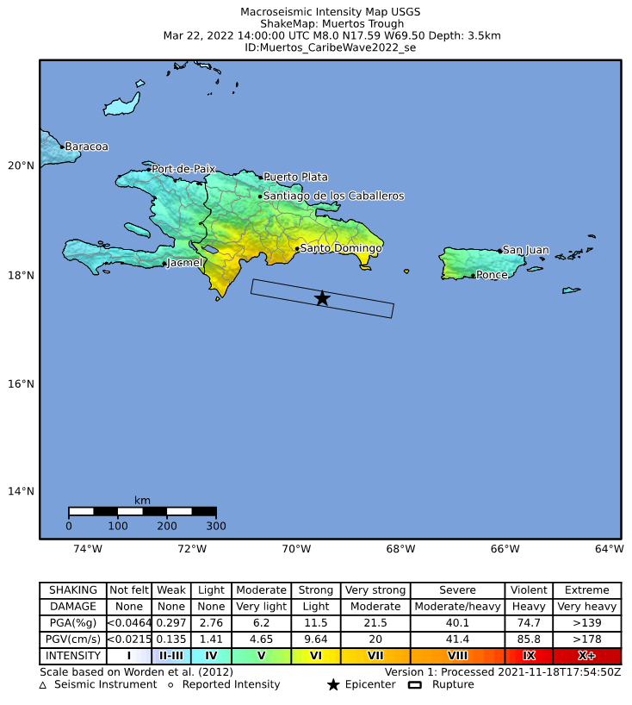
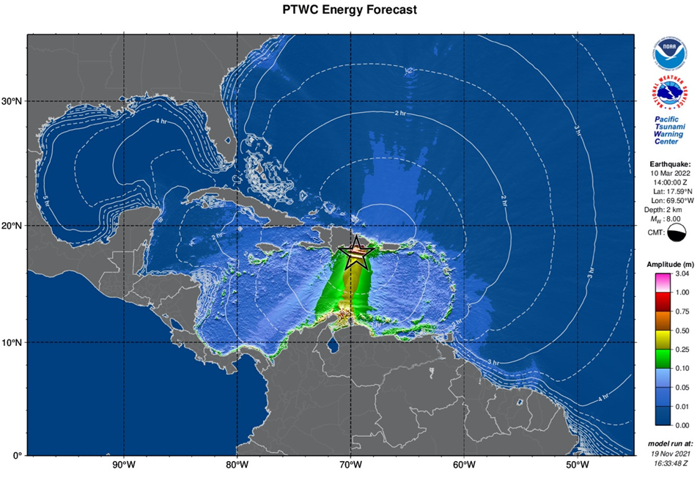
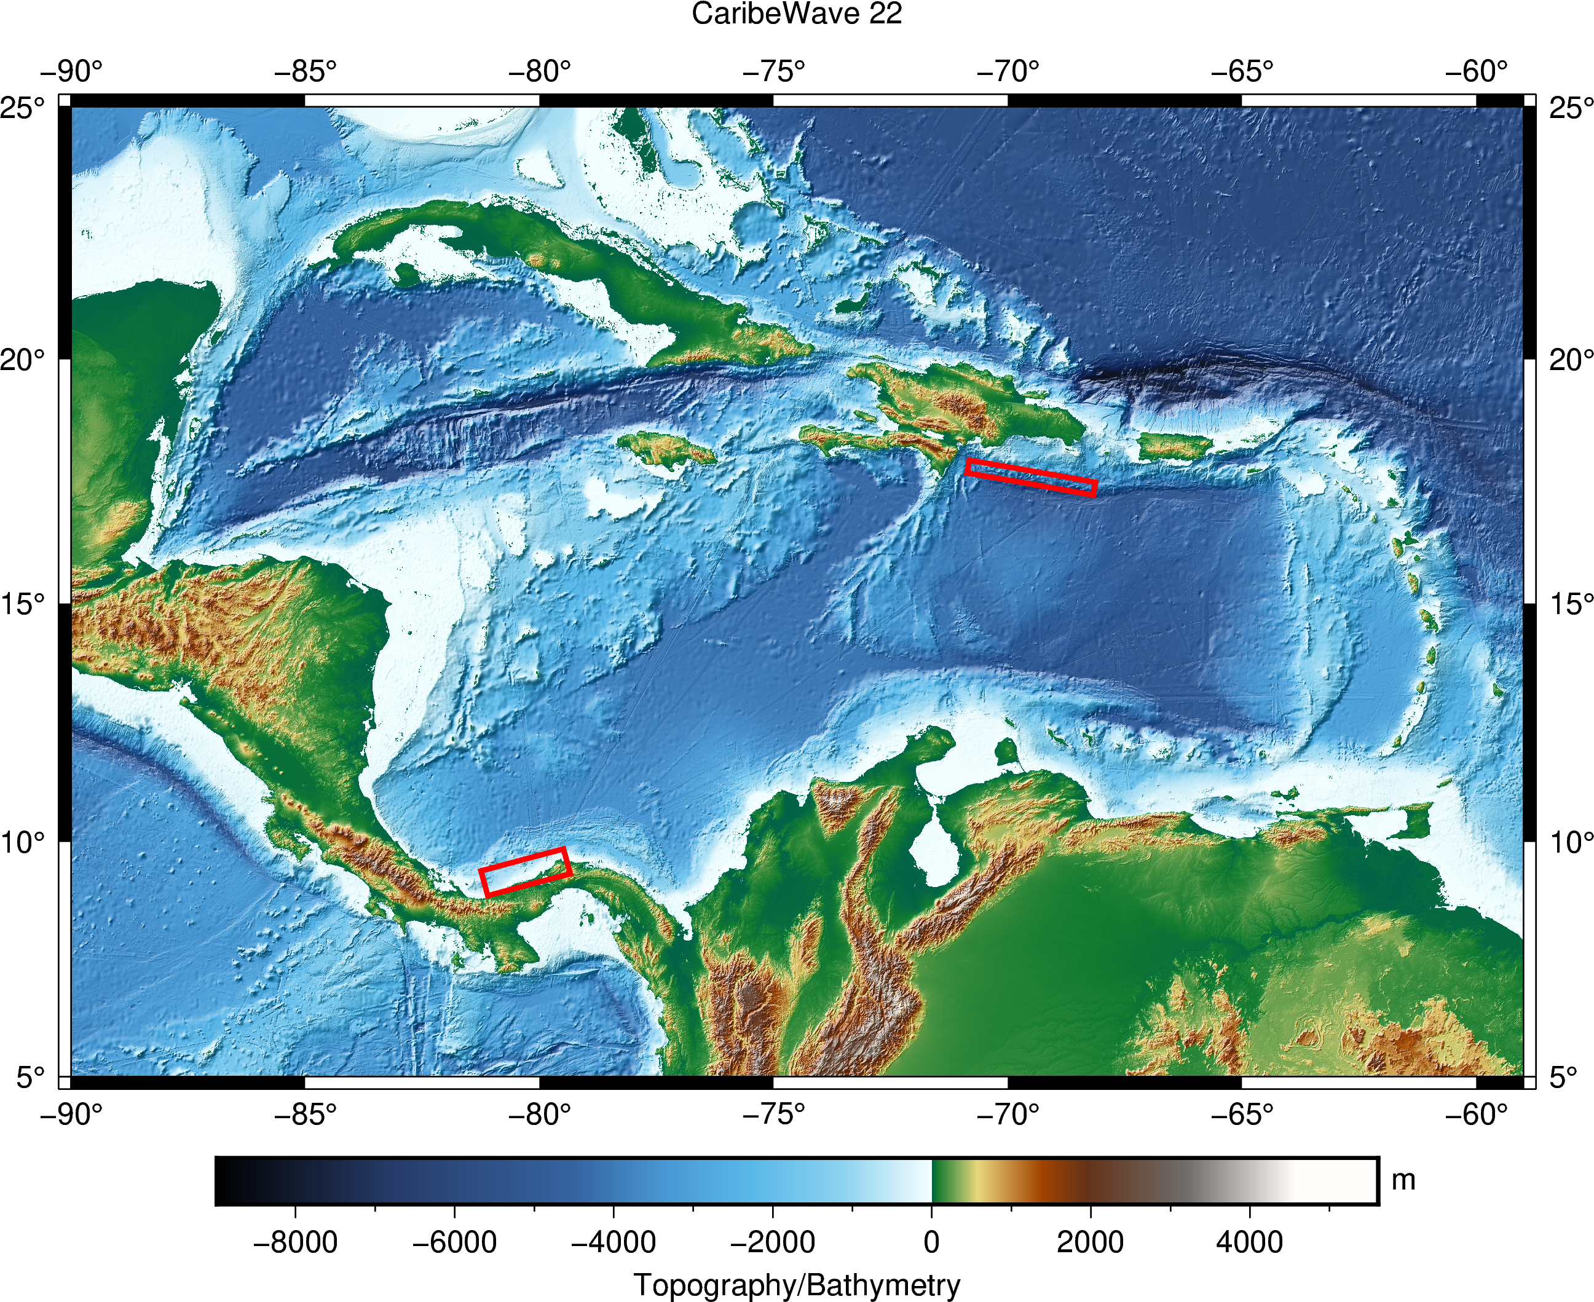
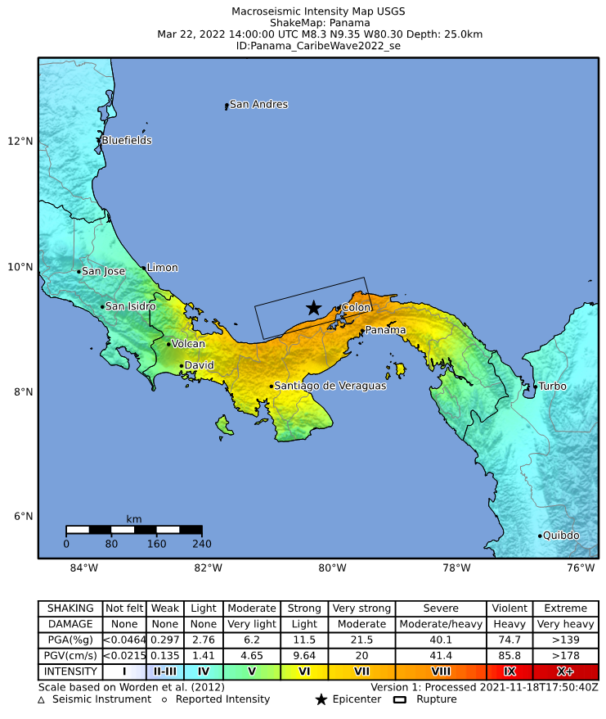
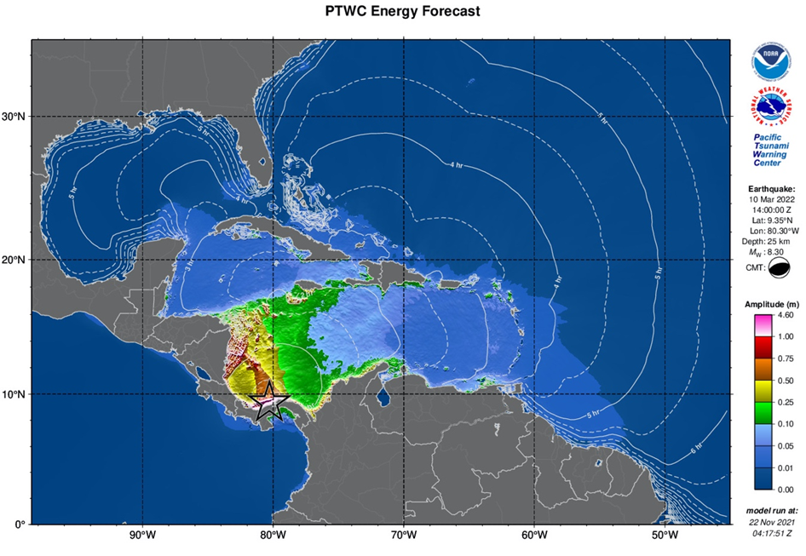
CARIBE WAVE 22
Earthquake and Tsunami Scenarios
Western Muertos Trough
Northern Panama
Scenario | Origin Time | Mw | Epicenter
Muertos Trough | 14:00:00 UTC March 10, 2022 | 7.9 | 17.5⁰N, 69.5⁰W
Northern Panama |  | 8.3 | 9.3⁰N, 80.3⁰W

Slide 12
Timeline
ACTION | DUE DATE
Circular Letter Issued by IOC to MS | ✓ December 2021
Handbook Draft Circulated among ICG CARIBE EWS TNC/TWFP and TT CARIBE WAVE 22 | ✓ December 2021
Deadline for Comments | ✓ December 2021
Exercise Handbook Available Online | ✓ January 2022
1st Webinar CW (Overview, PTWC Products) | ✓18 January 2022 – English ✓ 19 January 2022 – Spanish ✓20 January 2022 - French
2nd Webinar CW (Update, Communication Methods, CW Questionnaire) | ✓15 February 2022 - English ✓16 February 2022 - Spanish ✓17 February 2022 - French
Countries Indicate Selected Scenario | 25 February 2022
Exercise | 10 March 2022
Exercise Evaluation Due | 31 March 2022
Final Draft Caribe Wave 22 Report 13 April 2022
Notes:
*Update timeline

Slide 13
Questions, Comments
Thank You
Alison, Christa and Elizabeth
“Participation in CARIBE WAVE 21 was another success. We had excellent stakeholder participation including some schools. There were areas identified for improvements within the tsunami protocol which will be addressed going forward.” Grenada
“Scenario presented a good basis for analysis of capacities (local/national), communication gaps, and usefulness of
Warning Protocols. Exercise also served to re-orient/orient official on
Warning Protocols as well as need for agency/organizational Tsunami
Warning/Response Protocols.” Jamaica

