Slide 1
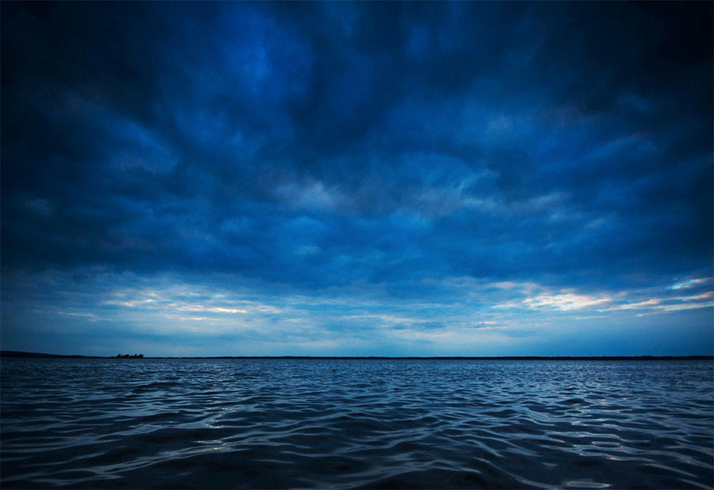
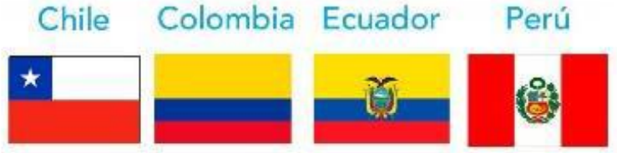
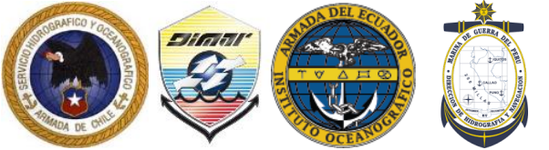
Tsunami Warning and Mitigation
WG - South East Pacific Region
Emergency Responses
and
Data Analysis

Slide 2
Content
General Actions and Emergency Responses.
Some observations to be remarked.
Use of Tsunami DART Buoy Network Data and Historical data.
Maximum Tsunami Amplitudes at Sea Level Stations in SEP.
Atmosferic Pressure vs Sea Level Observations.
Conclusions.

Slide 3
General Actions and Emergency Response
A total of 43 Sea Level Stations registered Tsunami readings, helping update and cancel Tsunami Threat Levels.
Continuos comunications were stablished between most of the National Tsunami Warning Centers from the Regional Working Group:
    Every Bulletin sent by all of the different NTWC were shared by e-mail.
    Every Bulletin sent by all of the different NTWC were published in a dedicated Platform created by the SEP Regional Working Group.
    Dedicated Chat used by the SEP Regional Working Group, was used to share information and solve doubts regarding to the tsunami Emergency.
Direct telephone communications with PTWC helped to better analyze the tsunami threat.
Tsunami Threat Evaluations from the different NTWC that were sent to the National Emergency Agencies, successfully triggered the activation of the National Tsunami Emergency Plans.

Slide 4
Some observations to be remarked
First 06 PTWC Bulletins about the Emergency were not able to reach some Tsunami National Warning Centers, because of non-earthquake sources.
PTWC manually re-sent its Bulletins to as many National Tsunami Focal Points as possible, which helped to start early monitoring of Sea Level Stations and DART systems close to the Volcanic Event in Tonga. (Some focal points not updated)
Based on PTWC´s Bulletin N°4 and Tsunami amplitudes detected at Rikitea Island at the French Polynesia , Chile issued its Bulletin N°1 with a Threat Message to the National Emergency Management Agency (ONEMI) establishing “Caution Level” for all its Islands in the Pacific as well as the Antartic Peninsula.
New statements had to be created to include Non Seismic Variables in the Tsunami Warnings Bulletins. (Sources: Land slides/Meteor/Seismic/Volcanic)
Some countries did not have their sea level data fully available online, which could have been used to help better advise if a tsunami was identified near their coast.

Slide 5
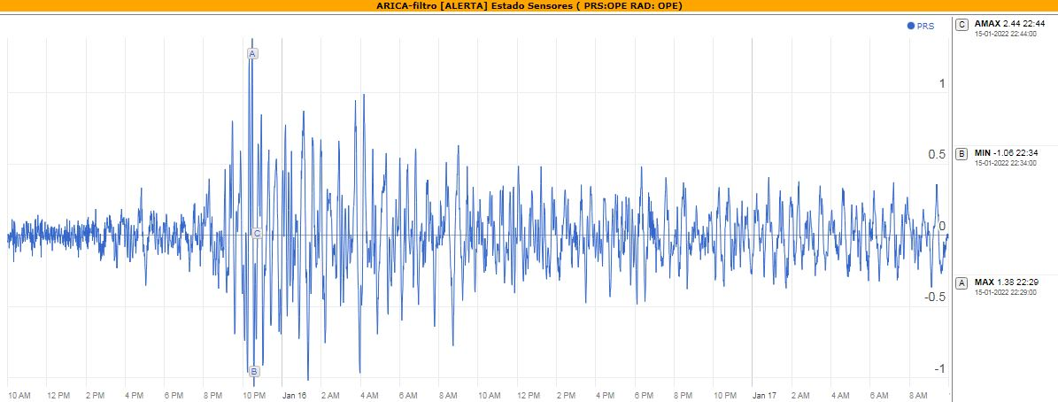
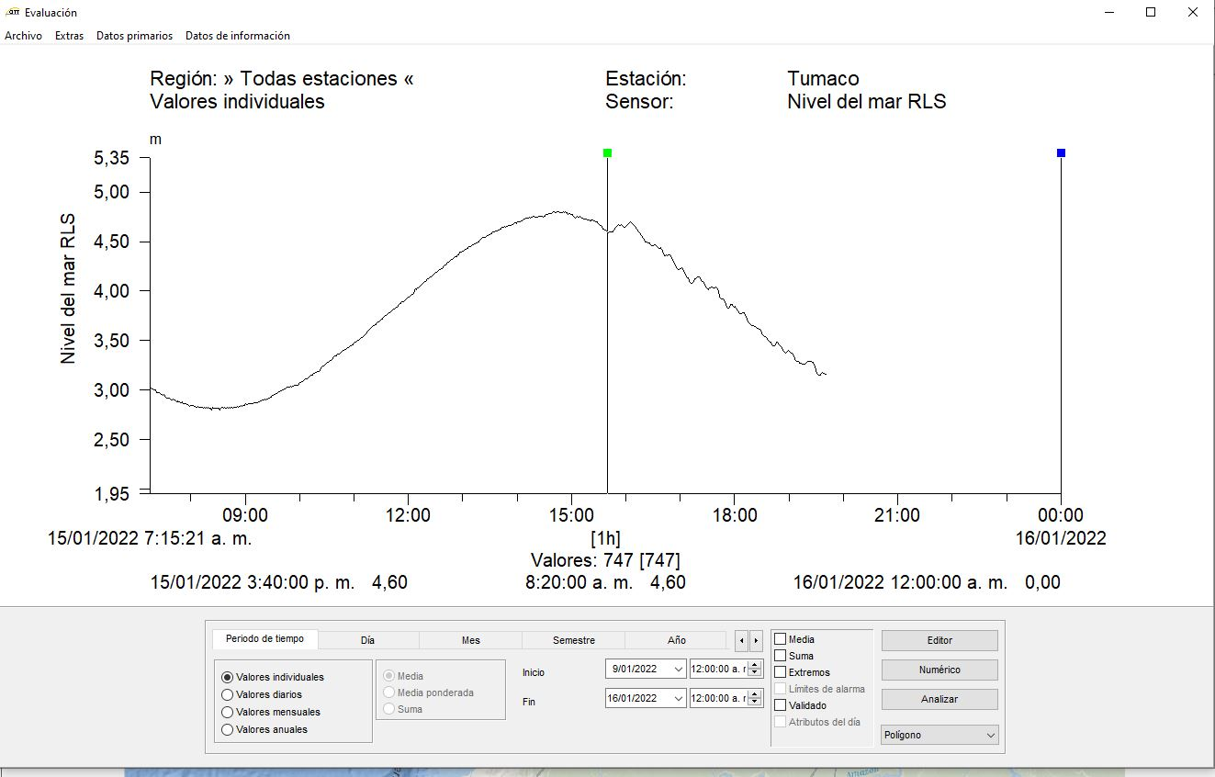
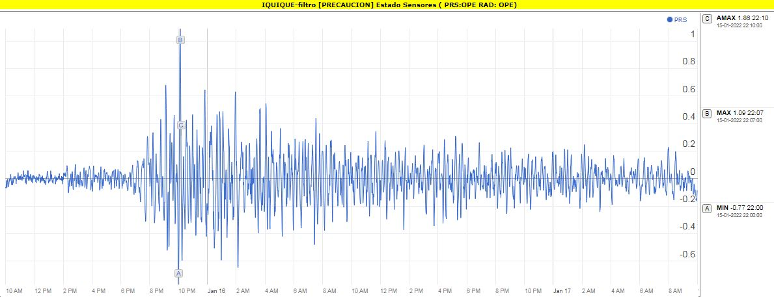
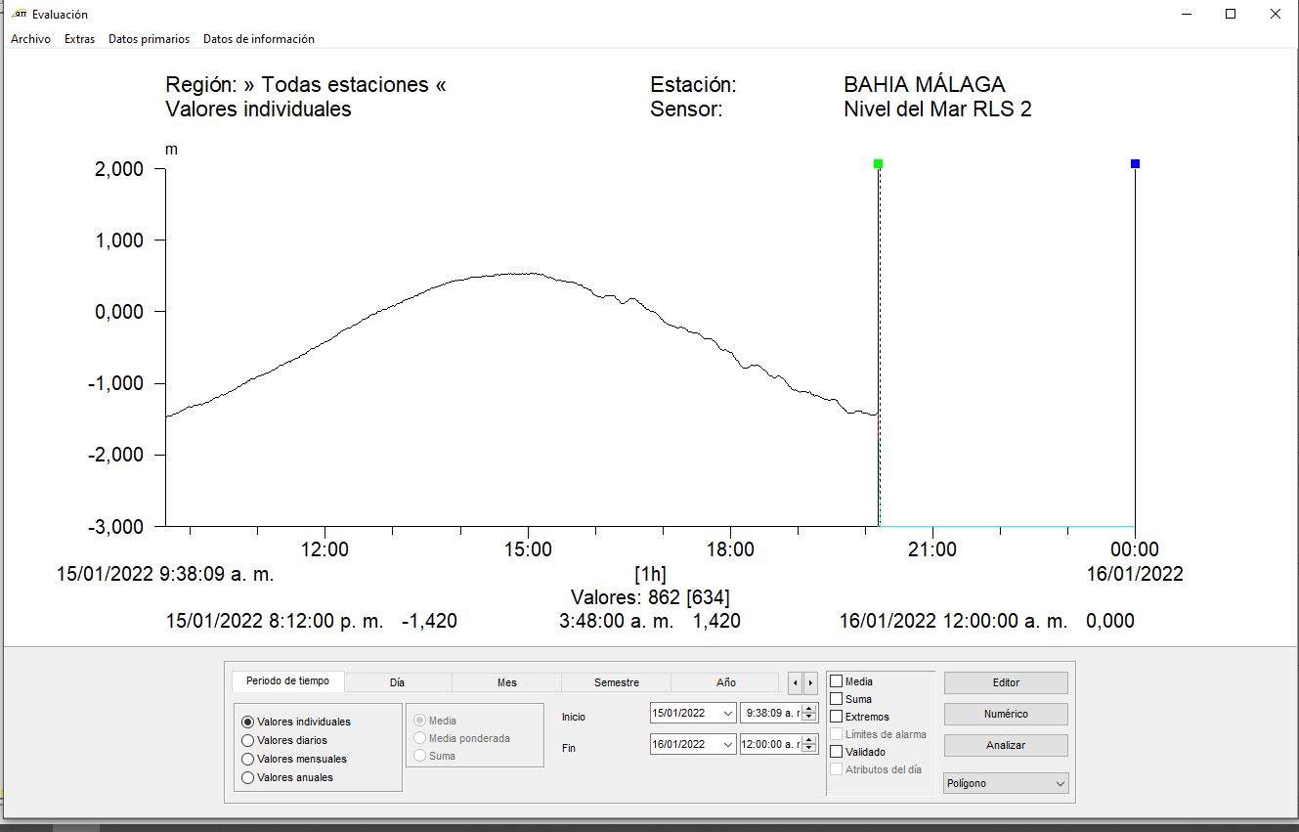
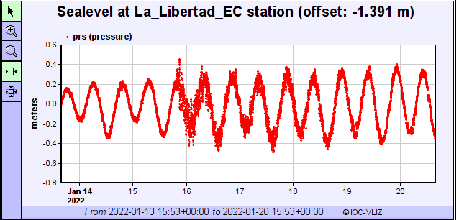
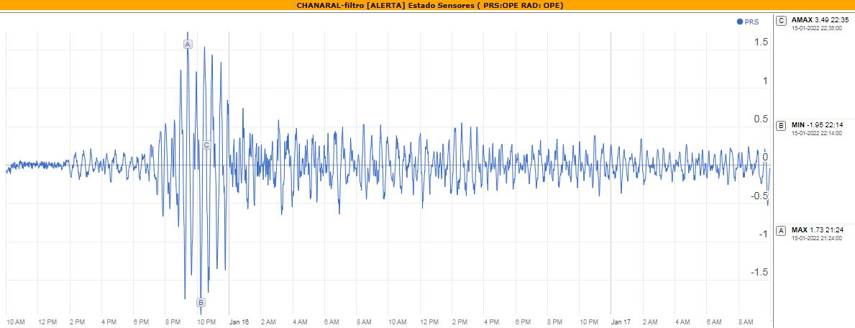
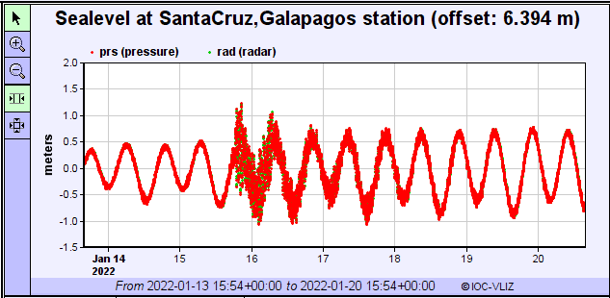
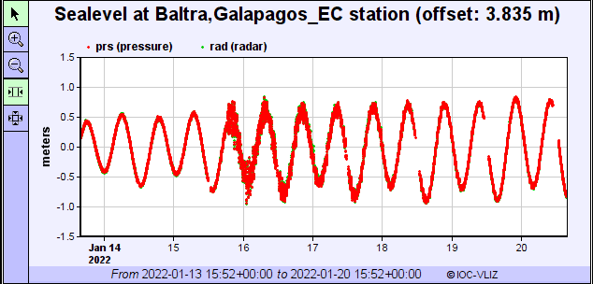
Maximum Tsunami Amplitudes at Sea Level Stations
Arica, Chile
Tumaco, Colombia
Country | ENM | Max Amplitude (m)
CHILE | Arica | 1.40
 | Iquique | 1.10
 | Chañaral | 2.00
 | Coquimbo | 1.50
 | Punta de Choros | 1.00
COLOMBIA | Tumaco | 0.06
 | Bahía Málaga | 0.06
ECUADOR | Baltra, Galápagos | 0.50
 | Santa Cruz, Galápagos | 0.90
 | La Libertad, Galápagos | 0.30
Iquique, Chile
Bahía Málaga, Colombia
Libertad, Ecuador
Coquimbo, Chile
Santa Cruz-Galápagos, Ecuador
Baltra-Galápagos, Ecuador

Slide 6
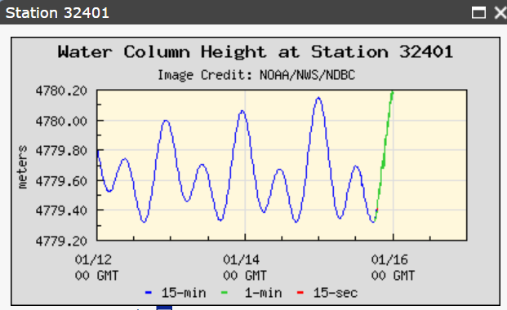
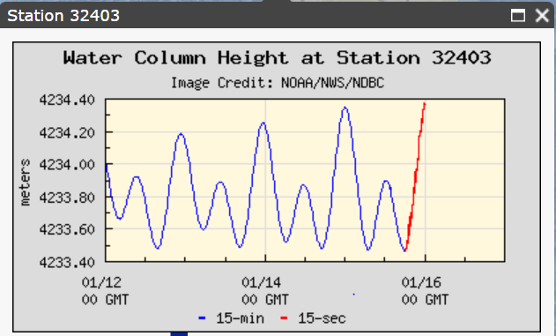
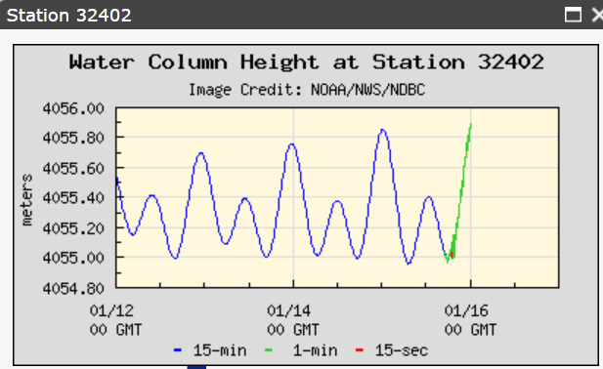
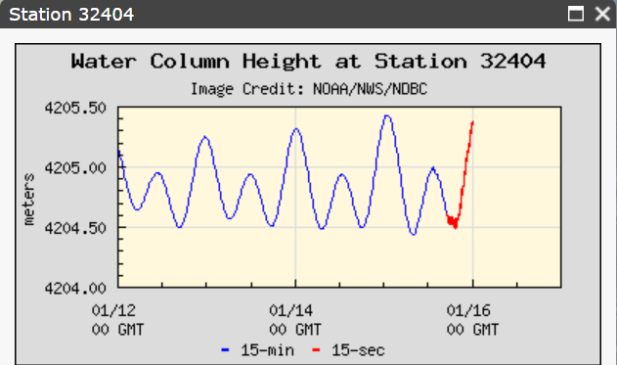
Use of Tsunami DART Buoy Network Data and Historical data

Slide 7
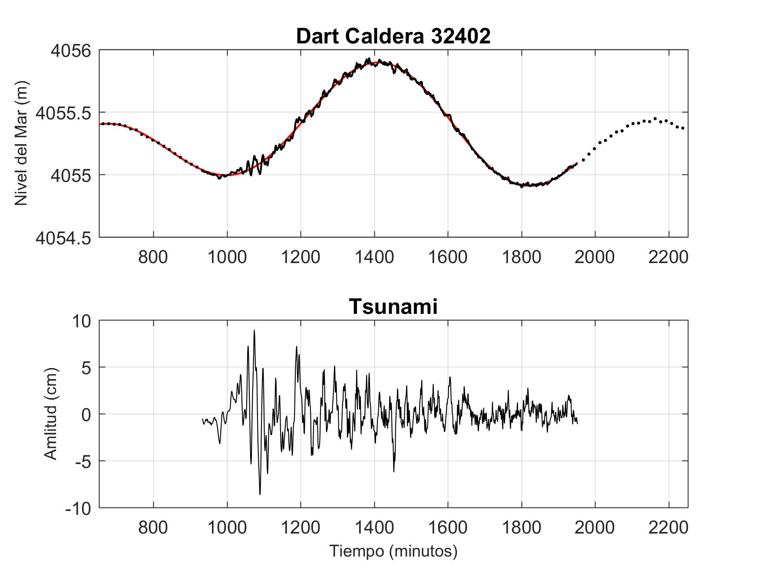
Tonga Eruption 2022, Caldera DART Buoy vs coastal Amplitudes
Start of Recording: 15-01-2022 17:00 UTC.
Observed Height ~ 15 cm a las 19:40 UTC

Slide 8
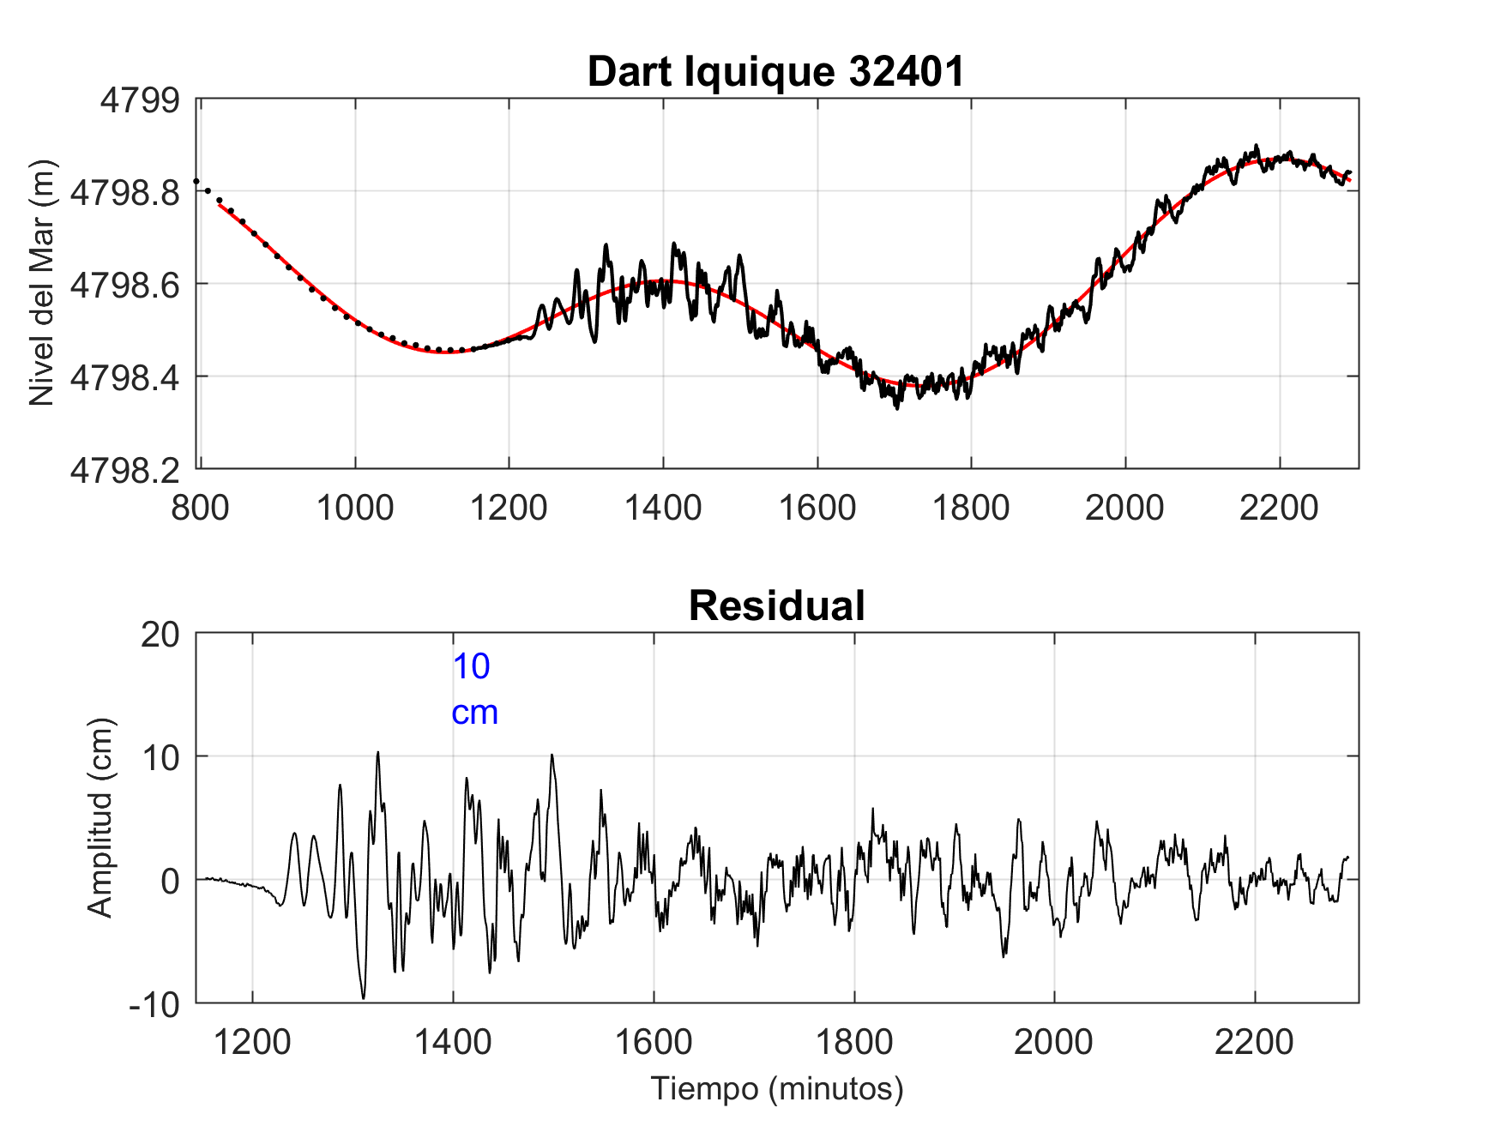
Japan 2011 Tsunami, Iquique Dart Buoy vs coastal amplitudes
Start of Recording: 13-03-2011 02:17 UTC
Observed Height ~ 20 cm at 03:55 UTC
Historical data
Location | Start of Tsunami Recording (UTC) | Max Height (m) | Time Max Height (UTC)
Arica | 12-03-2011 03:28 | 2.2 | 12-02-2011 08:09
Pisagua | 12-03-2011 03:13 | 0.8 | 12-02-2011 04:44
Iquique | 12-03-2011 03:14 | 1.0 | 12-02-2011 07:59

Slide 9
Tonga Eruption 2022, Caldera DART Buoy vs coastal Amplitudes
Start of Recording: 15-01-2022 17:00 UTC.
Observed Height ~ 15 cm a las 19:40 UTC
21:22 UTC Alert Tsunami Threat level for the following region:
Atacama Norte
Location | Start of recording (UTC) | Initial Height (m) | Max Height (m) | Time Max Height (UTC)
Chañaral | 15-01-2022 14:07 | 0.15 | 1.95 | 15-01-2022 22:14
Caldera | 15-01-2022 13:49 | 0.13 | 0.9 | 15-01-2022 23:32

Slide 10
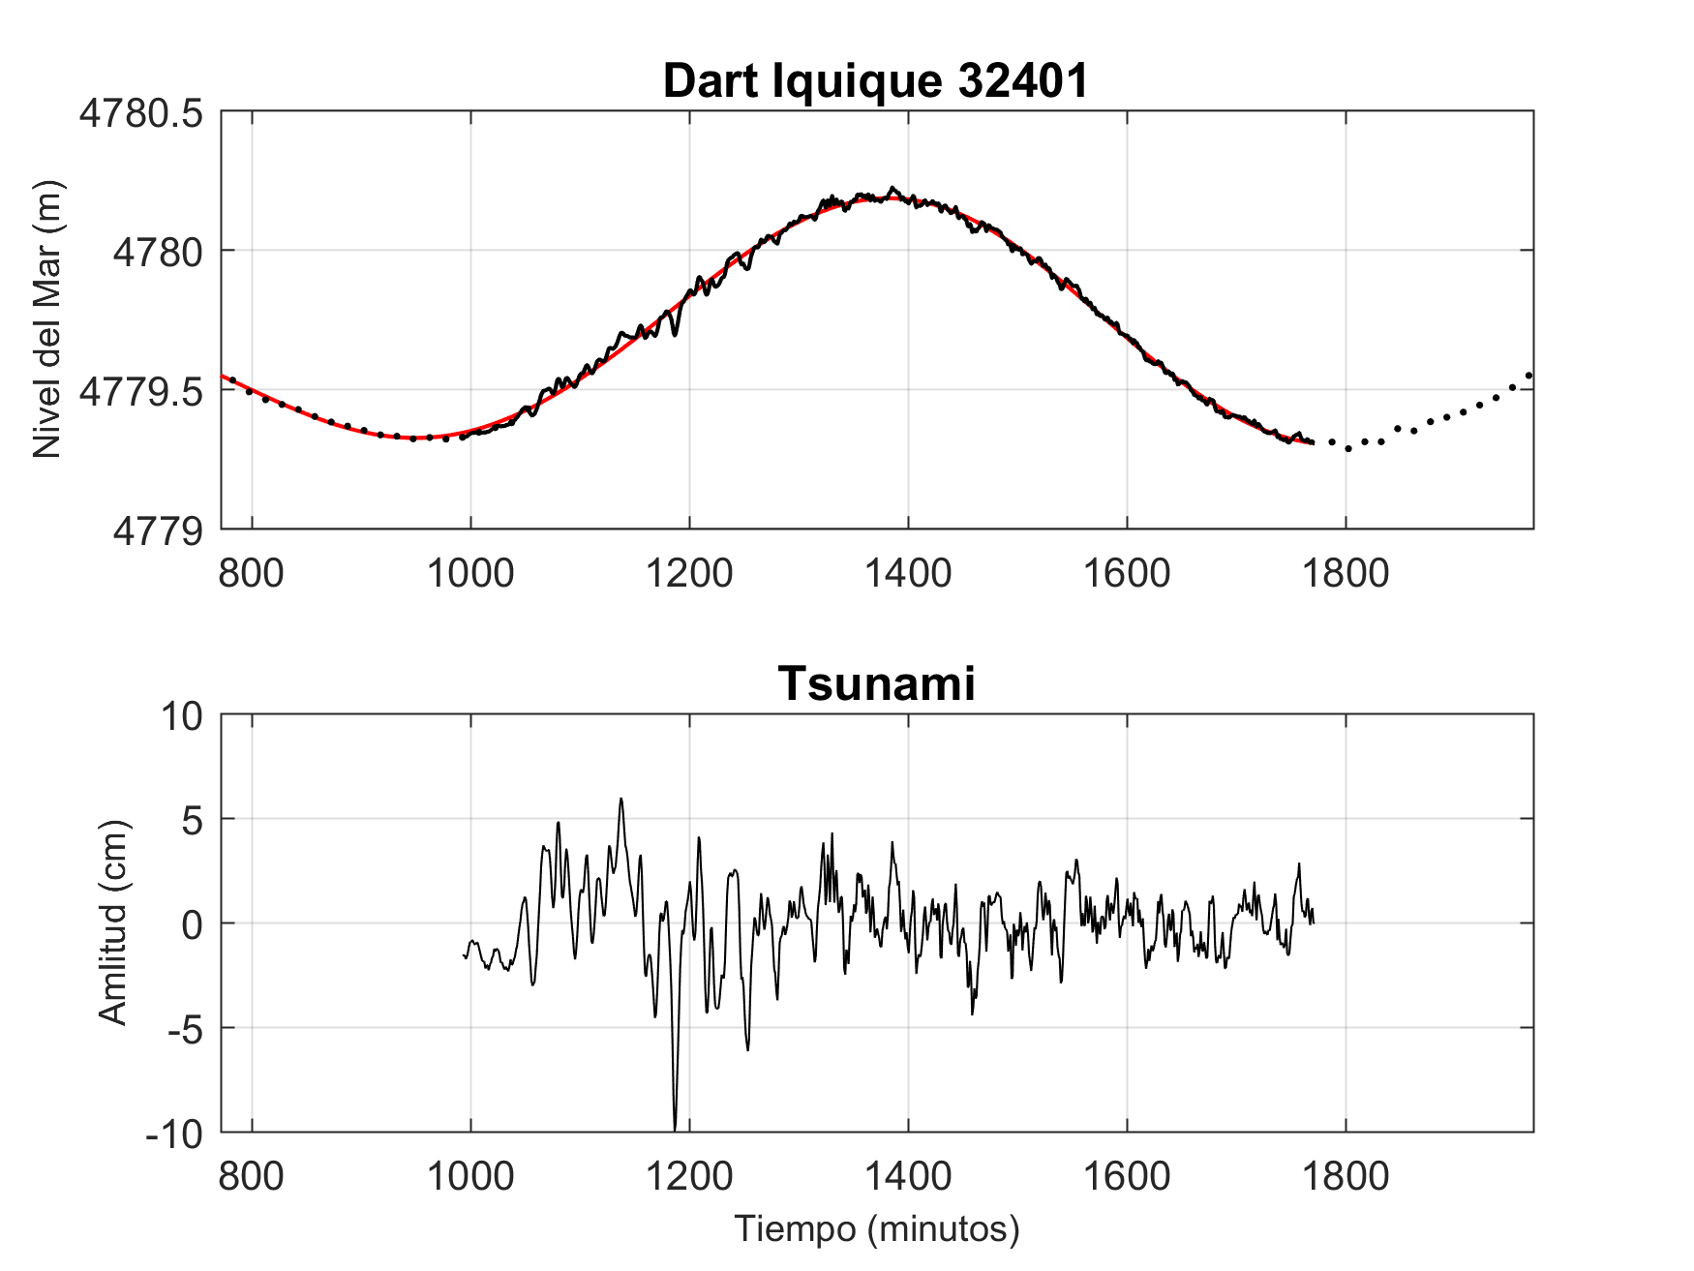
Tonga Eruption 2022, Iquique Dart Buoy vs coastal Amplitudes
Start of recording: 15-01-2022 17:00 UTC.
Observed Height ~ 15 cm a las 19:40 UTC
22:36 UTC Alert Tsunami Threat Level for the following regions.
Arica y Parinacota
Tarapacá.
Location | Start of recording (UTC) | Initial Height (m) | Max Height (m) | Time Max Height (UTC)
Arica | 15-01-2022 12:29 | 0.40 | 1.379 | 15-01-2022 22:29
Pisagua | 15-01-2022 11:31 | 0.15 | 0.5 | 16-01-2022 00:03
Iquique | 15-01-2022 11:21 | 0.10 | 1.09 | 15-01-2022 22:07
Patache | 15-01-2022 12:34 | 0.15 | 1.26 | 15-01-2022 21:40
P A T R I O T I S M O
HONOR
LEALTAD
VALENTÍA
INTEGRIDAD
DEBER

Slide 11
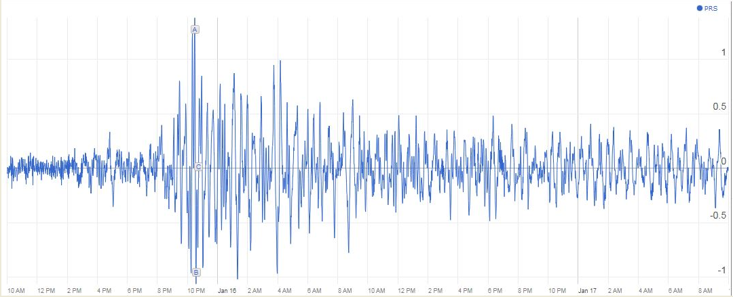
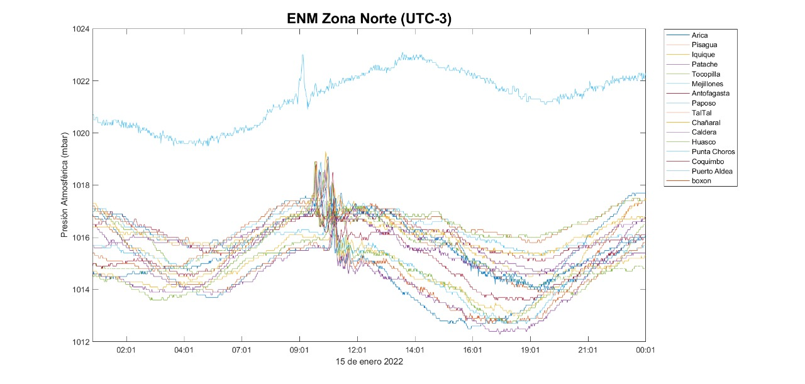
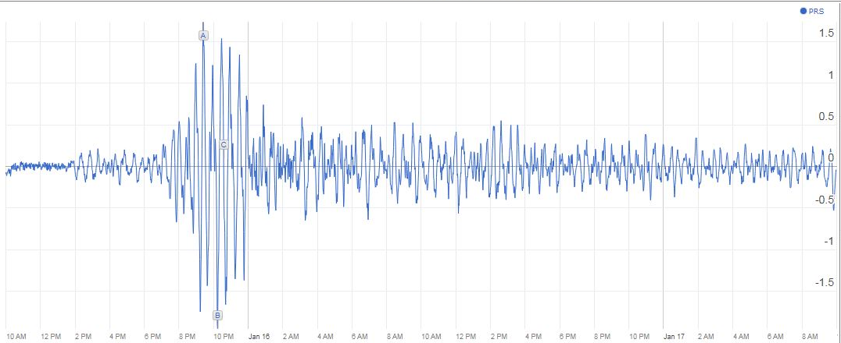
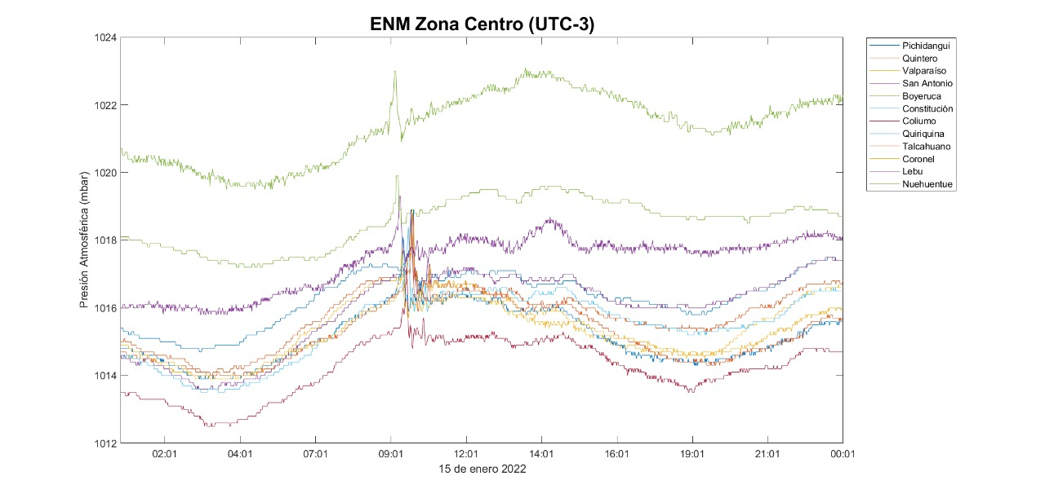
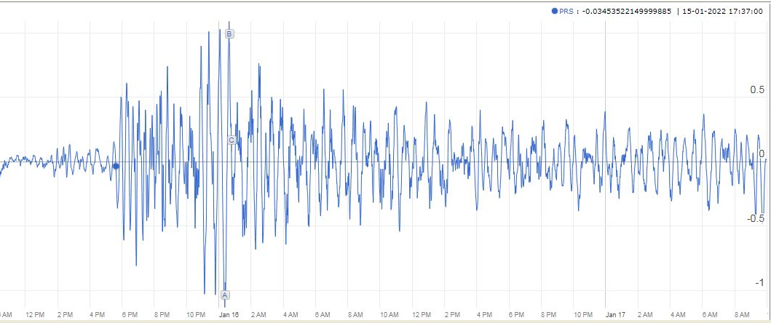
Tonga Eruption 2022, Atmosferic Pressure vs Sea Level
Start of Tsunami Recording (UTC) | Atmospheric Pressure Peak (UTC)
Arica
Chañaral
20 cm
Coliumo

Slide 12
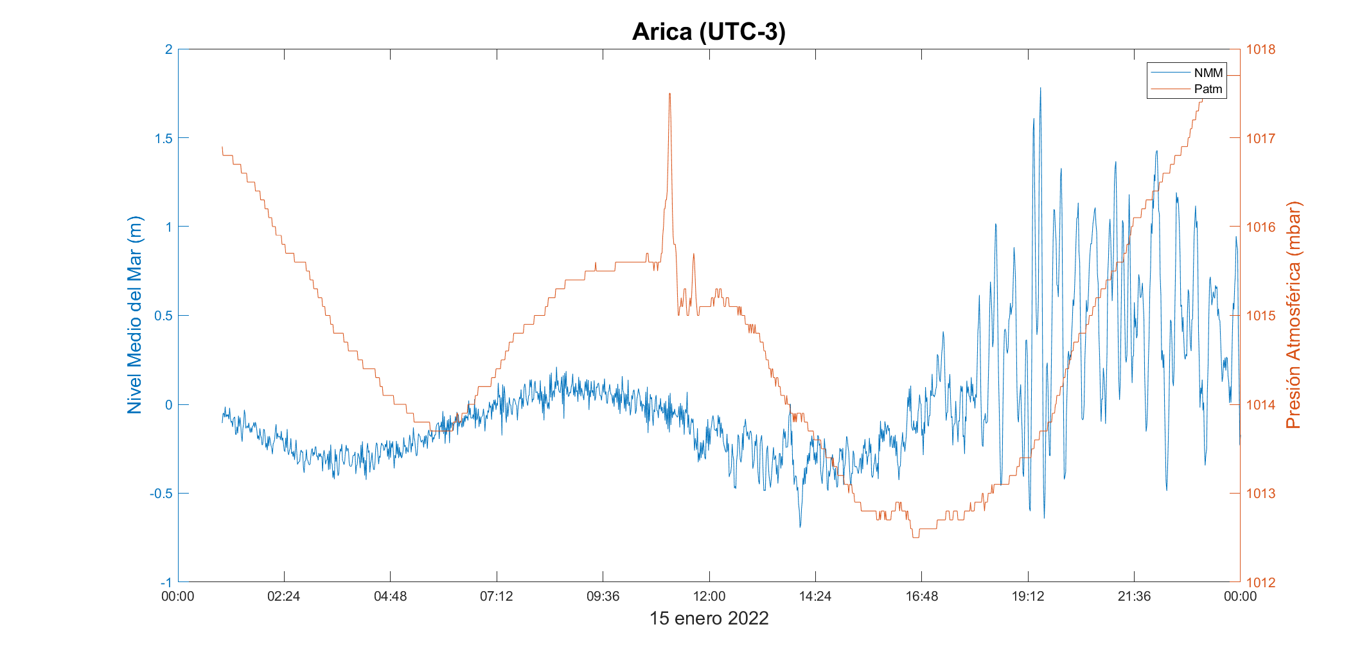
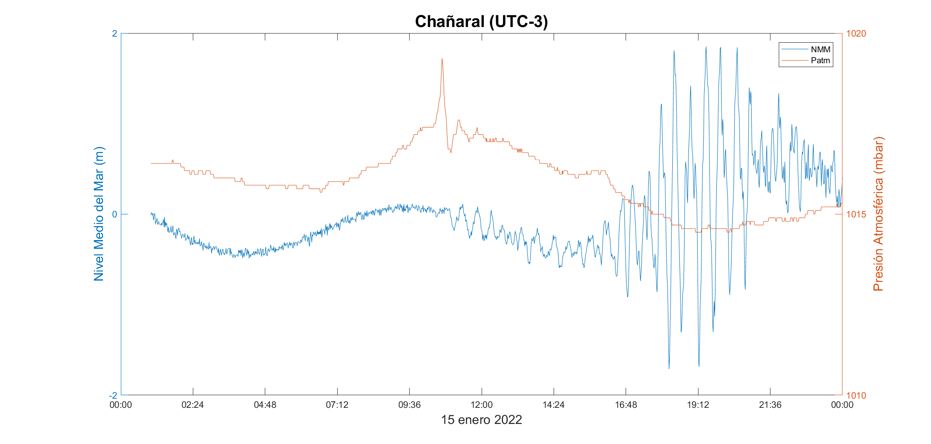
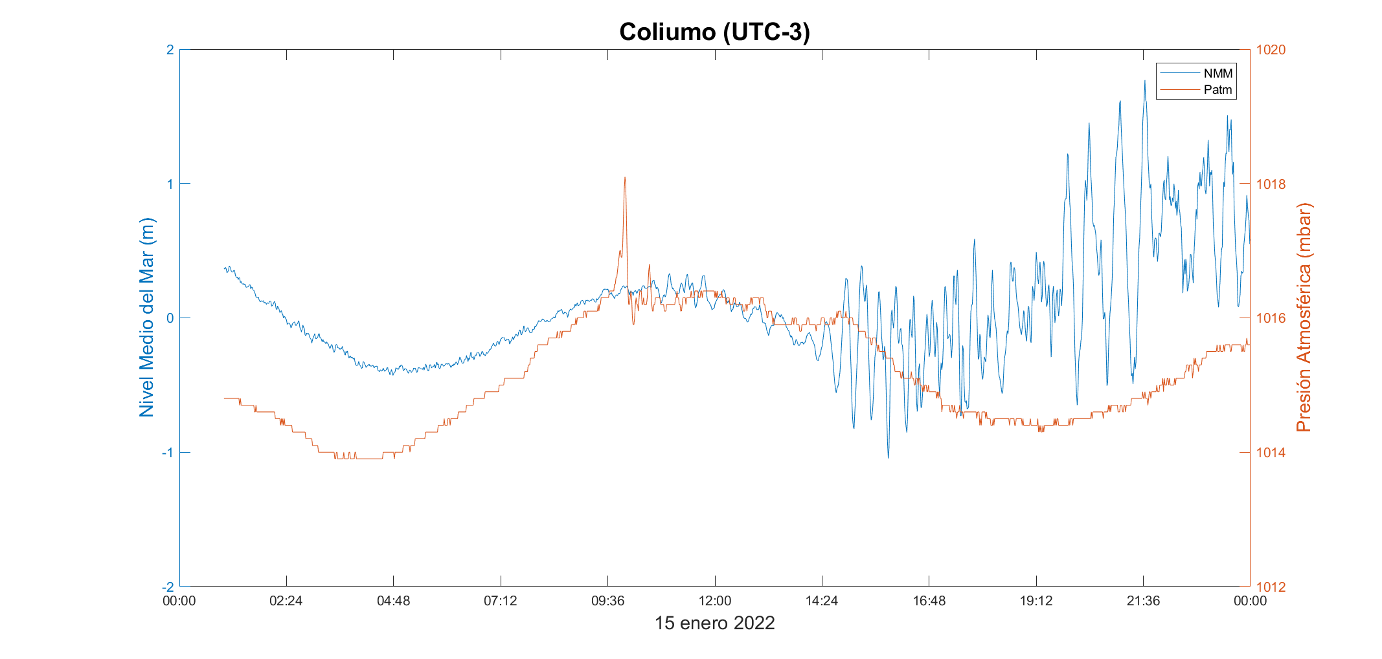
Tonga Eruption 2022, Atmosferic Pressure vs Sea Level
Location | Start of Tsunami Recording (UTC) | Atmospheric Pressure Peak (UTC)
Arica | 15-01-2022 15:27 | 15-01-2022 14:07
Chañaral | 15-01-2022 14:03 | 15-01-2022 13:43
Coliumo | 12-03-2011 13:47 | 15-01-2022 12:59

Slide 13
Conclusions
Importance to count with fully funcioning DART systems and sharing information from Seal Level Stations.
Usefulness of keeping fully documented records of past Tsunami events, that can be consulted in emergencies where Tsunami Models can not be run based on seismic parameters.
National Tsunami Focal Points should always be reachable, highlighting the
Importance of allways having their information updated.
Direct telephone communications with PTWC helped to better analyze the tsunami threat. (Thanks)
Interesting atmospheric pressure recordings with early Tsunami readings, were registered in most of the Sea Level Stations of the SEP-WG.
Social Media for early Tsunami awareness.

Slide 14
THANK YOU FOR
YOUR ATTENTION

