Slide 1

PTWS Working Group 1
Understanding Tsunami Hazard
SARAH-JAYNE MCCURRACH (NZ)
ICG/PTWS WG1 CO-CHAIR
ICG/PTWS TT CHAIR PTWS KPI
Diego Arcas (USA)
New Zealand Focal Point for PTWS
ICG/PTWS WG1 CO-CHAIR

Slide 2
OVERVIEW OF ICG/PTWS-WG1
1
Develop and promote best practice tsunami risk reduction material, programmes, standards, and tools for understanding tsunami risk, to support emergency management and early warning, including but not limited to:
  hazard assessment and coastal inundation models and products
  risk assessment methodology and risk forecasting
  scenario assessments including maximum credible and most likely events to understand likely exposure, vulnerability, and event frequency
  forecast and threat models
  evacuation and inundation modelling
  use of new and improved data including digital elevation modelling (DEM), GNSS and paleotsunami information
Work with scientific experts to support Member State tsunami risk assessment and risk reduction.
Improve best practice for assessing and reducing risk of local source and non-seismic tsunami sources.
Develop projects to address gaps or areas for improvement in tsunami risk assessment and risk reduction, this may include land-use planning, vertical evacuation or supporting early warning improvements
2
3
4

Slide 3
SOME KEY INTERSESSIONAL ACTIVITITES
1
Assessment of implications for ICG/PTWS-WG1 from the New PTWS Strategy.
Assessment of implications for ICG/PTWS-WG1 from outcomes for the ICG/PTWS XXIX Future Goals and Performance Monitoring Report.
Workshop of experts in Tsunami Sources and Risks in the Colombia/Ecuador Subduction Zone (Guayaquil, Eucador 2019). IOC Report No. 295
DART Buoys
Update - Tsunami Vertical Evacuation
TsuCat Version 4.2
Assessment of implications for ICG/PTWS-WG1 UN Decade of Ocean Sciences for Sustainable Development
2
3
4
5
6
7

Slide 4
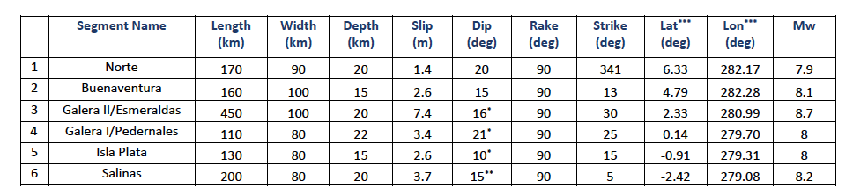

Workshop of Experts on Tsunami Sources Colombia/Ecuador Margin
A total of six rupture segments were identified with Magnitude varying between 7.9 and 8.7.
Sources were parametrized and recorded in IOC Report No. 295, TsuCat and NCEI database.
Preliminary tsunami impacts from each source were computed in deep water and reflected in the report.

Slide 5
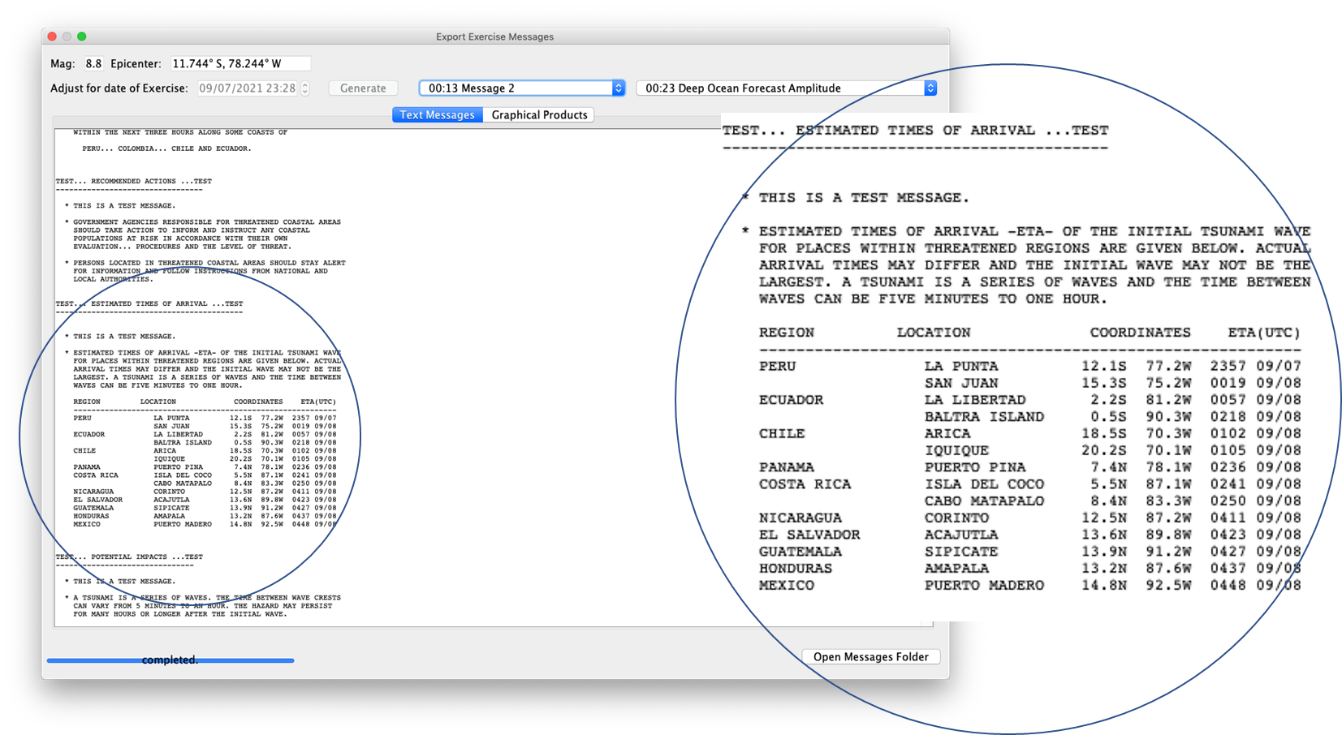
TsuCat Version 4.2
Updates to PTWC messages to include enhances graphical products, hill-shading and grouping of expected wave arrival times, by country.
New ability to download the entire tsunami source catalogue online.
Ability to now edit the dialog of the requested epicentre.
App improvements and bug fixes including to show ‘best’ source in very large events.
Grouping ETA by Country

Slide 6
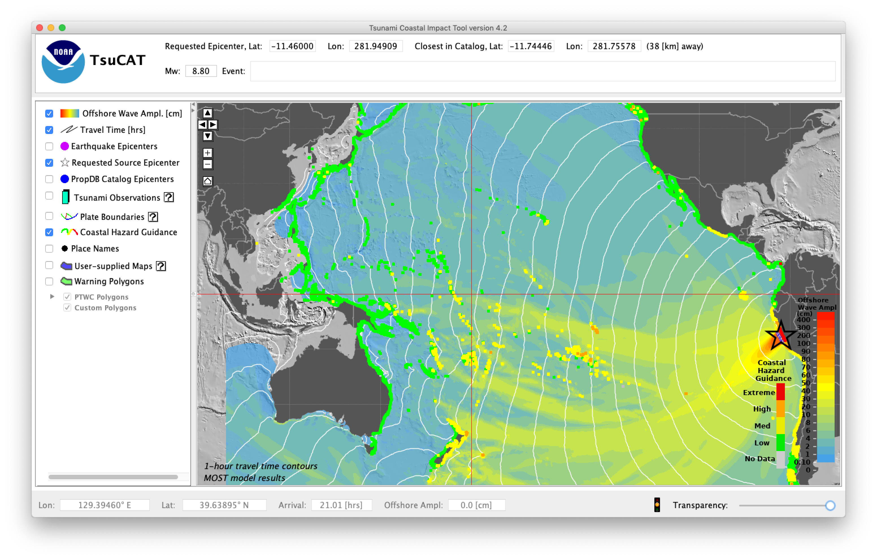
TsuCat Version 4.2
Updates to PTWC messages to include enhances graphical products, hill-shading and grouping of expected wave arrival times, by country.
New ability to download the entire tsunami source catalogue online.
Ability to now edit the dialog of the requested epicentre.
App improvements and bug fixes including to show ‘best’ source in very large events.
Actual Epicenter location vs. Requested

Slide 7
DART 4G
WG1 worked with NZ to analyse data captured on their new DART network from the March 5, 2021, Kermadec Earthquakes. A series of tsunamigenic earthquakes ranging in magnitude from M7.2 to M8.1. The DART buoys enabled scientists to accurately predict wave forecasts.
PMEL also continue to work with Chile and recently supported the Hydrographic and Oceanographic Service of the Chilean Navy, to acquire DART metadata as a proxy for the National DART Buoy Centre.
Due to the increased use of DART, PMEL are working on setting up a Web Portal for DART metadata updates.
IMAGES COURTESY OF DR BILL FRY – WG2
PMEL inversion of NZ DART
available
~1-2 hours after event, pre-arrival in NZ

Slide 8
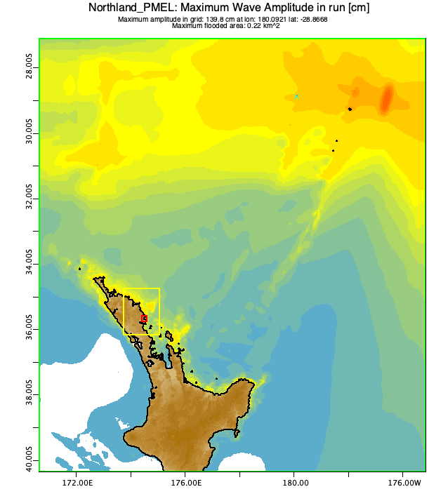
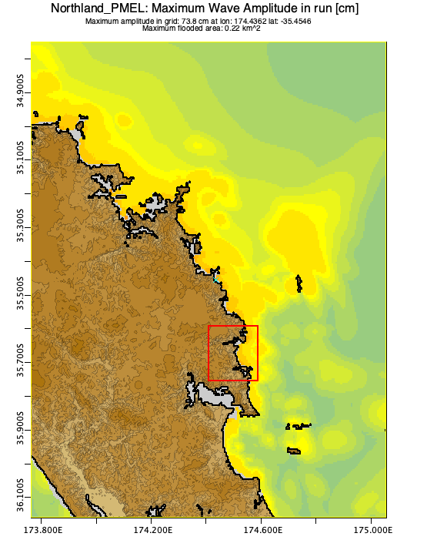
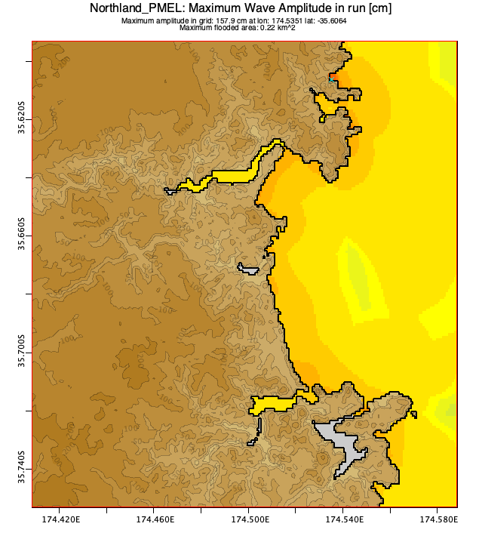
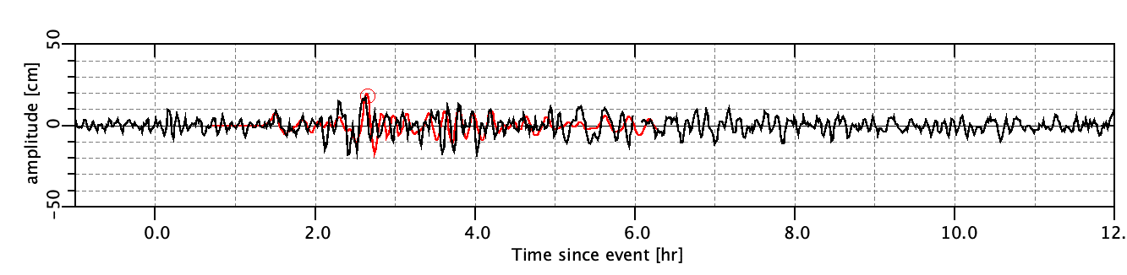
DART 4G
IMAGES COURTESY OF DR BILL FRY – WG2
Forecasts predicted minor land threat. Field measured tsunami runup (from post event analysis) was consistent with DART inversion forecasts.

Slide 9
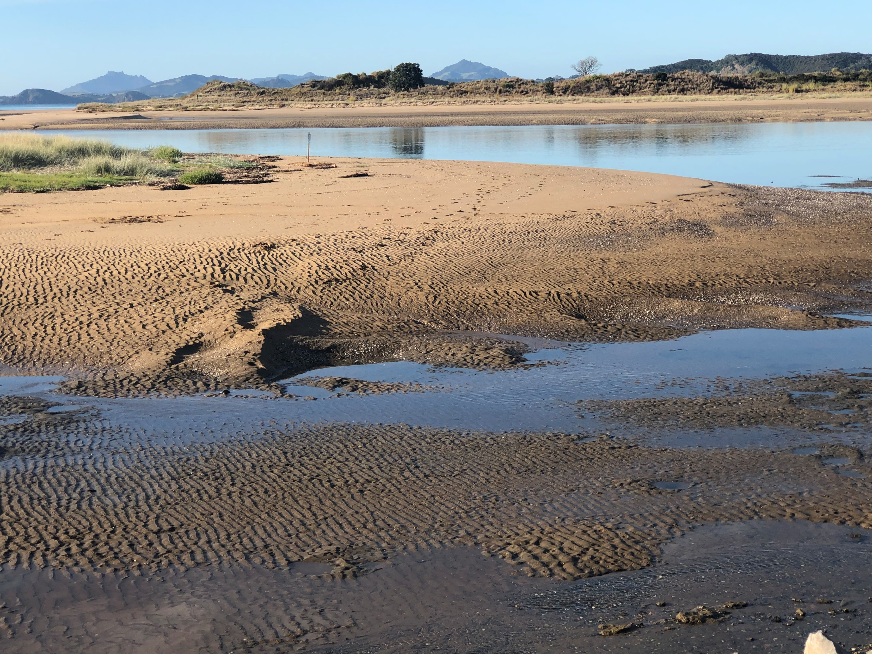
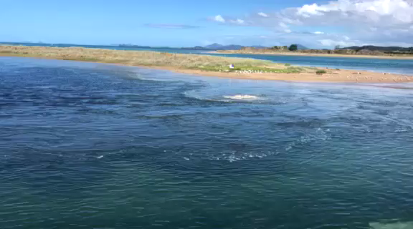
DART 4G
MARCH 5 KERMADEC TSUNAMI, TUTUKAKA
IMAGES COURTESY OF DR BILL FRY – WG2 AND NGUNGURU SCHOOL, Whangārei, NZ

Slide 10
Working Group 1 Recommendations to the ICG/PTWS-XXIX
Agree to support two scientific meeting of experts on:
  the New Hebrides Trench; and
  The Chile-Perú subduction zone.
If the above Recommendation is agreed, ICG/PTWS-WG1 recommend the ICG/PTWS- XXIX, agree one of these workshops be held in the next ICG/PTWS biennium.
Note the small number of official country nominations to ICG/PTWS-WG 1 and promote further nominations through the Steering Committee.
Endorse the proposed planned activities in Section 3 of this report.

