Slide 1
DBCP National Report
DBCP – 37, VIRTUAL, 8-11 November 2021
PhD (c) Juan Leonardo Moreno Rincon
lmoreno@dimar.mil.co
www.dimar.mil.co
https://dimar.maps.arcgis.com/apps/opsdashboard/index.html#/48d2c76148af428789abae6b3a8789de

Slide 2
Current Programme
Name/Agency
General Maritime Directorate - National Marine Meteorological Service
Number and type of buoys
01. 29/10/2021 deployed wave buoy at San Andres Island
Purpose of programme
Operational, Met/ ocean research and developmental
Main deployment areas
Colombian Caribbean sea and Colombian Pacific
Vandalism incidents
During 2021 Colombia have not buoys deployed.

Slide 3
Planned Programme(s)
Name/Agency
General Maritime Directorate - National Marine Meteorological Service
Number and type of buoys
03 directional wave buoys.
07 metocean buoys
Purpose of programme
Operational, Met/ ocean research and developmental
Main deployment areas
Colombian Caribbean sea and Colombian Pacific

Slide 4
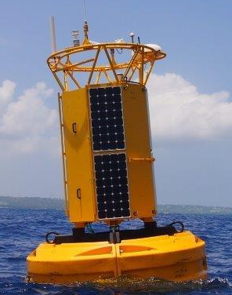
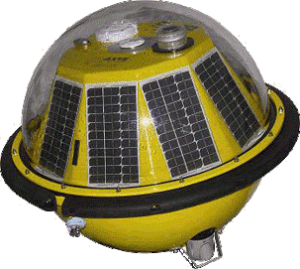
Technical Developments
Buoy Design and Instrumentation
Metocean Buoy
Temperature
Wind
Humidity
Pressure
Radiation
CTD
ADCP
Wave Buoy
Sea Surface Temperature
Wave spectra

Slide 5
Publications & User Impact

Slide 6
Additional Comments
QC
Good wave data.
Good current data.
Good oceanographic and weather data
Communications
INMARSAT DATA PRO
IRIDIUM
GOES
Buoy Lifetime
03 years in directional wave buoys.
07 years metocean buoys.
Data Accessibility
Access to ocean observation information for data buoys is not yet available, mainly because it has not been possible to homogenize the data and put them on an accessible platform.

Slide 7
Additional Comments (continued)
New Observations
Due to the reduction in income and budget cuts, the network at the moment does not plan to increase the network of buoys, at the moment the focus is to maintain what it already has.
DBCP linkage
It would be ideal to have more collaboration so that the equipment we have can be shown on international platforms

Slide 8
Contribution to UN Decade and UN SDGs
The historical information from the data buoys is considered to be a Colombian contribution to the international access on wave data. These data are part of the different initiatives that are developed in the Colombian jurisdictional waters and can be consulted at www.cedoldo.dimar.mil.co

Slide 9
Thank you!

