Slide 1
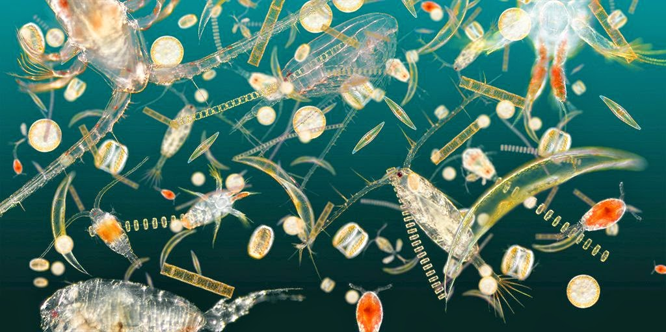
SCOR Working Group 154
Integration of Plankton-Observing Sensor Systems to Existing Global Sampling Programs (P-OBS)
Co-Chairs: Emmanuel Boss (USA) and Anya Waite (Germany)
Other Full Members: Silvia Acinas (Spain), Ilana Berman-Frank (Israel), Marcela Cornejo (Chile), Katja Fennel (Canada), Heidi Sosik (USA), Sandy Thomalla (South Africa), Julia Uitz (France), and Hidekatsu Yamazaki (Japan)
Associate Members: Sonia Batten (Canada and PICES), Jørgen Berge (Norway), Herve Claustre (France), Gérald Grégori (France), Johannes Karstensen (Germany), Frank Muller-Karger (USA), Anthony Richardson (Australia), Bernadette Sloyan (Australia), and Rik Wanninkhof (USA)

Slide 2
Why Now? The Time is Right to Expand Biological Measurements in Ocean Observing Programs

Slide 3
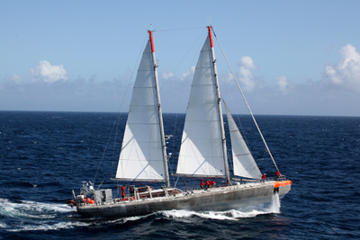
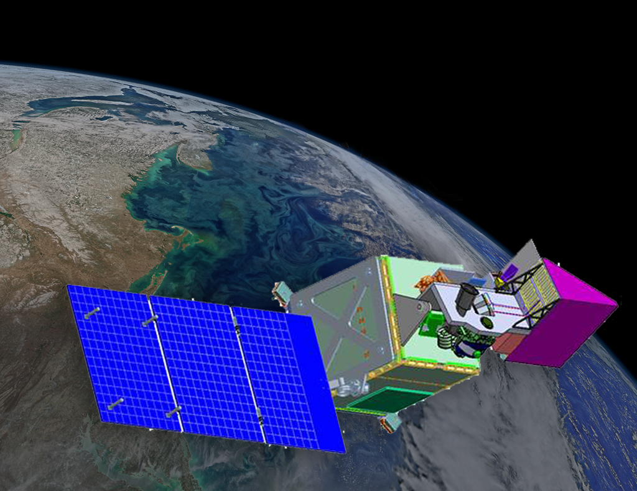
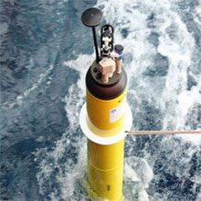
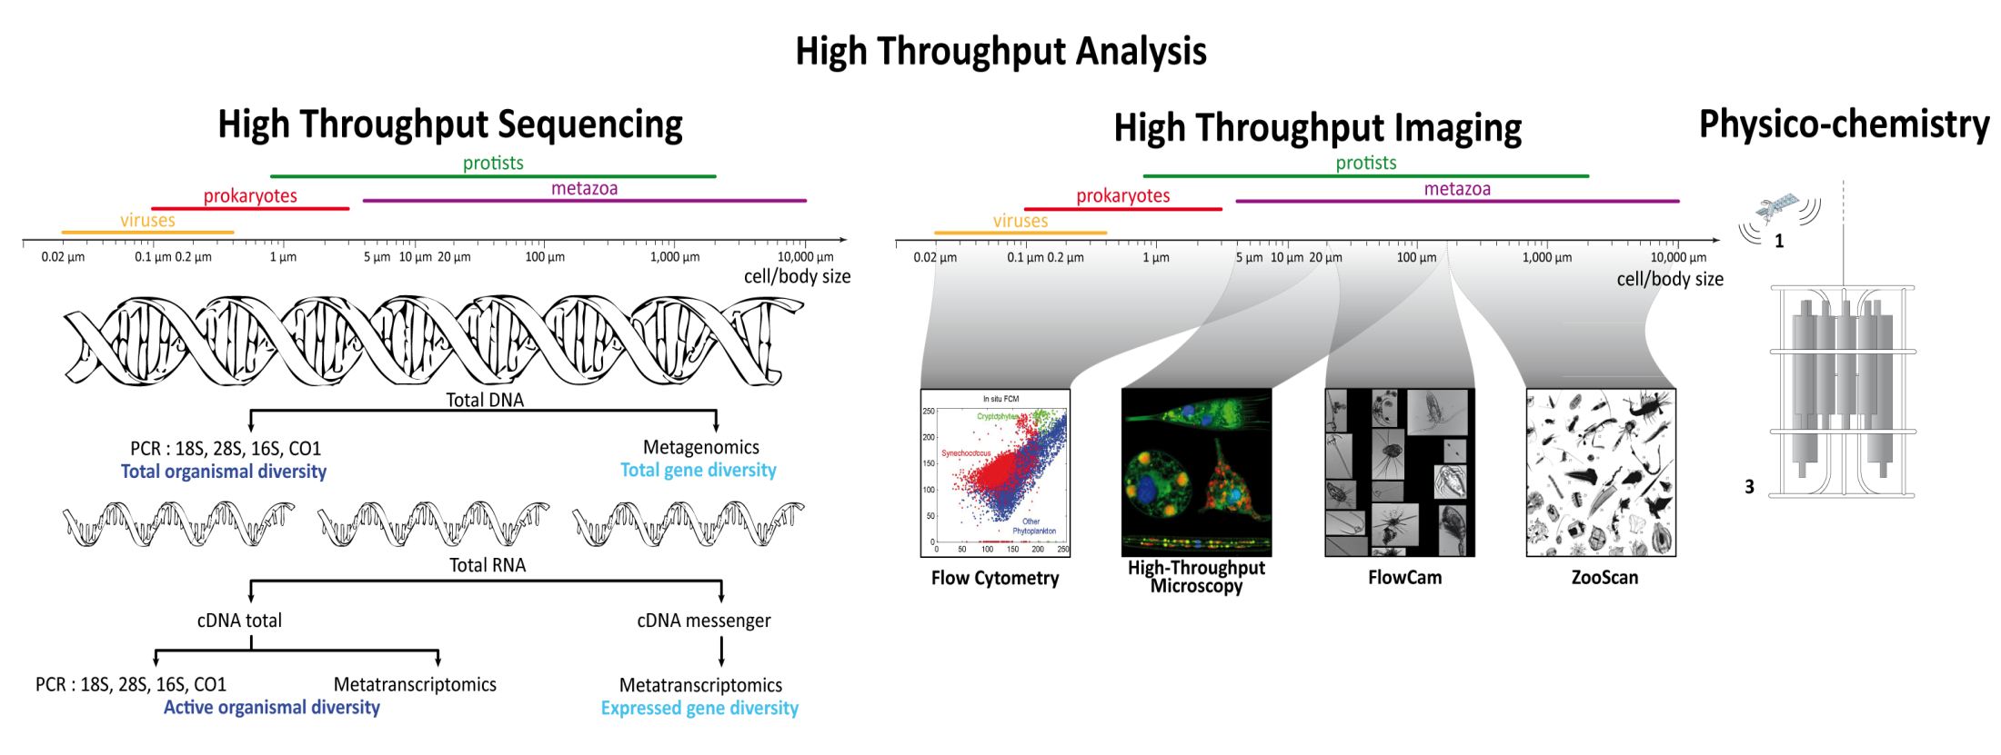
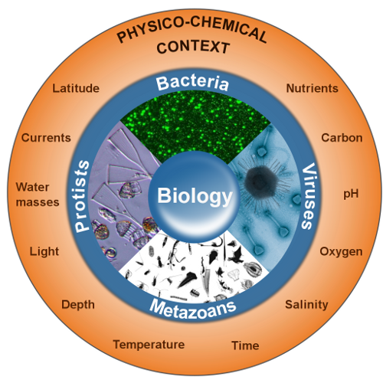
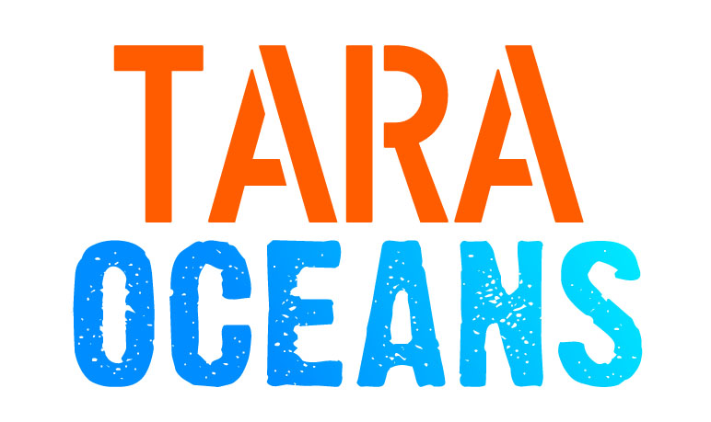
Why now?
Remote Sensing Ocean Color
BGC Argo, SOCCOM
NASA-PACE: UV<->NIR
Imaging

Slide 4
Why now?
IMSOO : Implementation of Multi-Disciplinary Sustained Ocean Observations Workshop, Miami, 8-10 February 2017
Build on established societal and scientific requirements expressed in EOVs, identify key applications that will benefit from co-located and/or complementary multi-disciplinary sustained observations.
Identify near-term innovation priorities for observing platforms and instrumentation to enable multi-disciplinary observations and modelling.
Identify programmatic and professional connections between existing and emerging observing networks that will increase multi-disciplinary observations.
After discussions with Frank Muller-Karger and Patricia Miloslavish, Emmanuel founded the SCOR WG.
NASA-PACE: UV<->NIR

Slide 5
Terms of Reference
General: Identify best practices and technical feasibility to incorporate plankton measurements into global ocean observing platforms (initially GO-SHIP and expansion into OceanSITES).
Specific:
Identify current technologies (sensors / analysis) that can be integrated into existing observing infrastructure.
Provide the details associated with each technology (e.g. power, cost, and human effort).
Document applications and measurement protocols (develop if necessary).
Identify synergies with measurements from other programs (e.g. BGC-Argo, space-based measurements, Continuous Plankton Recorder surveys) to provide cross-calibration and a better representation of the 4-D distribution of the parameter measured.
Identify technological limitations and/or gaps, and areas of priority to invest in development.
Increase awareness and access biological oceanographic.

Slide 6
Benefits
Science: data is critical to quantify variability of plankton in space and time, discover and quantify new life forms, constrain models, and better characterize processes leading to ecosystem change.
Society: data are critical to quantify marine food webs, detect harmful algal blooms, and sustain ecosystem services (e.g. fisheries and nutrient cycling).
Observing systems: increasing the value of these assets to science and society, including developing markets of technology and information transfer.
Conservation: Establishment of ecosystem-based approaches to marine resource management depends on sufficient data to quantify ecosystem members and functions.

Slide 7
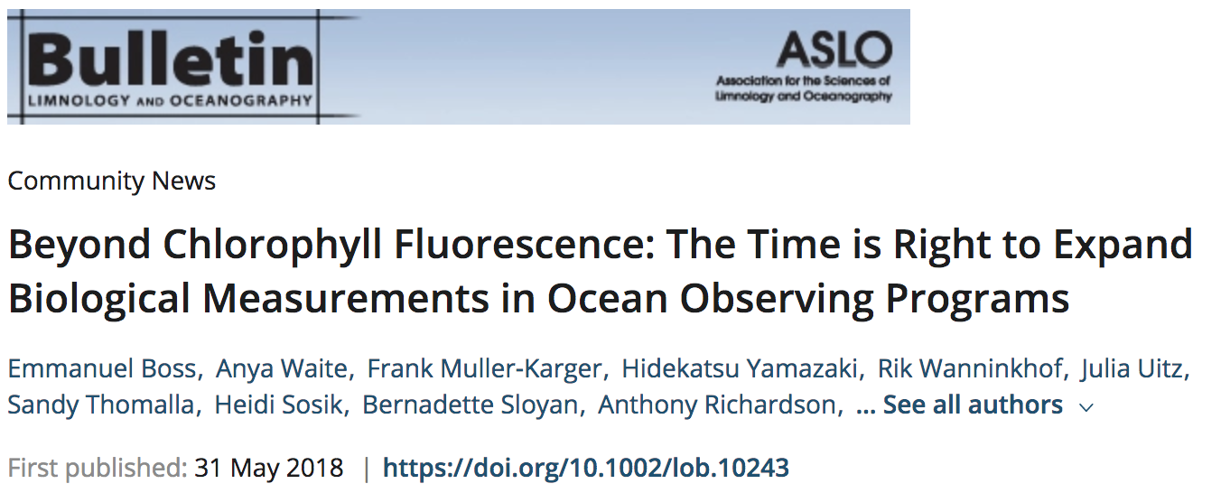
Deliverables
An article reporting about the activity and inviting input.
A manual with the protocols for plankton measurements on board research vessels (initially GO-SHIP but expandable to Ships of Opportunities).
A manual with the protocols for plankton measurements with research buoys (initially OceanSITES but expandable to other programs).
A website where our findings will be disseminated. The website will include information on ALL the specifics outlined above.
A workshop supporting capacity-building for early career researchers.
Present progress at conferences.

Slide 8
Our first meeting as a group took place February 10th in Portland.
In preparation we have divided into 6 groups:
Allows high-resolution mapping of organisms and particles which are transforming our understanding of their distribution in the ocean. Major data demands and a requirement for community consensus
Imaging
Flow Cytometry
Powerful tool to detect, discriminate, and quantify auto- and heterotrophic bacteria, eukaryotic micro-organisms, and viruses.
Genetics
Standardizing, managing, and interpreting these genomic data is an emerging challenge for biologists and oceanographers.
Bulk BGC (HPLC, POC)
measured routinely and collected in conjunction with validation of ocean color remote sensing and calibration of sensors on autonomous platforms, such as the floats of the BGC-Argo program
Bio-optics
Mature technologies used on both moorings and research vessels. The quality control and interpretation of these data still require significant expertise and no global standards exist.
Bio-Acoustics

Slide 9
Some clear synergies with other existing programs were highlighted in the proposal:
Ocean Colour Remote sensing
BGC-ARGO
CPR

Slide 10
In our first year:
Learn about GO-SHIP and Ocean-SITES and their constraints.
Survey the technology available to study plankton (instruments, lab analysis). Invite input from outside experts.
Consult with modelers regarding parameters of interest to constrain biogeochemical as well as eco-system models (helps with prioritization). Link measurements to EOVs.
Assemble on website protocols as well as data on associated efforts.
Prepare presentations for OceanObs’ 19.

Slide 11
Synergies with POGO
Partnership for Observation of the Global Ocean
Source for information and relevant expertise.
Links to material our WG produces.
Sustainability beyond the 3yrs of the WG life.

